Slide 1
Semantic relatedness emerges in deep convolutional neural networks designed for object recognition
Taicheng Huang (黄泰诚)
AI of Brain & Cognition Center
2021/03/11
Notes:
My name is Taicheng Huang, from AI Center in JiaLiu’s lab. It’s a great honor to make a presentation here. Today I’d like to talk about xxx.

Slide 2
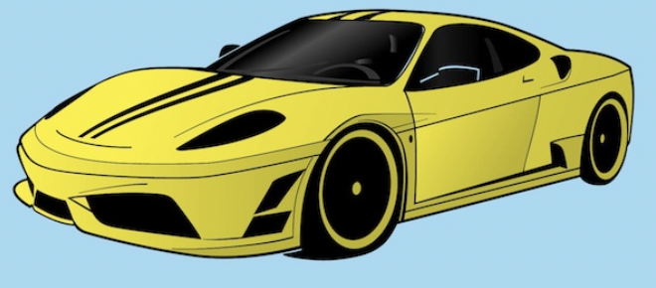
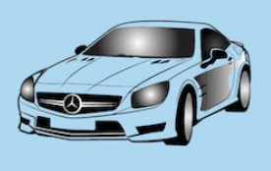
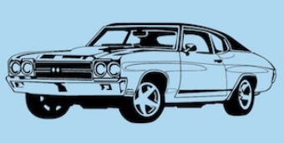
Understand the nature of objects
Basic question of object recognition: How do we recognize objects rapidly?
Difficulties in object recognition
Notes:
1 Object in this world is complicated. We live in this world, every second we need to recognize objects in different appearance, color or visual angle within a very short time.
2 The ability evolved to rapidly recognize object ensures our survival.
3 The basic question of object recognition.
4 This simple question was not solved for many difficulties in object recognition
5 Yellow car on left side have the same category as cars on right side. Although they’re different.
6 Easy for us to know airplane is not a car, although they have similarities on appearance.

Slide 3
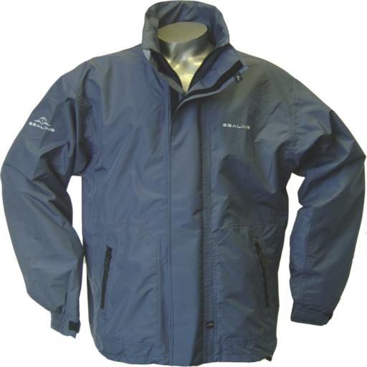
Understand the nature of objects
Which one is more similar to the target?
A
B
C
D
Notes:
1 Many studies try to figure out.
2 I would like to do a simple experiment to explain my opinion: why we recognize object so fast.
3 One yellow car and four objects, then one question: which one is more similar.
4 Everyone says A.
5 Remove A, ask the same question. Remove B….
6 Why we make such consistent responses? There must be a reason. Sth make us recognize objects rapidly.

Slide 4
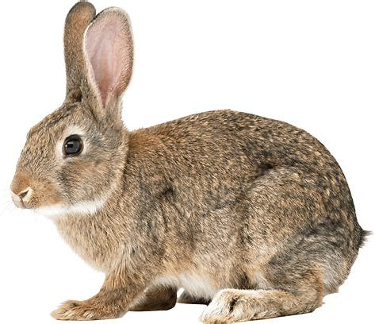
Semantic relations play critic roles in object recognition
Common point?
Physical Entities
Cars
Vehicles
Artefacts
Vehicles
Cars
Artefacts
Physical Entities
Notes:
1 To explain the reason, all images placed here, and let’s build relationship between them.
2 First, yellow car and van, Car.
3 Yellow car and yacht, Conveyance.
4 Yellow car and cloth, artefacts
5 Yellow car and dog, physical entity
6 We build their relationship by their similarity through response we tested before, a semantic tree.
7 More objects used, we can easily know the place of each object in the tree hierarchical structure.

Slide 5
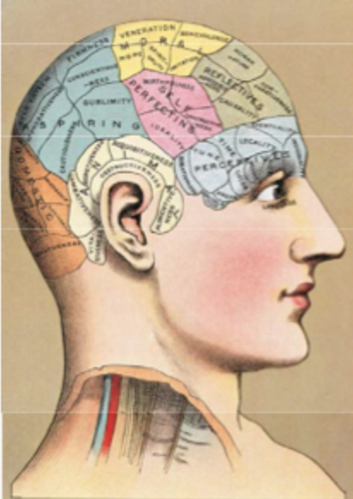
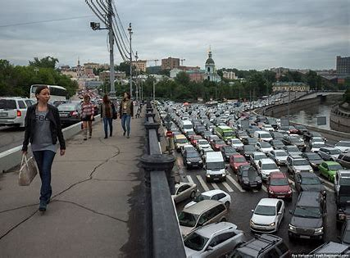
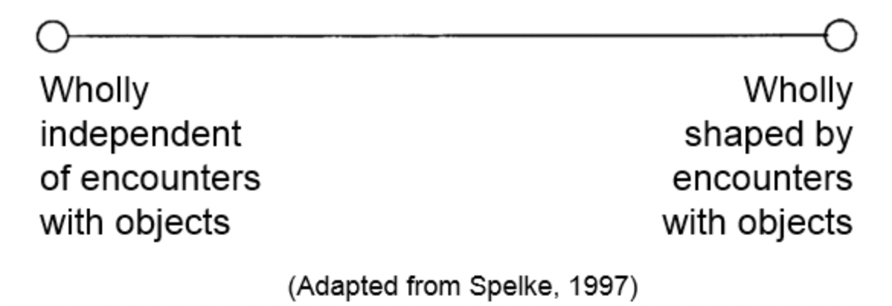
Wait! Where does semantic relatedness come from in our mind?
Two hypotheses about the origin of semantics
Nativism
Empiricism
Semantics innates in our mind, which is just waiting to be nurtured. Proper nurturing is needed in order to make use of skills and abilities.
Semantics is aquired through a person’s sensory experience. Nature plays a crucial role in molding and shaping skills and abilities
Notes:
1 It looks that semantic relatedness build in our mind is a good reason why we recognize object so rapidly.
2 We still have questions. Where does it come from? Origin of semantics answer how do we build mechanism to recognize objects rapidly.
3 Two hypotheses. Blablabla
4 In a short, blablabla.
5 Two hypotheses are too different from each other, that anyone wants to know which one is correct.
6 Evidence?

Slide 6
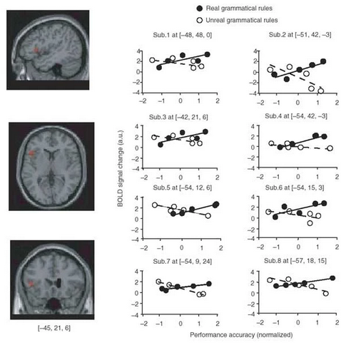
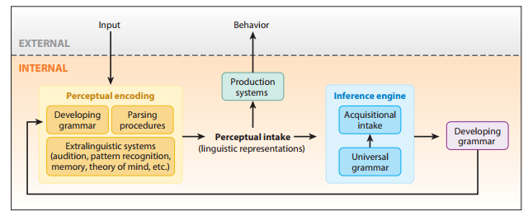
Support evidence for nativism
Chomsky’s nativist theory of language: The language acquisition device
Universal grammar is the key to acquire a language
(Lidz and Gagliardi, 2015)
(Musso et al., 2003)
Notes:
1 Evidence for nativism, language theory.
2 Origin from reason why infants learn language so fast. Because of universal grammar.
3 progress to be explained.
4 support evidence: broca region is a neural substrate of universal grammar.

Slide 7
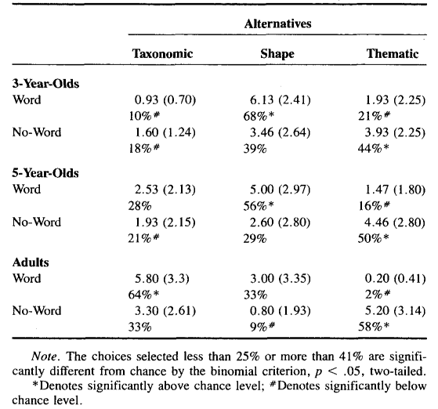
Support evidence for empiricism
Which one is more similar to the target?
Cake
Conception
Perception
Conception
Pie
Hat
Gift
(Imai et al., 1994)

Slide 8
Potential confounding caused the divergence of conclusions under each hypothesis
The world we are living mixes effects from both natural environment and inborn genetics
We have no idea if we can still live freely when there is no genetic influence or natural environment.
The reason why we make the divergence is that we can’t totally control one factor from the other one.
Empirism/Environment
Nativism/Genetics
Notes:
1 What’s the reason caused the divergence of conclusions under each hypothesis?
2 We set elements of creatures and outside environment here. We know they are independent individuals.
3 However, due to we live in this world, it’s unavoidable that self and outside things interacted with each other.
4 The world we are living mixes ….
5 So the reason why we make the divergence is that …

Slide 9
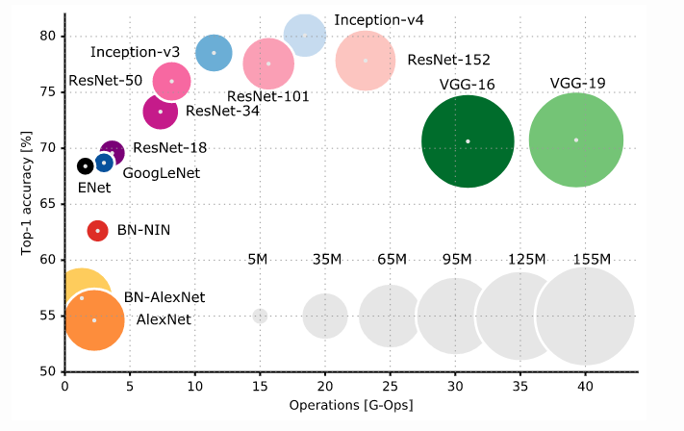
An agent who works without inborn priors from genetics
The deep convolutional neural network
Three advantages:
Operable
Inspired from primate visual system
Good object recognition accuracy
Notes:
1 If we have an agent who works…
2 Do we have? Actually we have, although it’s not perfect as human.
3 The DCNNs. 1) operable, no priors from genetics. 2) architecture inspired from human visual cortex. 3) Good object recognition ability.
4 DCNNs first designed by LeCUN, and successfully recognize handwritings.
5 With further development, get better object recognition ability, even with similar accuracy as humans.
6 DCNN be a suitable model to explore effect of visual experience to the formation of object recognition.

Slide 10
Transformation from perception to psychology in DCNNs
AlexNet
Perceptual cue
(Physical stimulus)
Representations indicated how DCNN encode perceptual cues into its psychological world, then recognize them
Notes:
One more important thing state here.
1 See DCNNs in phychology way.
2 Uniqueness of phychology: two world theory.
3 Perceptual cue indicated physical world, everything is objective and measurable.
4 AlexNet encode perceputal cue, and transform cues as representations to do object recognition.
5 Representations indicated how AlexNet understand the image as the perceptual cue.

Slide 11
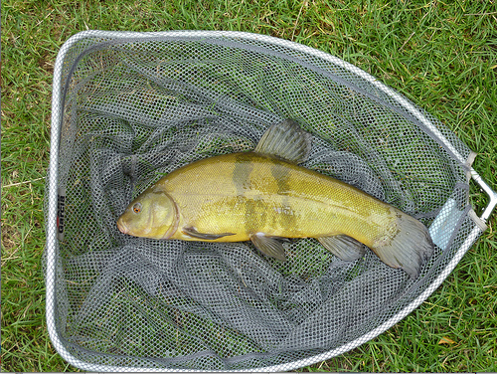
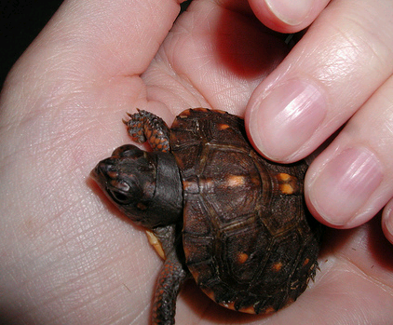
Category similarity of the AlexNet is structured
Category: tench
1000x1 from fc3
…
Pearson correlation
Category: turtle
1000x1 from fc3
…
Notes:
1 Since representations indicated the cognition of AlexNet to the perceptual image, we check if representations are structured.
2 For each image, get representions.
3 with the representations, we can measure similarity between them according to categories.
4 On the right side, we see the category similarity of the last linear layer. Structured.
5 Further, with the indicator of semantic relations, looks that followed semantic relationship as humans.

Slide 12
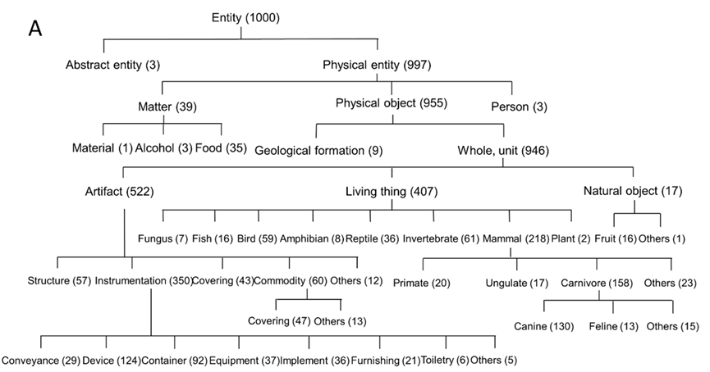
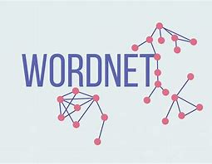
Measurement of semantic similarity
Notes:
1 We verify it to measure semantic similarity of humans.
2 WordNet. ImageNet, 1,000 categories.
3 Introduce tree structure.
4 how to measure semantic similarity.

Slide 13
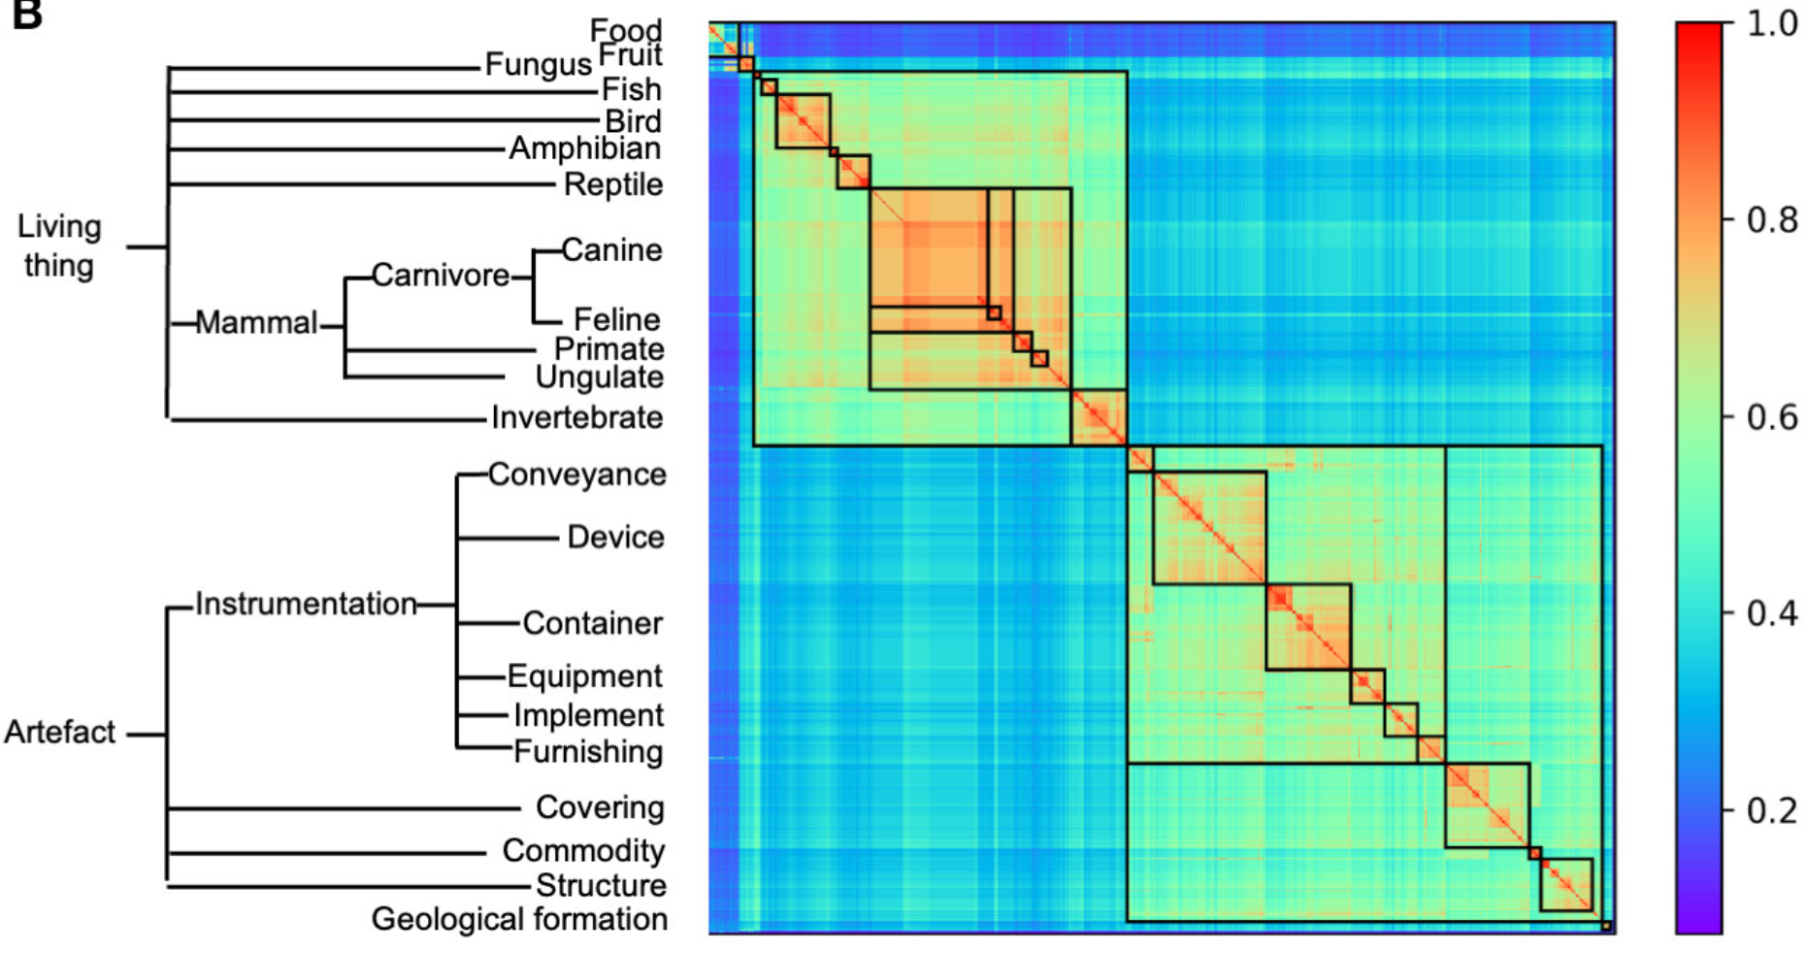
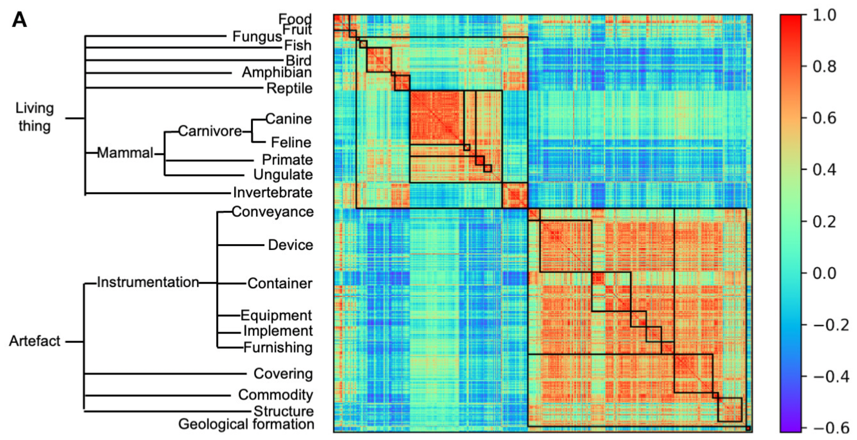
High correspondence between semantic relations from the WordNet and category similarity from the AlexNet
WordNet semantic relations
AlexNet category similarity
Pearson correlation: r = 0.56
Notes:
1 With this way, we measure semantic relatedness between each pair of categories.
2 Compare it to AlexNet category similarity, high correspondence.
3 Higher correspondence happened especially to categories belong to living things, which was more affected by object appearance.
4 To artefacts, lower correspondence while still significantly correspondence.
5 Semantic relatedness emerges in DCNNs

Slide 14
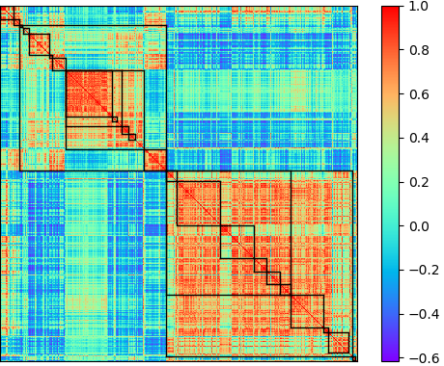
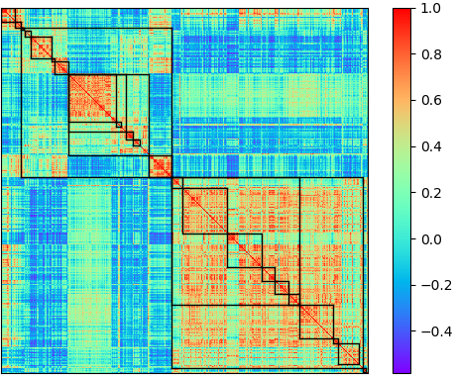
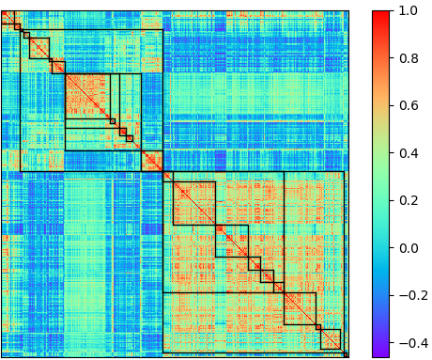
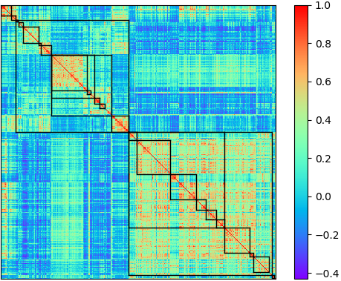
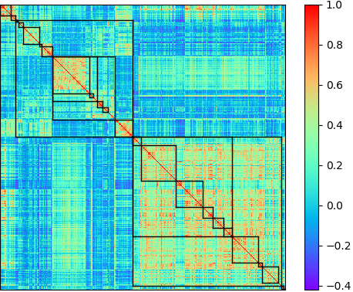
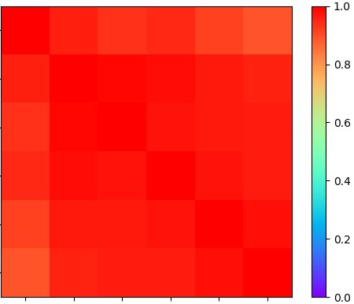
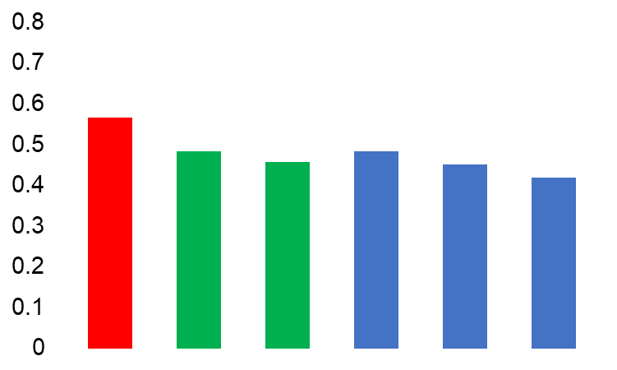
Semantic structure in DCNNs is invariant to implementations
AlexNet
VGG11
VGG19
WordNet semantic relations
ResNet18
ResNet50
ResNet101
AlexNet
VGG11
Correspondence to WordNet semantic similarity
VGG19
ResNet18
ResNet50
VGG11
VGG19
ResNet101
AlexNet
ResNet50
ResNet18
ResNet101
Notes:
1 Further investigations on DCNNs in different architecture.
2 Similar category similarity, all correlations higher than 0.89.
3 Compared to WordNet semantic relations, high correspondence to WordNet semantic similarity.
4 Indicated invariant to implementations.

Slide 15
Correspondence to the WordNet semantic similarity increased as a function of layers
AlexNet
VGG11
Notes:
1 We also examined relation of this correspondence to convolutional layers.
2 Increase as a function of layers.
3 First two layers, network have no ability to distinguish two categories.
4 Higher convolutional layers better discrimination.
5 Also to VGG11.

Slide 16
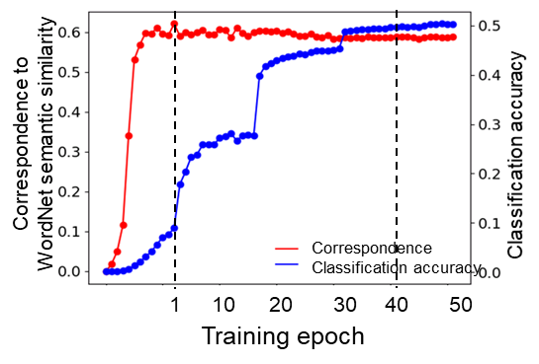
How did the hierarchical relatedness of object categories emerges from the beginning of AlexNet
500,000 images within the first epoch
Notes:
1 Since AlexNet perform semantic relatedness which generated from training for object recognition, how did it form?
2 Retrained the AlexNet from start, and plot the developmental trajectory.
3 Two lines, red line: correspondence; blue line: classfication accuracy, i.e. object recognition ability. We can clearly find both lines are asynchronous.
4 semantics formed within the first epoch, stabled very fast, which is far prior to object recognition.
5 We selected four stages for detailed observation, no, start show, finer, finer finer.
6 Looks that the category similarity followed a coarse to finer progression.

Slide 17
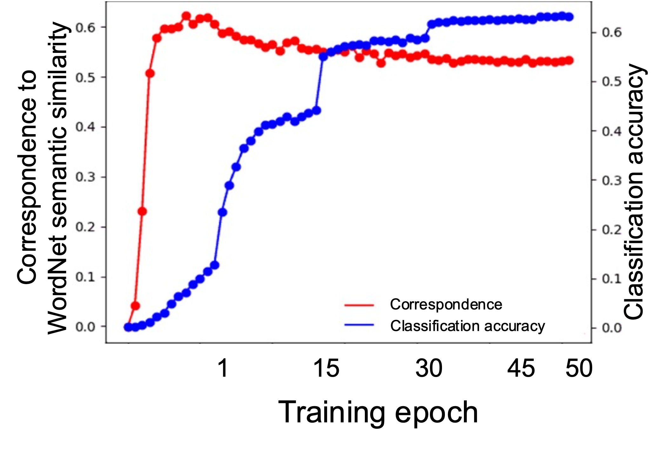
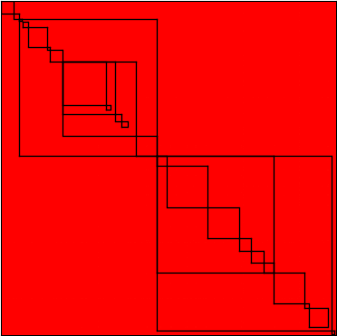
Similar developmental trajectory was also observed in VGG11
Random initialization
500,000 images within the first epoch
After the first epoch
After the 40th epoch
Notes:
1 Similarly, main conclusions from the developmental trajectory could also be observed in VGG11
2 Asynchronous curves between correspondence to Wordnet semantic similarity and classification accuracy. And structure of the category similarity in VGG11 formed in a coarse to finer fashion.

Slide 18
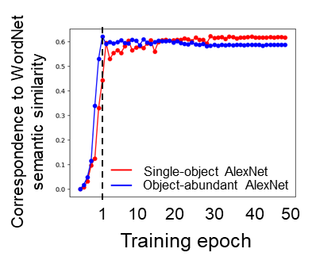
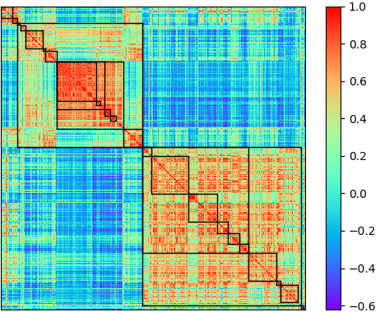
Effect of object co-occurrence to the emergence of semantic relatedness in DCNNs
Single-object image
Co-occurrent surroundings
Pool & water
Human
Plants
Surroundings exclusion
Target
Single-object AlexNet
Object-abundant AlexNet
r = 0.82
Notes:
1 Since we know that semantic relatedness emerges in DCNNs for object recognition, and its developmental trajectory followed a coarse to finer fashion, we still have something more needed to be considered.
2 One proper effect to the formation of semantic relatedness is the object co-occurrence effect.
3 As you can see, this is an image which selected from ImageNet dataset, and this image was used as one training image for AlexNet.
4 AlexNet need to identify the target in the image, while except for the target, the image includes background that always co-occurrent with the target.
5 co-occurrent objects could be a potential factor to form semantic relatedness in DCNNs.

Slide 19
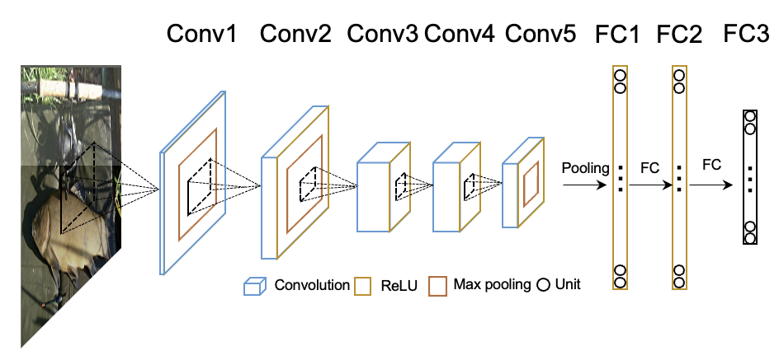
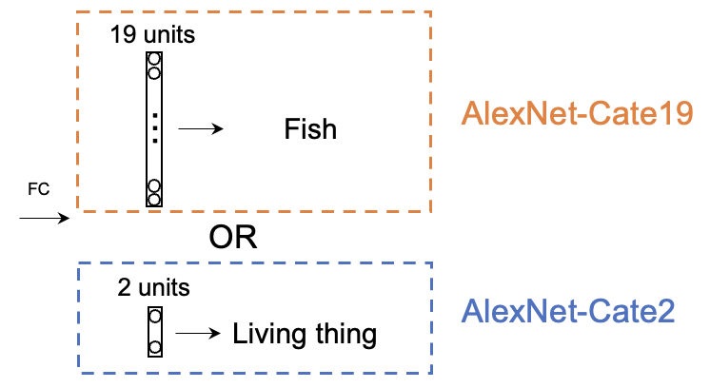
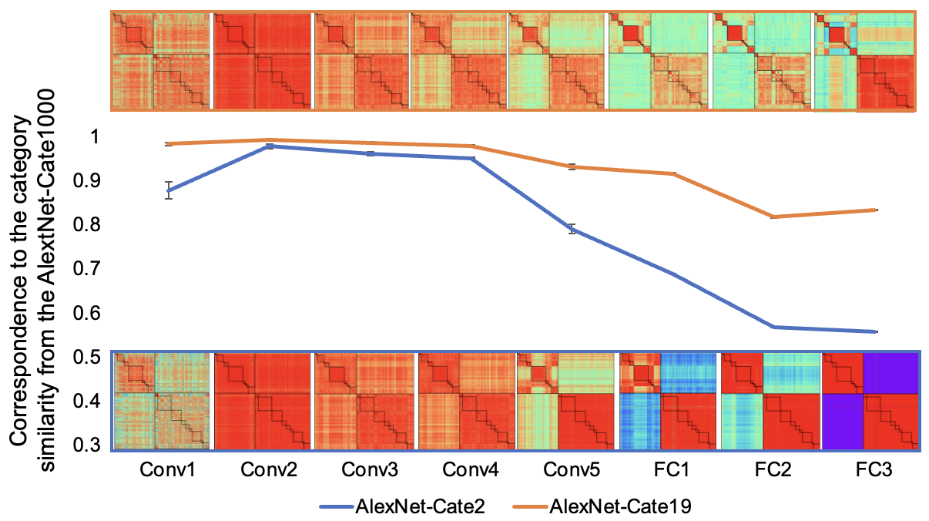
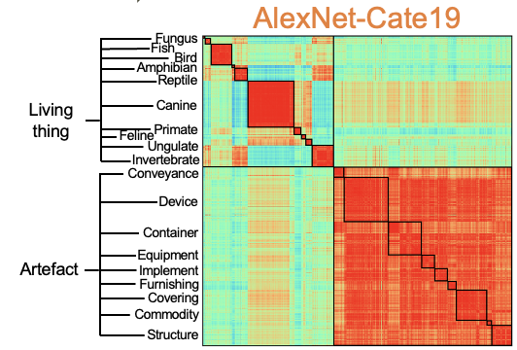
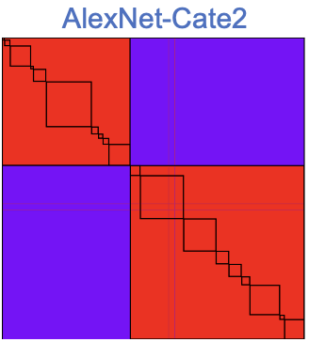
Effect of task demand to the emergence of semantic relatedness in DCNNs
Tench
Fish
Living thing
Notes:
1 One alternative

Slide 20
Discussions
Notes:
第一部分，关于mind from 的两个假设： nativism and empiricism

Slide 21
When we’re talking about semantics, what do we mean?
Definition of semantics:
Semantics are not just concepts about linguistics.
Semantic relations were affected by multiple features.
Living thing: appearance
Artefact: function
Prerequisites are needed to figure out the origin of semantics
Semantics about living thing: empiricisim
Semantics about artefact: Nativism?
Category similarity
r=0.70
Living thing
Artefact
r=0.41

Slide 22
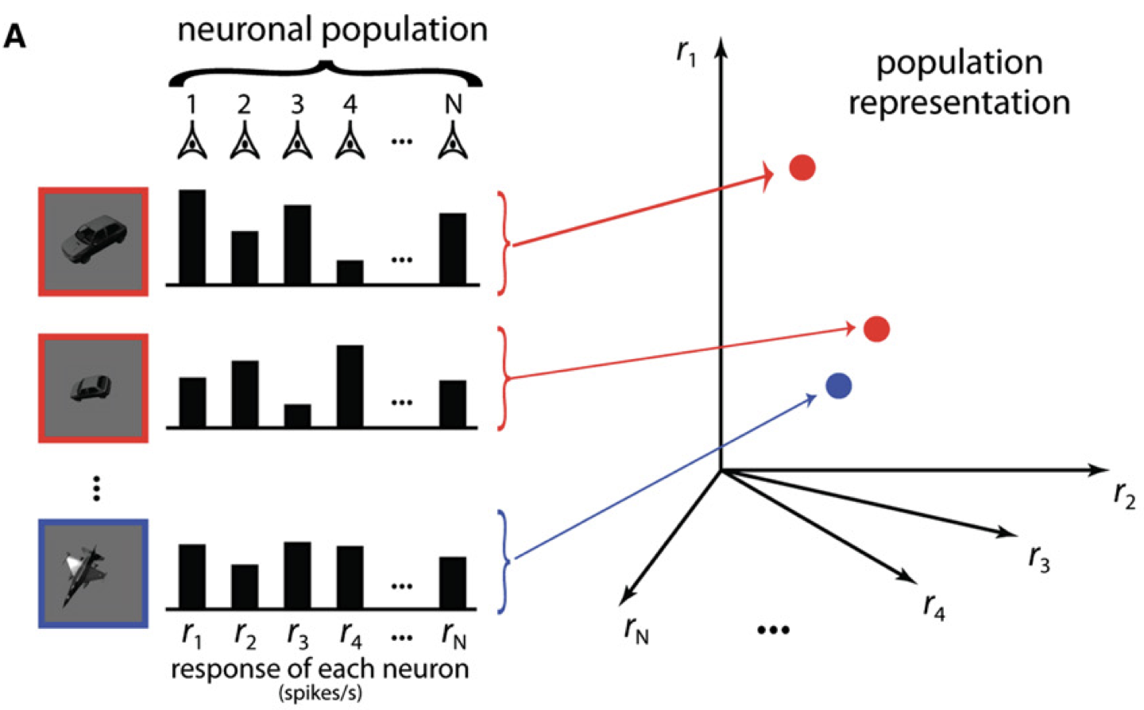
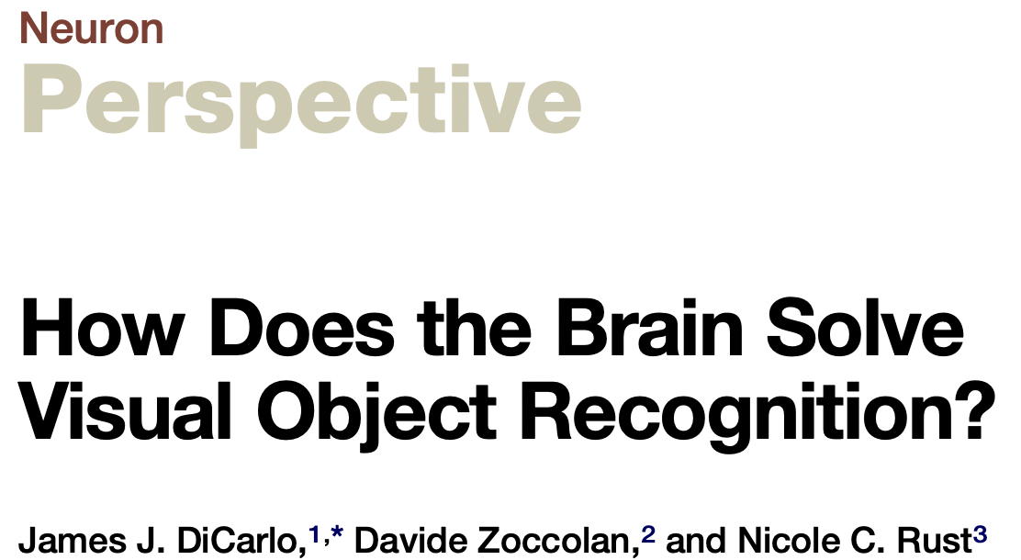
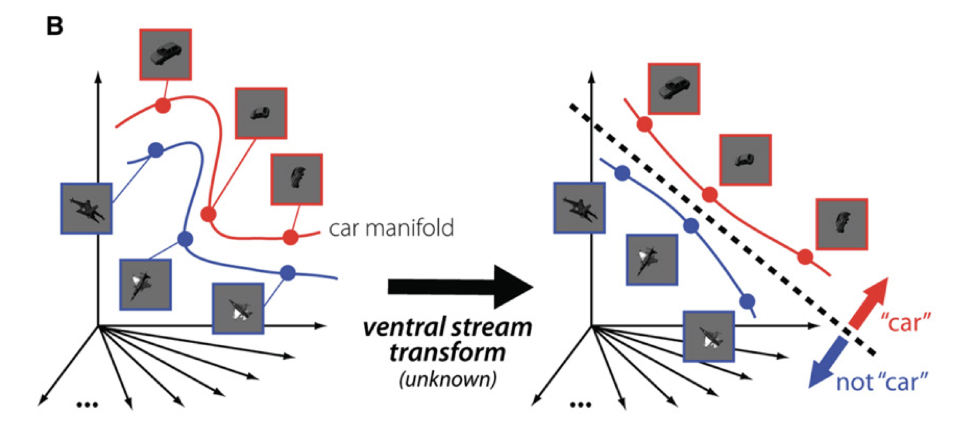
Semantics is a format of abstract representation, so does object recognition
Semantic is the same thing as object recognition? Or it’s only a part of object recognition?
(DiCarlo et al., 2012)

Slide 23
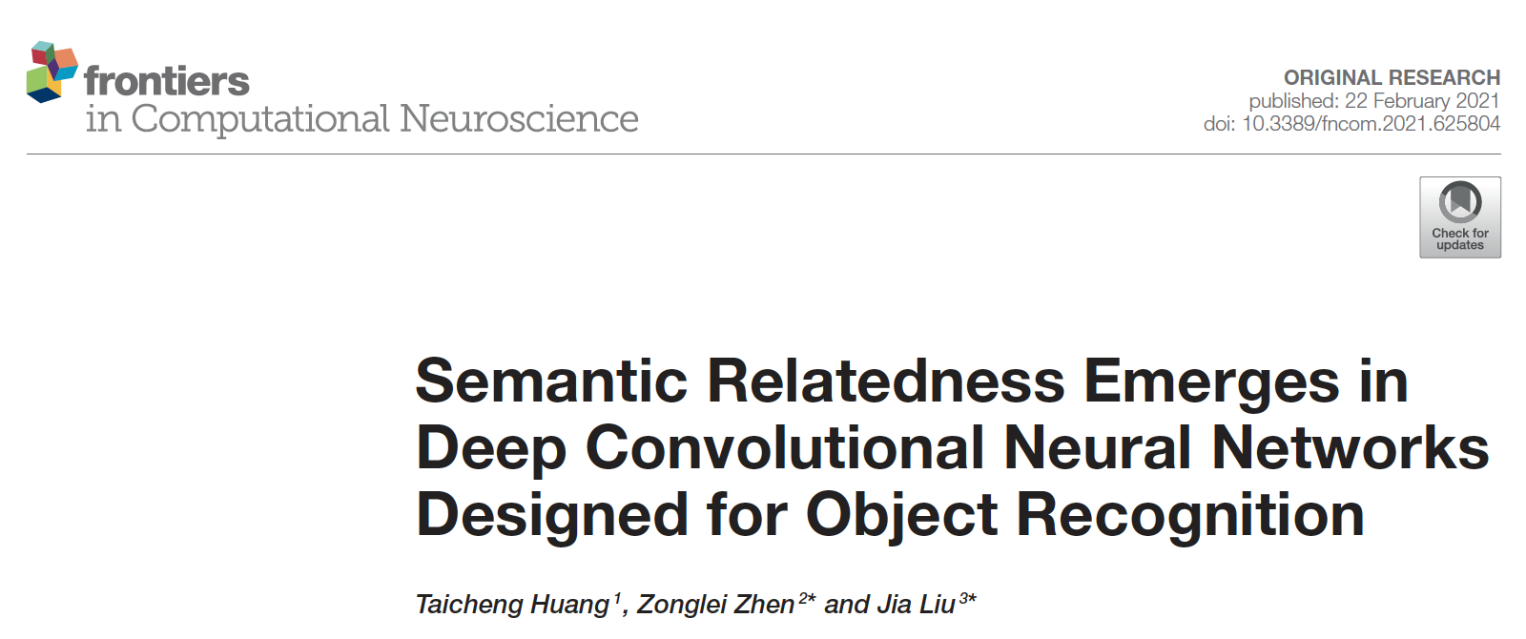
Take-home messages
Semantic relatedness emerges when only visual experiences were provided for training in object recognition task.
Works for concepts rely on appearances instead of functions.
The hierarchical structure was constructured in a coarse-to-finer fashion, and matured far prior to the object recognition.
The fineness of the relatedness was greatly shaped by the demand of tasks that the DCNNs performed
Deep neural network could be used as a model to unwind factors that intermingled with each other in traditional studies.

Slide 24
Thank you for your listening!

Slide 25
Reframe the stream of the present study
How do we recognize object rapidly?
Where does semantic relations come from?
Why we can not ascertain which hypothesis is correct?
Deep convolutional neural network
Because we build semantic relations of objects in mind
Nativism/Empiricism
Nativism and empiricism interacted with each other
An agent perform good object recognition while works without inborn priors
Semantic relatedness in DCNNs
Formed in coarse to finer fashion
Task demand matters

Slide 26
Marr’s three levels of analysis
Computational
We faced a problem in a generic manner, but do not say how these problems are to be solved.
Example: the question we asked, and the potential hypotheses we made.
Algorithmic
Form a bridge between the computational and implementational levels, describing how the identified problems can be solved.
Example: DCNNs are good models to answer the questions.
Implementational
The physical substrate and its organization, in which computation is performed.
Example: All conclusions we made from the results.
Computational
Algorithmic
Implementational

Slide 27
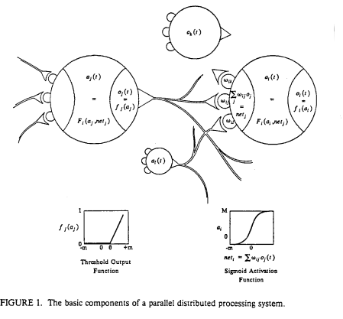
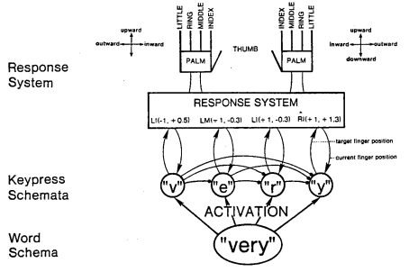
The origin of deep neural network – connectionist theory
The parallel distributed processing proposed by McCllelland, Rumelhart and Hinton, 1986
(McCllelland et al., 1986)

Slide 28
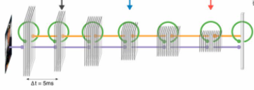
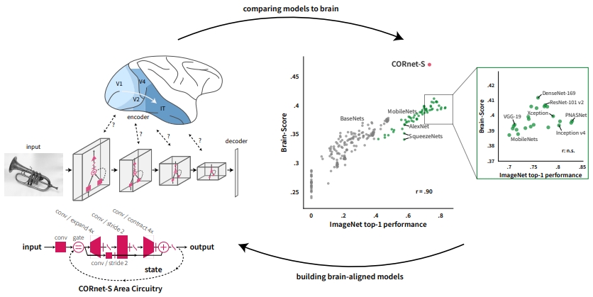
Deep neural network as a tool for cognitive questions
Operation on stimulus
Operation on architecture
Operation on learning rules
Recurrence effect to dynamics
Gradient descent
Hebbian learning rule
Reinforcement learning
Markov Chain Monte Carlo
Delta rule
Perceptron learning rule
Correlation learning rule
Out star learning rule
Effect of object co-occurrence
(Kietzmann et al., 2019)
(Kubilius et al., 2019; CORnet)

Slide 29
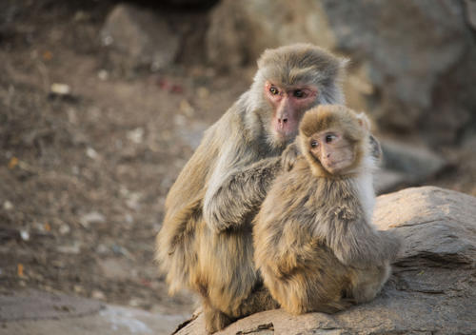
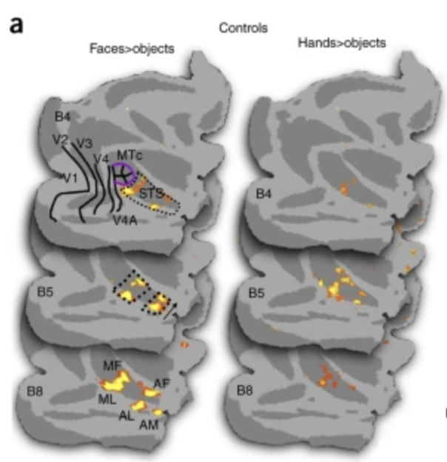
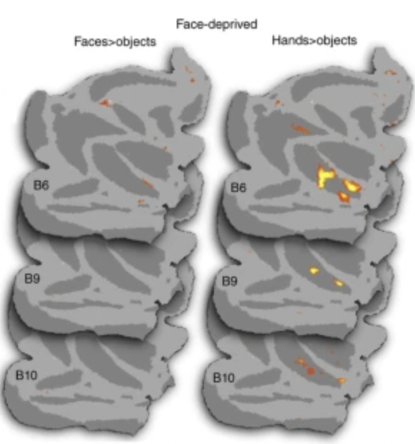
Support evidence for empirism
Face recognition in monkey
Control Group
Face-deprived Group
(Arcaro et al., 2017)
Notes:
1 On the other hand, face recognition in monkey support for empirism.
2 normal monkey and face-deprived monkey. Different activation in their brain.
3 eye track result also support that the face-deprived monkey did not care about face.

Slide 30
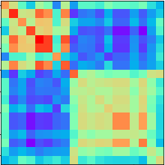
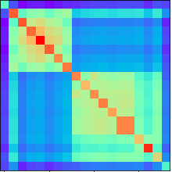
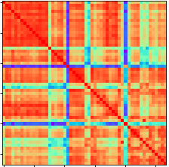
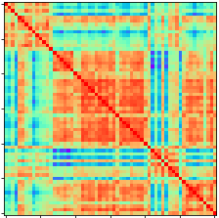
Formation of the semantic structure is a coarse to finer progression
AlexNet
19x19
19x19
WordNet
Coarse
Corr.
Coarse
Fine
…
Corr.
Fine
…
1000 categories
19 superordinate concepts
food, fungus, fish, bird, amphibian, reptile, mammal, invertebrate, conveyance, device, container, equipment, implement, furnishing, toiletry, covering, commodity, structure, and geological formation
Notes:
1 Further quantify this coarse to finer fashion.
2 We extract category similarity in coarse and fine-grained level.
3 Coarse level, selected 19 superordinate categories that covered most of the 1,000 categories.
Average image representations within each superordinate category, and calculate category similarity according to the 19 superordinate categories.
4 Finer level, extract categories within each superordinate category, and measure correspondence to the wordnet semantic relatedness.
5 We measure the developmental trajectory in coarse or fine-grained level.
Verify Coarse to finer progression

Slide 31
Similar developmental trajectory was also observed in VGG11
Notes:
1 Similarly, main conclusions from the developmental trajectory could also be observed in VGG11
2 Asynchronous curves between correspondence to Wordnet semantic similarity and classification accuracy. And structure of the category similarity in VGG11 formed in a coarse to finer fashion.

