Slide 1


Tsinghua Laboratory of Brain and Intelligence Seminar Series（2021.04.29）
Assessing and manipulating multi-item working memory
in human brains
Huan Luo（罗欢）
School of Psychological and Cognitive Sciences
IDG/McGovern Institute for Brain Research
Peking University
huan.luo@pku.edu.cn

Slide 2

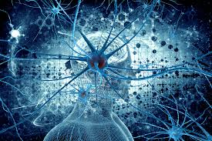
Spatiotemporal reorganization of information in the brain
External world
Internal world
Information reorganization in time and space
…
…
Friston, K. and G. Buzsaki, TICS, 2016
Temporal dynamics of external world does not necessarily correspond to that of the internal world (brain)
Notes:
所以，简单来说，外部世界所包含的存在着相互关系的多个物体是如何表征在复杂的大脑神经活动中的呢？这其中需要一种从外部到内部的信息时空重新组织的方式，而这也是我们研究的出发点和核心。所以，关键科学问题是研究xxxxx，此外，我们着重研究xxx,这完全不同于在人类受试上通常采用的xxx

Slide 3
Oscillation-based information processing in the brain
Temporal organization essentially underlies many cognitive functions, e.g., speech, audiovisual, auditory processing
(e.g., Luo et al., PLoS Bio., 2010; Luo et al., Current Bio, 2013, etc.)
Brain has its own temporal windows (tens to hundreds of milliseconds) for information processing and storage
Buschman & Kastner, Neuron, 2015
Communication through neural oscillation
Notes:
近年来的神经电生理研究发现神经元之间，神经环路之间，脑区之间的信息传递和交流是通过不同节律的神经振荡来实现的。

Slide 4

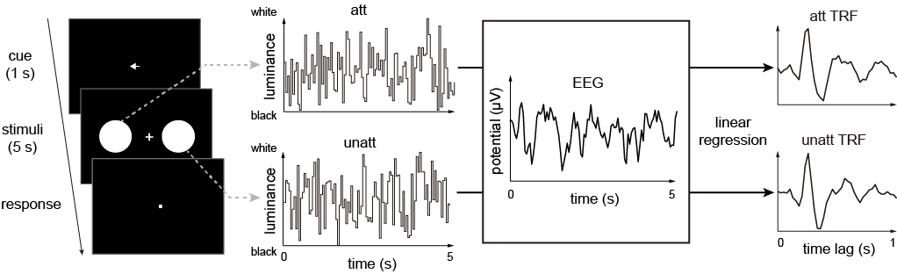
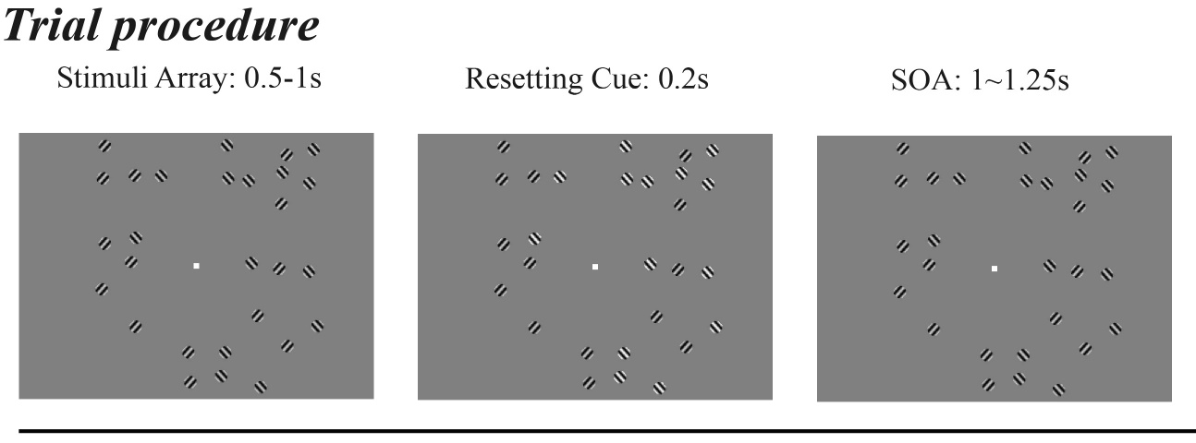
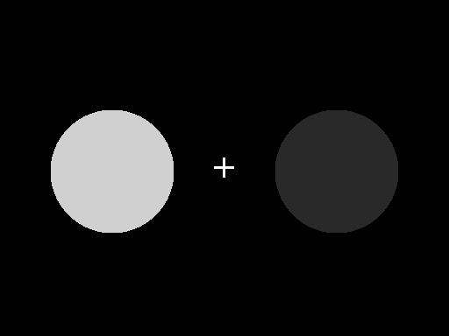
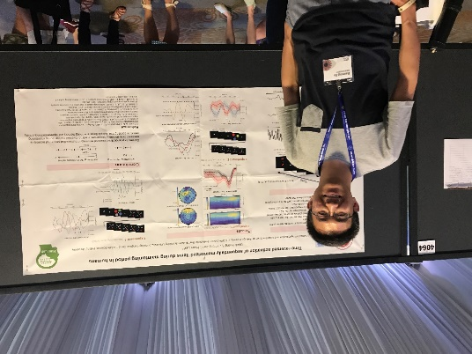
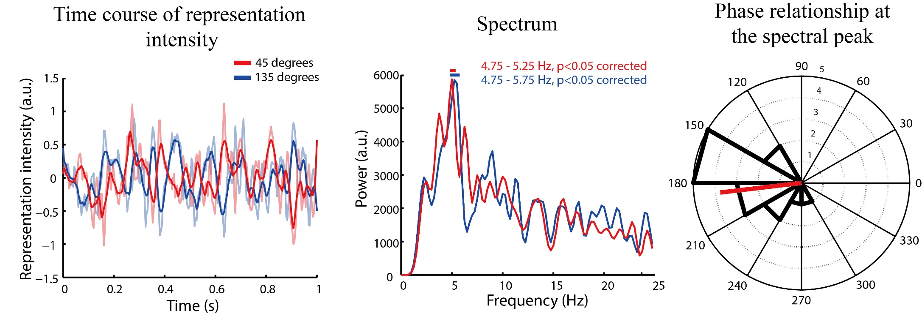
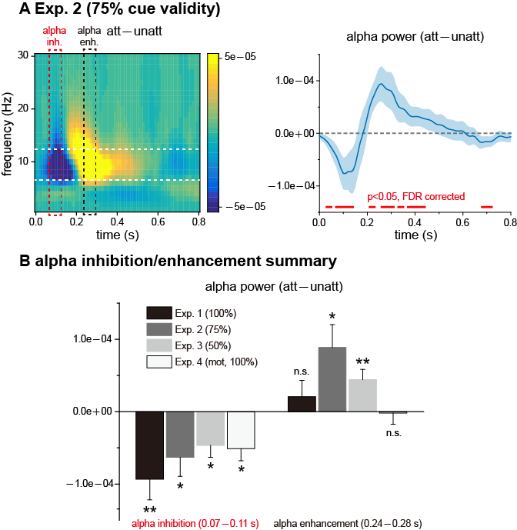
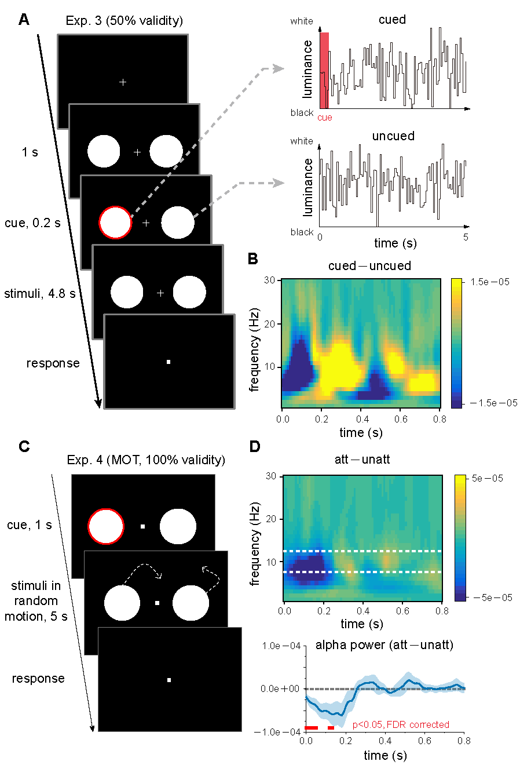
Dynamic attention: neural evidence
Spatial/object attention
Feature attention
Ce Mo
（莫测）
Jianrong Jia
（贾建荣）
Jia et al., PLoS Biology, 2017
Jia et al., NeuroImage, 2019
Mo et al., Nature Communications, 2019
e.g., Landau et al., 2015; Dugue et al., 2016; Kienitz et al., 2018; Spyropoulos et al., 2018; Fiebelkorn et al., Helfrich et al., 2018

Slide 5
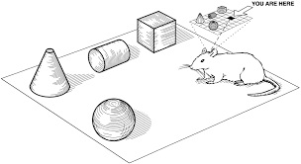
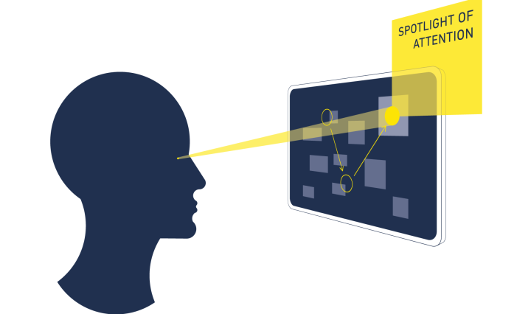
From attention to working memory (WM)
Multi-item attention
Multi-item WM
Temporal organization of multiple Items in attention
Time-based multi-item maintenance in WM ?
Replay, reactivation, Short-term neural plasticity (STP), etc…
50-100 ms
Time
e.g., Lisman & Jensen, 2013
Notes:
通过这一系列的高时间分辨率的技术手段，我将主要从两个方面开展研究。一是多物体注意，一是多物体记忆。一个基本的思路和假设是，外界物体存储在神经网络中，而他们之间的关系则通过一种时间上序列激活的方法进行表征和存储。

Slide 6

Outline
I. Accessing WM representation during retention
Project 1: sequence structure reorganizes item representations in WM
Project 2: content and structure maintenance in auditory sequence memory
155-2346-3897
II. Manipulating multi-item WM (causal evidence)
Project 3: “Dynamic perturbation” approach to manipulate WM & STP-based neural modelling
Notes:
通过这一系列的高时间分辨率的技术手段，我将主要从两个方面开展研究。一是多物体注意，一是多物体记忆。一个基本的思路和假设是，外界物体存储在神经网络中，而他们之间的关系则通过一种时间上序列激活的方法进行表征和存储。

Slide 7
Outline
I. Accessing WM representation during retention
Project 1: Sequence structure reorganizes item representations in WM
Project 2: Distinct content and structure maintenance in auditory sequence memory
155-2346-3897
How to access information representation during WM retention ?
II. Manipulating multi-item WM (causal evidence)
Project 3: “Dynamic perturbation” approach to manipulate WM; STP-based neural modelling
Notes:
通过这一系列的高时间分辨率的技术手段，我将主要从两个方面开展研究。一是多物体注意，一是多物体记忆。一个基本的思路和假设是，外界物体存储在神经网络中，而他们之间的关系则通过一种时间上序列激活的方法进行表征和存储。

Slide 8

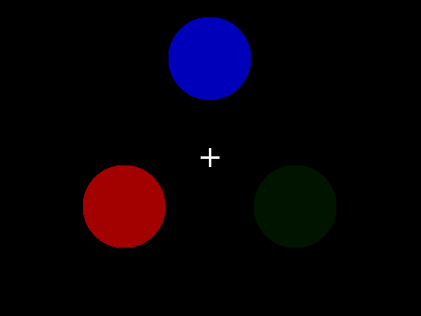
Approach I: Tagging item-specific reactivation during retention
WM retention period
Using luminance sequence to tag item-specific response during retention (via color binding properties)
Backward sequential reactivation
(2nd before 1st)
Temporally compressed reactivation
(1 s to 200 ms）
Backward reactivation is related to recency effect in behavior
Qiaoli Huang
（黄巧莉）
Huang et al., eLife, 2018

Slide 9
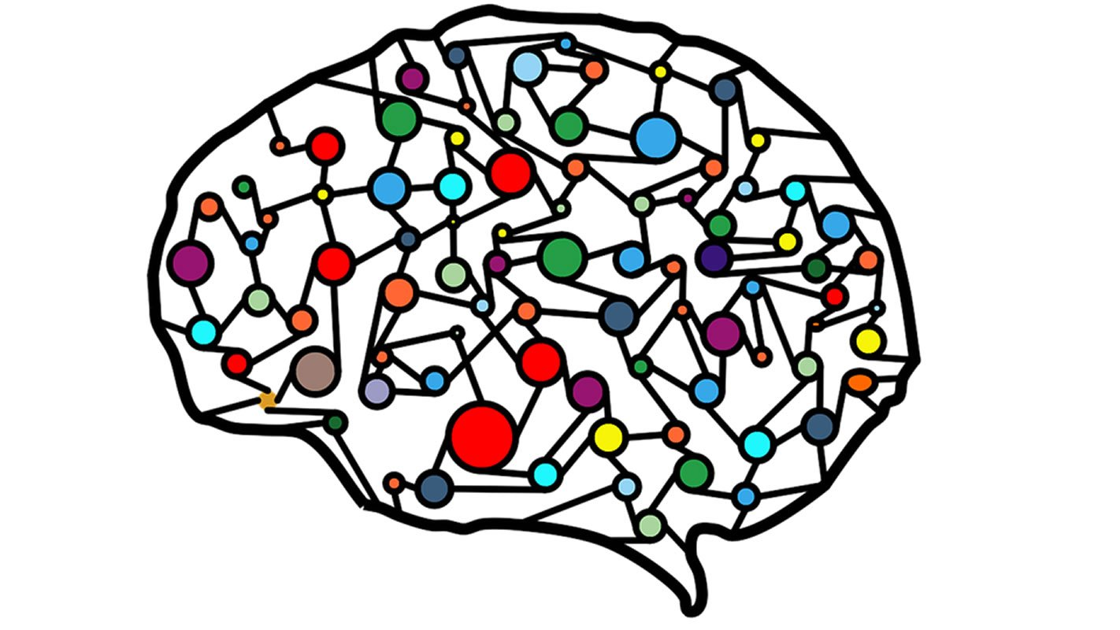
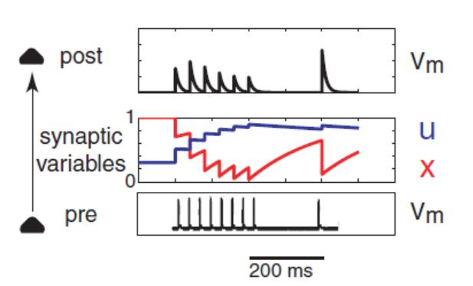
Approach II: Transiently perturbing network to reactivate WM representations
Short-term neural plasticity
(STP-based WM storage)
Activity-silent WM network
Impulse-response approach
(Wolff et al., 2017)
e.g., Hempel et al., 2000; Wang, 2001; Robert and Wade, 2002; Mongillo et al., 2008; Fiebig and Lansner, 2017; Mi et al., 2017; Trübutschek et al., 2017; Miller et al., 2018; Masse et al., 2018, 2020
Notes:
In a new study, we used MEG recordings, inverted encoding and Bayesian modelling to assess the reactivations during retention period.

Slide 10

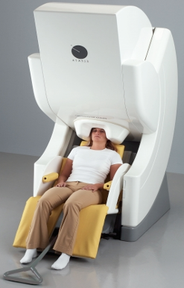
Outline
I. Accessing WM representation during retention
Project 1: sequence structure reorganizes item representations in WM
Project 2: Distinct content and structure maintenance in auditory sequence memory
155-2346-3897
Q: Would items in a sequence reside in distinct latent states of the ‘activity-silent’ WM network?
A: We could PING the network during retention to access and compare the items’ reactivation profiles
II. Manipulating multi-item WM (causal evidence)
Project 3: “Dynamic perturbation” approach to manipulate WM; STP-based neural modelling
Qiaoli Huang （黄巧莉）
Huihui Zhang （张惠惠）
MEG
Notes:
通过这一系列的高时间分辨率的技术手段，我将主要从两个方面开展研究。一是多物体注意，一是多物体记忆。一个基本的思路和假设是，外界物体存储在神经网络中，而他们之间的关系则通过一种时间上序列激活的方法进行表征和存储。

Slide 11
Experimental paradigm (Exp 1)
A neutral PING stimulus during retention
Memorizing two orientations and their sequential order
Classical recency effect in behavior
(2>1)
Huang, Zhang, Luo, Biorxiv

Slide 12
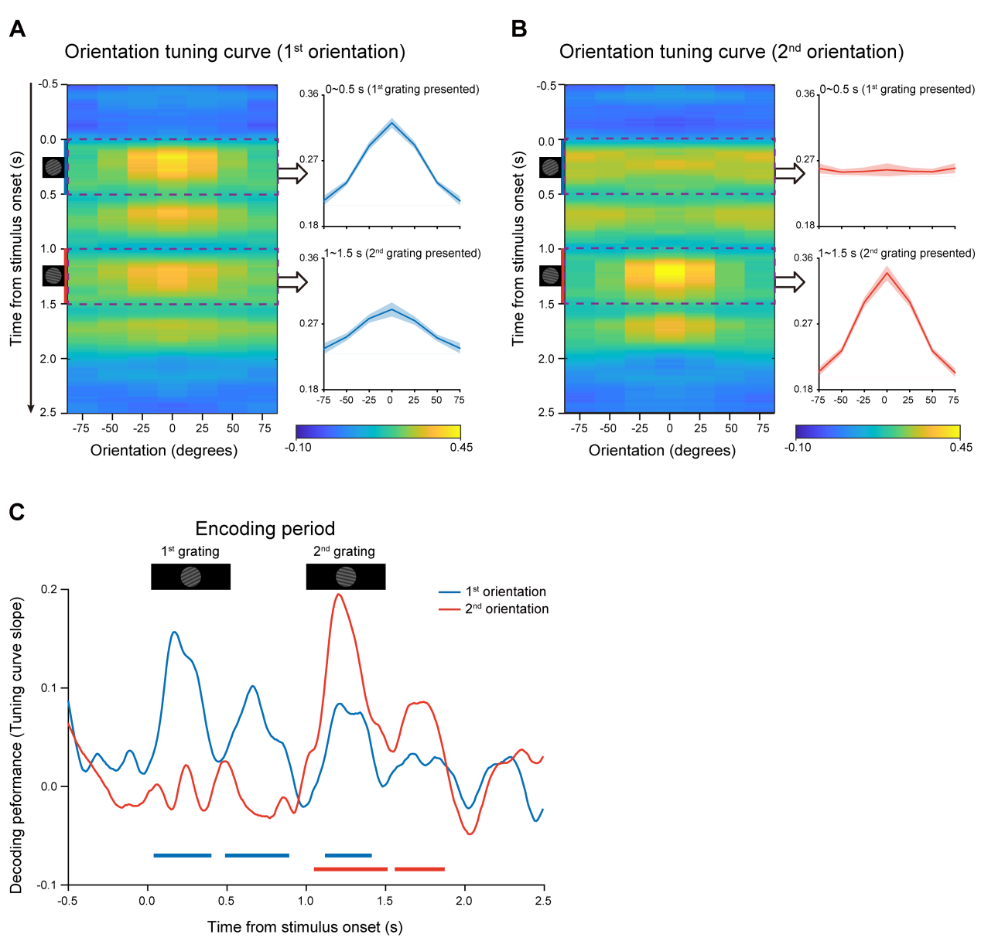
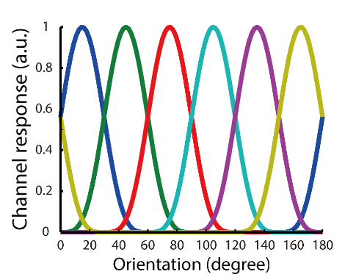
Orientation decoding during encoding period
Using Inverted Encoding Model to decode orientation information
Slope of turning curve
Huang, Zhang, Luo, Biorxiv

Slide 13
Backward reactivations during retention period (after PING)
The nonspecific PING stimulus (impulse) successfully reactivates WM orientation information
The 2nd item is reactivated prior to the 1st item, consistent with the backward replay (Huang et al., eLife, 2018)
The 2nd item resides in a more excitable latent state of the WM network, compared to the 1st item
Huang, Zhang, Luo, Biorxiv

Slide 14
Backward reactivations are related to recency effect
Huang, Zhang, Luo, Biorxiv
Notes:
Again, we see a reactivation of the 2nd orientation prior to the 1st item. Most importantly, we find that the reactivation profiles are related to recency effect on a subject-by-subject basis

Slide 15
Backward reactivations are not due to passive memory decay
Memorizing items without imposed sequence structure shows decreased recency effect and comparable reactivations, indicating that they reside in similar latent states
Huang, Zhang, Luo, Biorxiv
Notes:
Again, we see a reactivation of the 2nd orientation prior to the 1st item. Most importantly, we find that the reactivation profiles are related to recency effect on a subject-by-subject basis

Slide 16
Summary I
Sequence structure reorganizes WM items into distinct latent states, i.e., being reactivated at different latencies, and the reactivation profiles further correlate with recency behavior.
Memorizing the same list of items without sequence requirements disrupts the recency effect and elicits comparable reactivations.
Model fitting on new behavioral results reveals a dominant function of the abstract sequence structure imposed on WM items, instead of low-level memory decay, in mediating sequence memory behavior, i.e., recency effect.

Slide 17
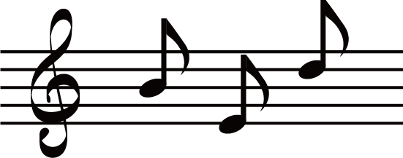
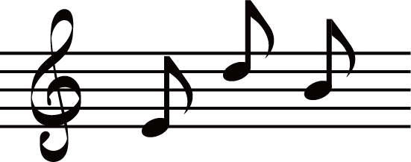
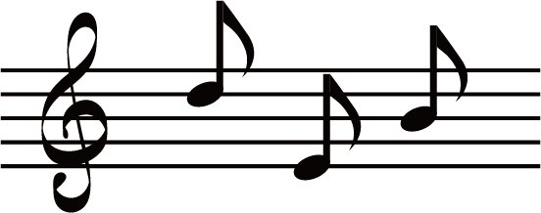


Outline
I. Accessing WM representation during retention
Project 2: content and structure maintenance in auditory sequence memory
155-2346-3897
Same pitch (content) but at different ordinal positions (sequence structure)
II. Manipulating multi-item WM (causal evidence)
Project 3: “Dynamic perturbation” approach to manipulate WM; STP-based neural modelling
Ying Fang
Qiming Han
Notes:
通过这一系列的高时间分辨率的技术手段，我将主要从两个方面开展研究。一是多物体注意，一是多物体记忆。一个基本的思路和假设是，外界物体存储在神经网络中，而他们之间的关系则通过一种时间上序列激活的方法进行表征和存储。

Slide 18
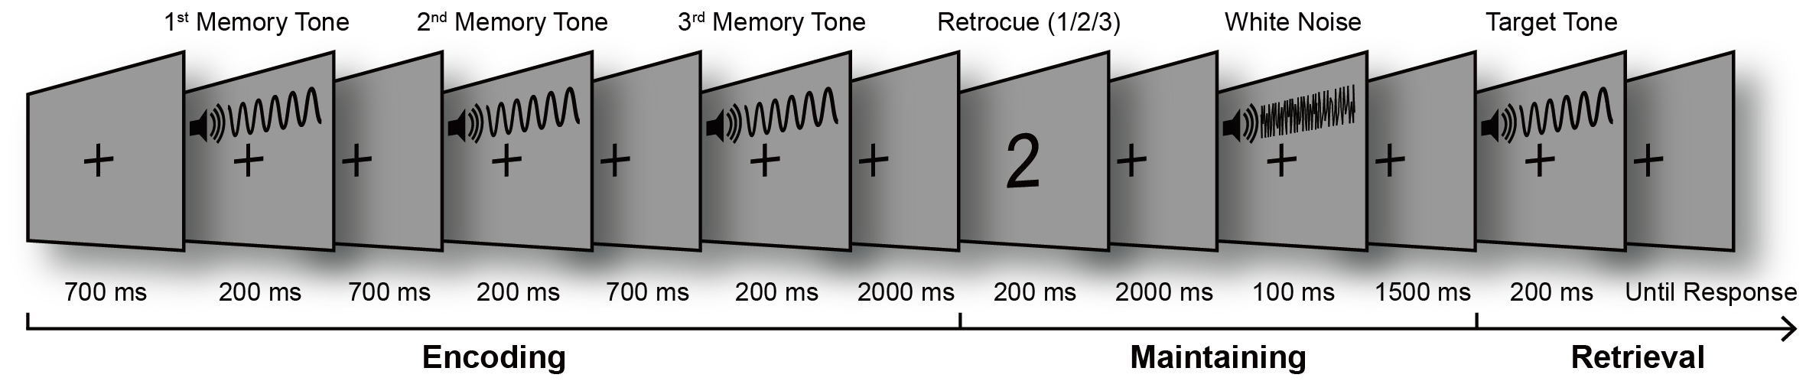
Experimental paradigm (N = 30)
Encoding period
f1: 381 Hz
f2: 538 Hz
f3: 762 Hz
f4: 1077 Hz
f5: 1524 Hz
f6: 2155 Hz
1st
2nd
3nd
Content
Structure
Fan et al., Biorxiv

Slide 19
Experimental paradigm (N = 30)
Maintaining period
Recalling
“Structural Retrocue”: indicating to-be-recalled position
“White noise” PING: Transiently perturbing auditory cortex
Fan et al., Biorxiv

Slide 20
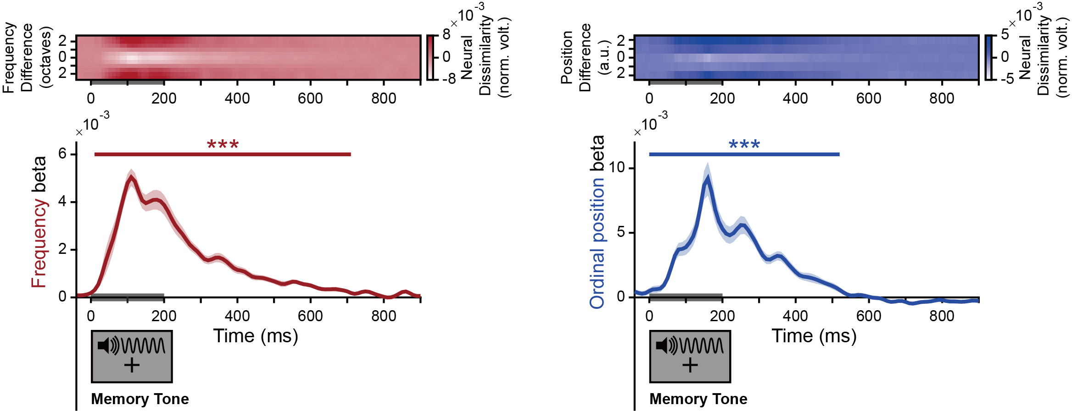
Each tone carries content and structure codes in parallel
Encoding period
Each tone is presumably characterized by specific content (one of the six frequencies) and structure (one of the three positions)
Content
Structure
64-channel Representational
Similarity Analysis (RSA) at each time point for decoding
Fan et al., Biorxiv

Slide 21
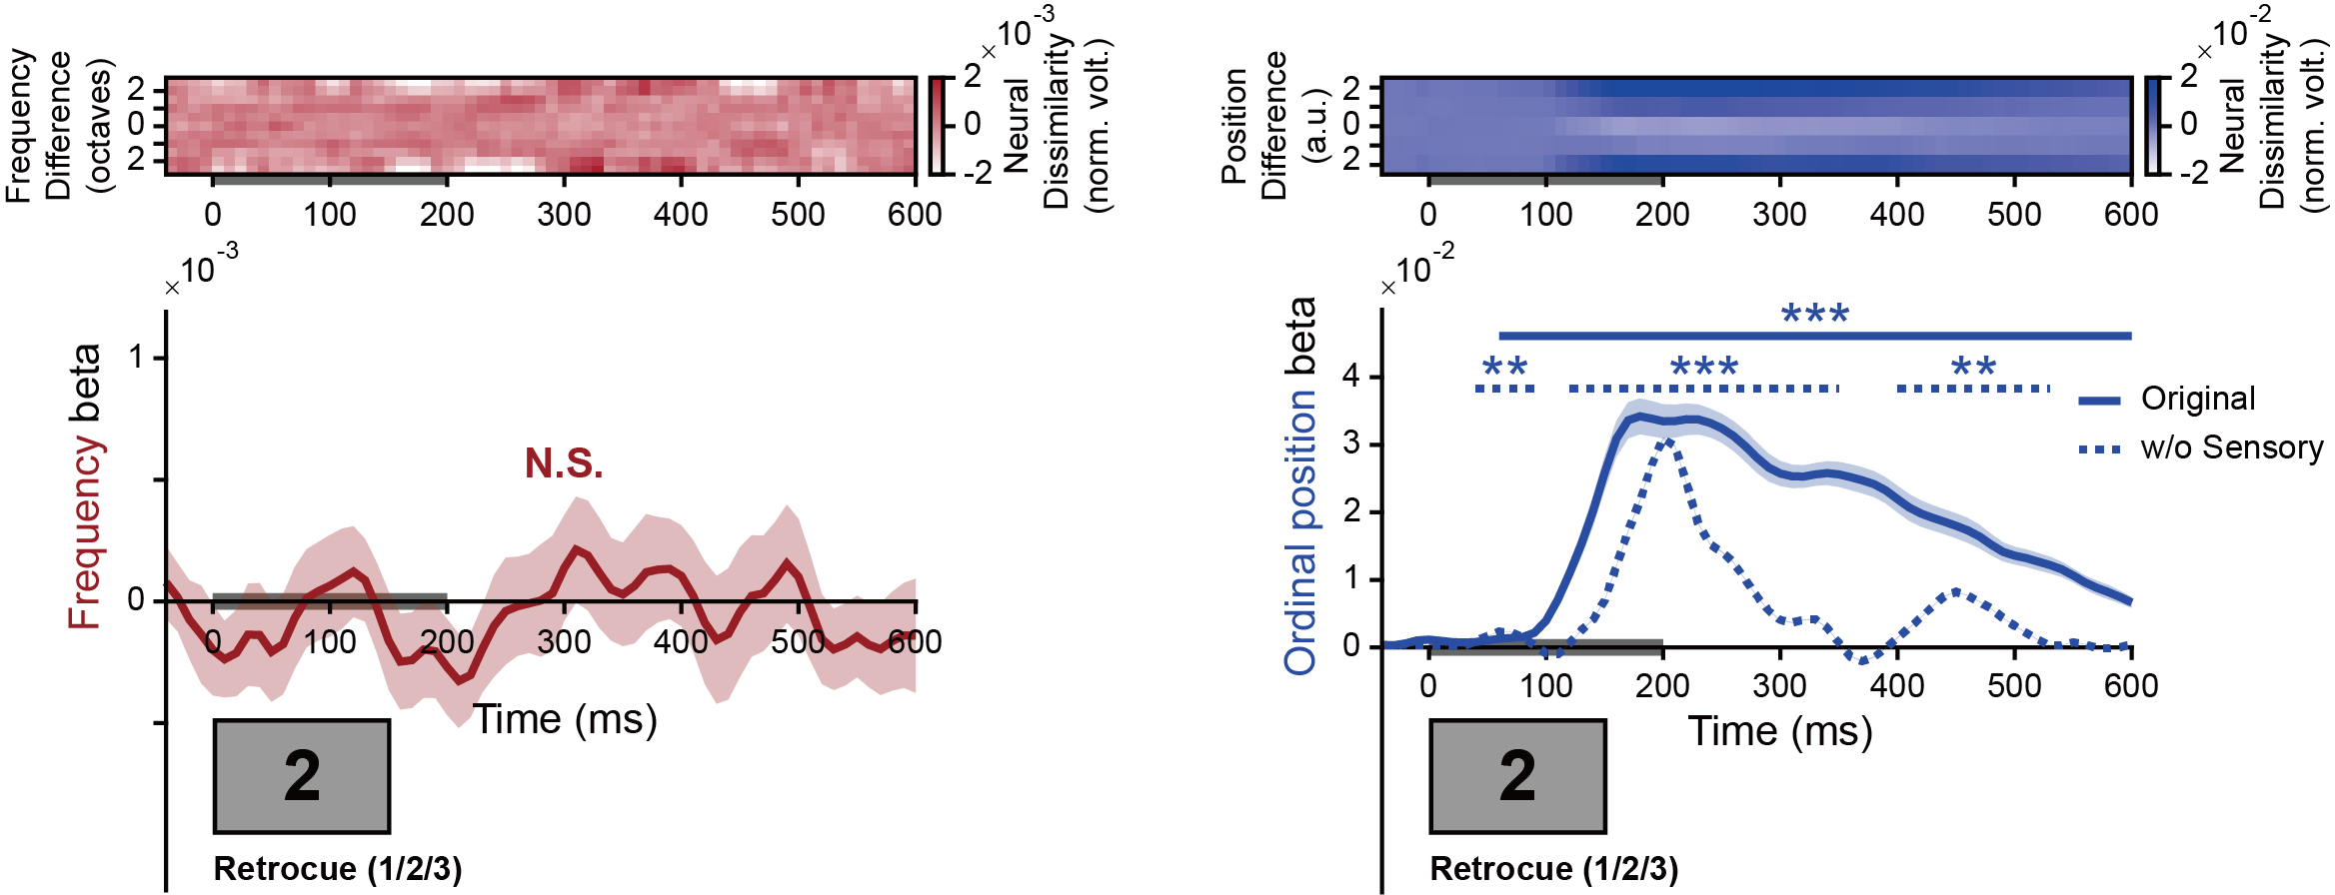
Retrocue during retention reactivates structure but not content
Maintaining period
No content
Structure reactivation
Fan et al., Biorxiv

Slide 22
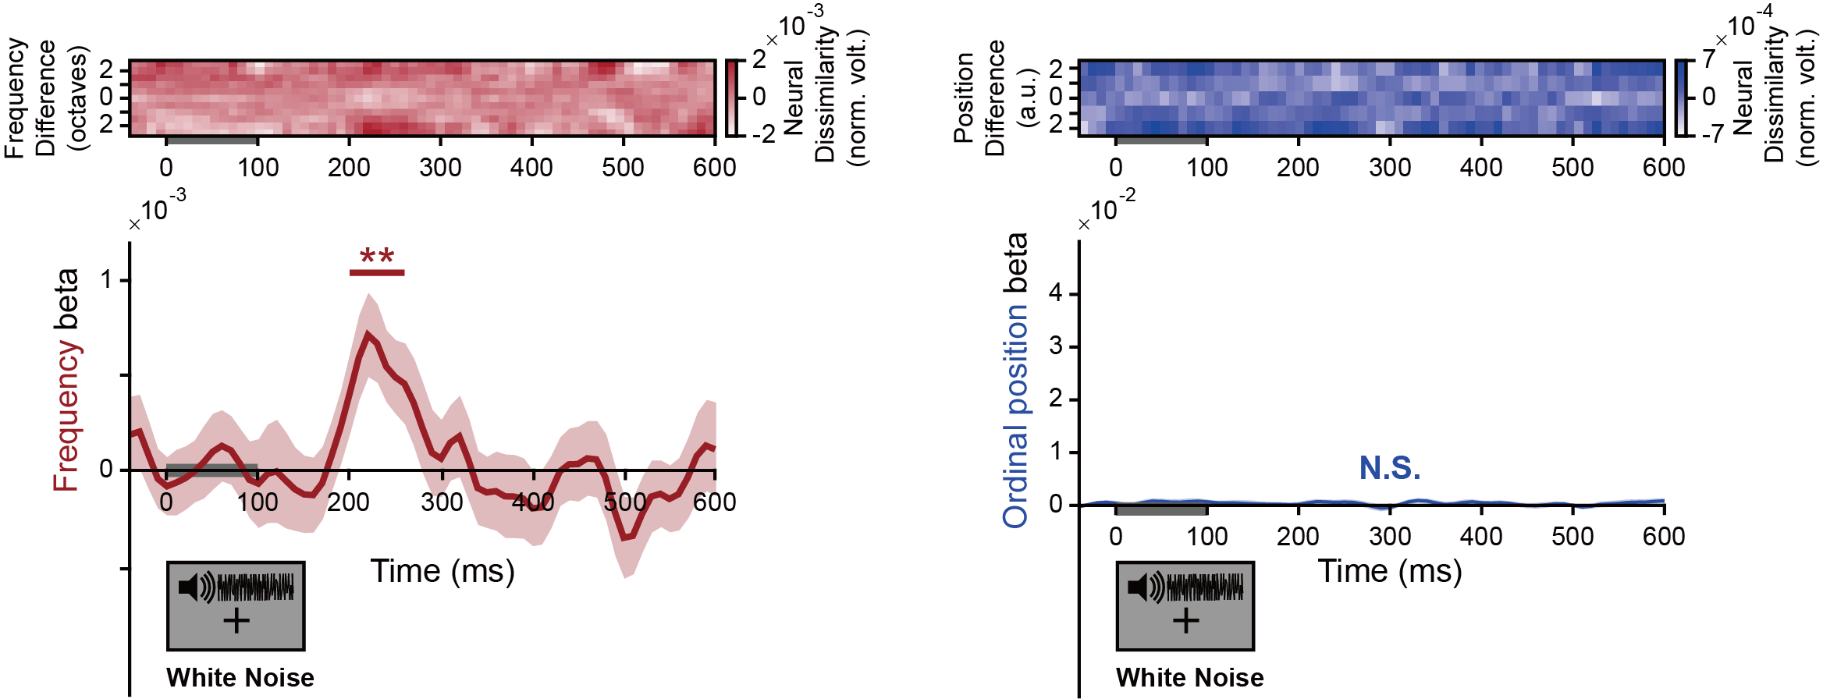
White noise PING during retention reactivates content but not structure
Maintaining period
Content reactivation
No structure
Fan et al., Biorxiv

Slide 23
White-noise elicited content reactivation is related to memory performance
Maintaining period
Fan et al., Biorxiv

Slide 24
Representational dynamics: Dynamic content vs. Stable structure
Dynamic representation for content
vs.
Stable code for structure
Fan et al., Biorxiv

Slide 25
Summary II
Each tone in the sequence is characterized by two codes in parallel: content and structure
During retention, a retrocue reactivates structure but not content, whereas a following white noise reactivates content but not structure, implying their storage in different regions
The content reactivation is further correlated with subsequent memory behavioral performance, confirming its genuine indexing of WM storage
Stable code for structure vs. dynamic code for content
The dissociated content/structure storage might facilitate memory transfer by applying stable structure to newly incoming contents (e.g., Behrens et al., Neuron, 2018)

Slide 26

Outline
I. Accessing WM representation during retention
Project 1: Sequence structure reorganizes item representations in WM
Project 2: Distinct content and structure maintenance in auditory sequence memory
155-2346-3897
II. Manipulating multi-item WM (causal evidence)
Project 3: “Dynamic perturbation” approach to manipulate WM; STP-based neural modelling
Li, Huang et al., Progress in Neurobiology, in press
Jiaqi Li
Qiaoli Huang
Notes:
通过这一系列的高时间分辨率的技术手段，我将主要从两个方面开展研究。一是多物体注意，一是多物体记忆。一个基本的思路和假设是，外界物体存储在神经网络中，而他们之间的关系则通过一种时间上序列激活的方法进行表征和存储。

Slide 27
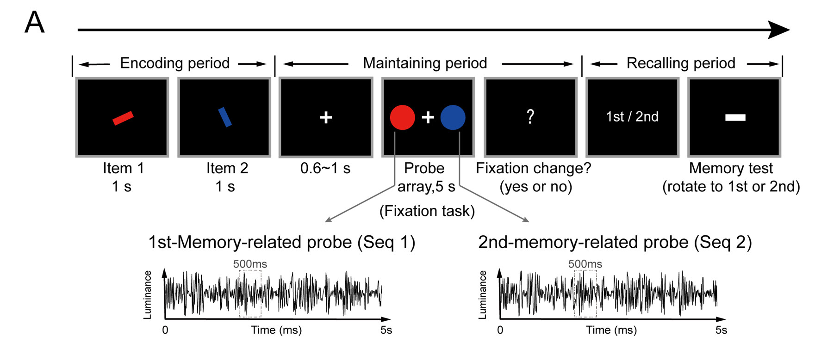
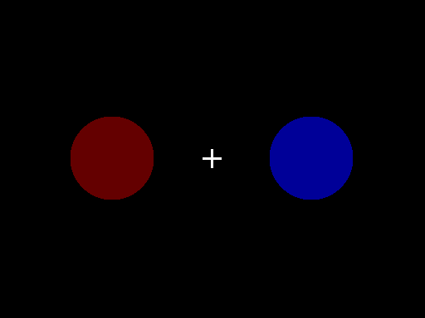
Experimental paradigm: presenting flickering probes during retention
“Dynamic perturbation”
Introducing temporal correlations between Seq1 and Seq2
during retention to modulate the items’ relative memory strength
Li, Huang et al., Progress in Neurobiology, in press

Slide 28
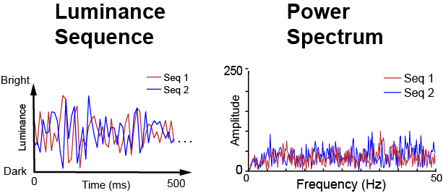
Baseline condition: independent perturbations
Two independent luminance sequences
(no temporal correlation between items)
Li, Huang et al., Progress in Neurobiology, in press

Slide 29
Uncorrelated flickering probes do not affect recency effect (Baseline)
Li, Huang et al., Progress in Neurobiology, in press

Slide 30
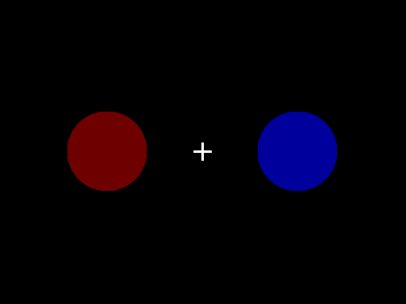
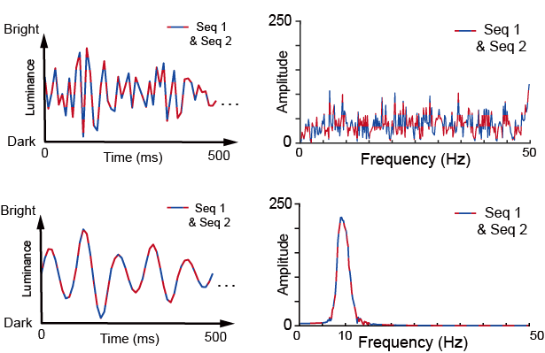
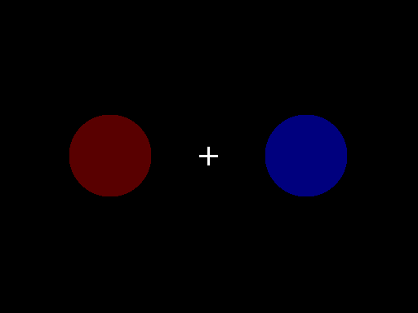
“Temporal synchronization” condition
Synchronization condition
（Seq1 = Seq 2, the same luminance sequences）
Full Synchronization
(Seq 1 = Seq 2)
Alpha-band Synchronization
(Seq 1 = Seq 2)
Li, Huang et al., Progress in Neurobiology, in press

Slide 31
Synchronized flickering probes disrupts recency effect (Sync)
Li, Huang et al., Progress in Neurobiology, in press

Slide 32
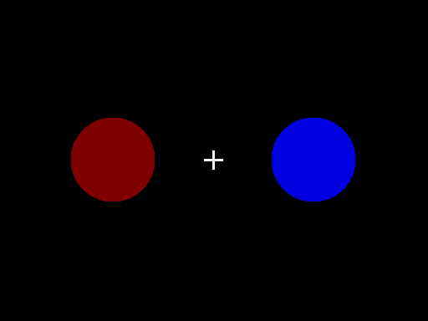
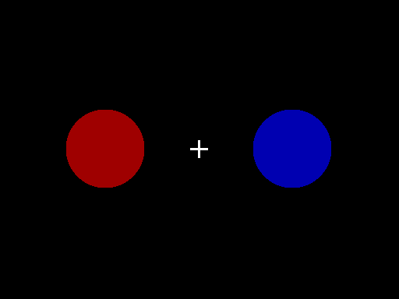
“Order reversal” condition: introducing temporal lags between Seq1 and Seq2
Red leads Blue by 200ms
Cannot perceptually distinguish the two conditions
Red lags Blue by 200ms
Li, Huang et al., Progress in Neurobiology, in press

Slide 33
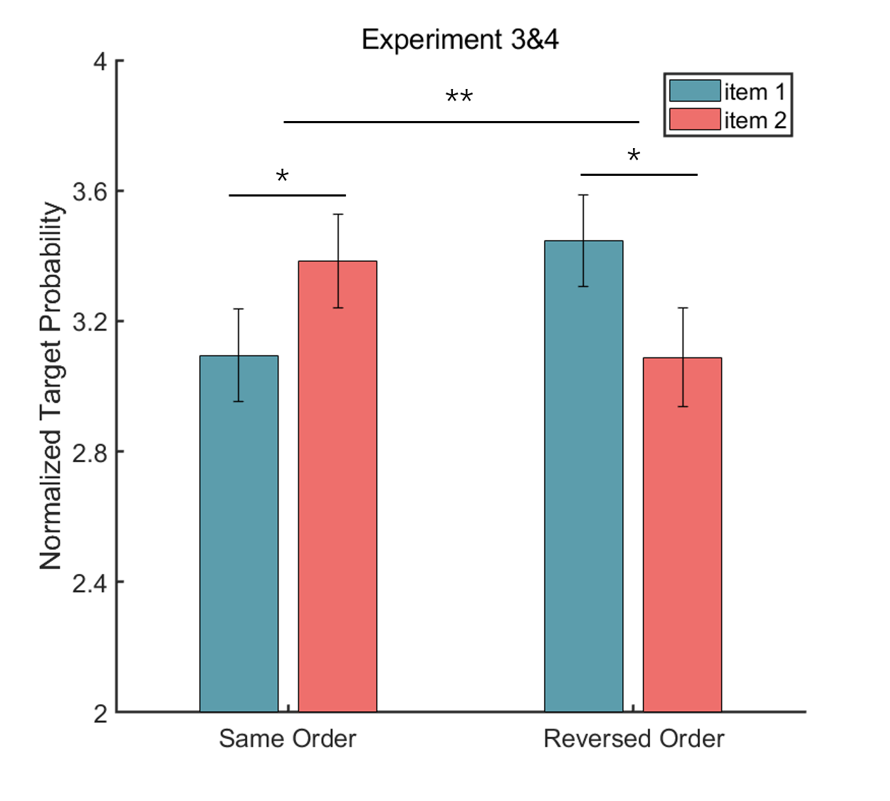
Order reversal of flickering probes reverses recency effect
Shifting by 200 ms (N =54)
Red leads Blue by 200ms
Red lags Blue by 200ms
Li, Huang et al., Progress in Neurobiology, in press

Slide 34
“Order reversal” manipulation: effective within certain range
Shifting by 200 ms
Shifting by 500 ms
Li, Huang et al., Progress in Neurobiology, in press

Slide 35
“Dynamic perturbation” approach: underlying mechanisms
Dynamic perturbation approach
Input
Temporally correlated dynamic perturbation
Changes in items’ reactivation competition
？
Output
Changes in their relative memory strength
Changes in items’ synaptic efficacies
Notes:
But we still don’t know what happens in-between, or the internal neural network.

Slide 36
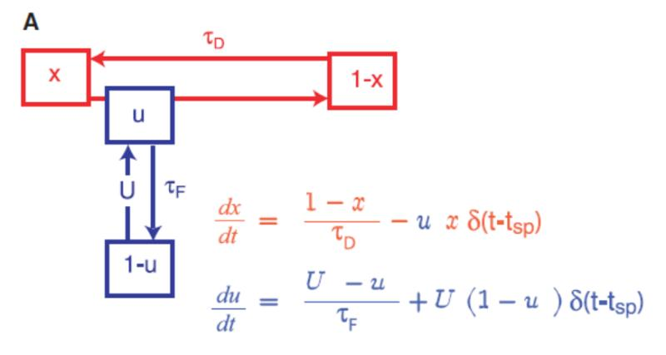
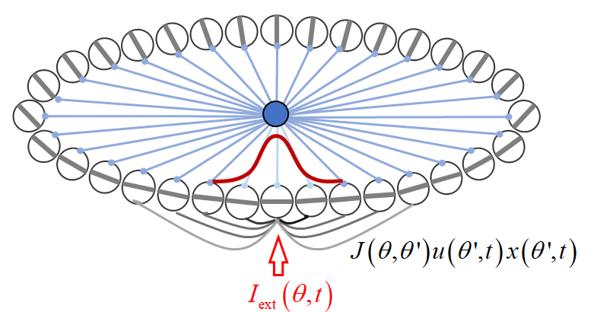

The Computational Neural Model --- CANN-STP model
Continuous attractor network (CANN)
Short-term neural plasticity
(STP)
STP, a phenomenon that synaptic efficacy changes over time with neuronal activity
Memory is retained in the facilitated recurrent connections between neurons
Mongillo, Barak and Tsodyks, Science, 2008
Yuanyuan Mi, Chongqing U
Notes:
我们建立了一个网络来模拟记忆的存储和我们在记忆保持阶段的动态干扰来（1）看是否能够重复我们的行为发现；（2）了解背后突触强度的变化

Slide 37
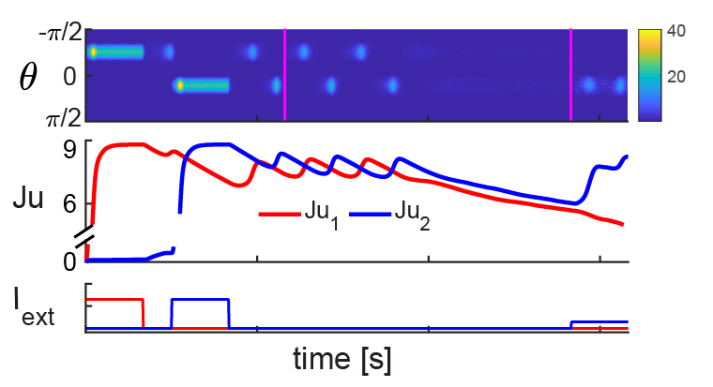
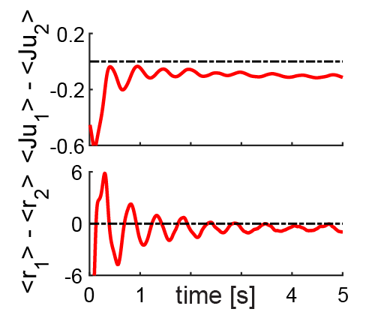
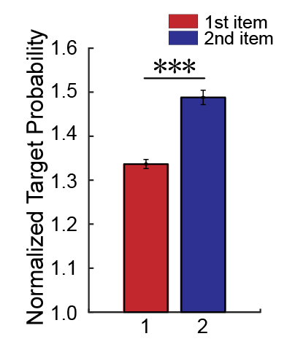
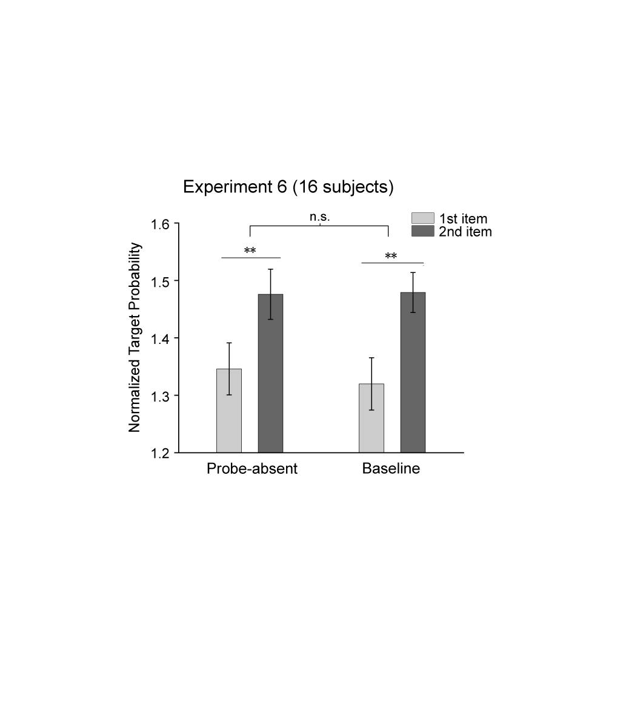
Network Performance without Probe Perturbation
Li, Huang et al., Progress in Neurobiology, in press
Notes:
We mimicked the whole experimental procedures to do the model simulation and used exactly the same way to calculate the memory recalling performance. Due to STP, the synaptic efficacy of the neuron, denoted by Ju here will remain at high value for a while . Because the average synaptic efficacy is larger for the 2nd than the 1st, the memory strength will show the recency effect.

Slide 38
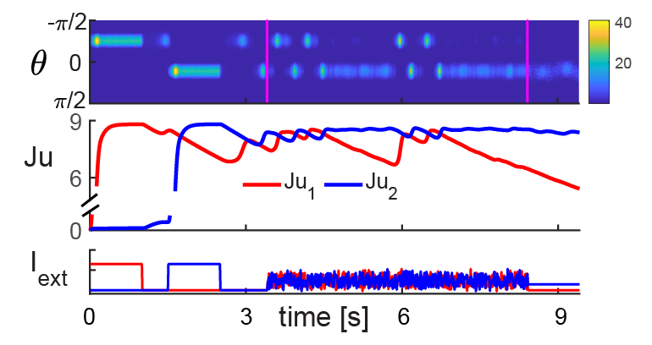
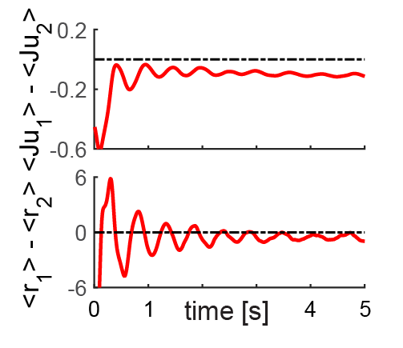
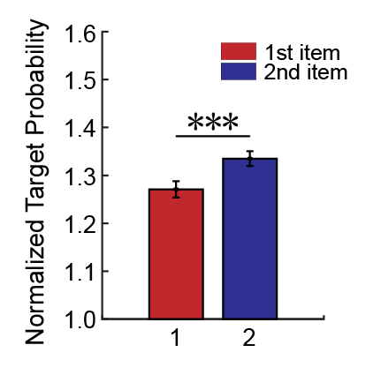
Baseline Condition
Li, Huang et al., Progress in Neurobiology, in press

Slide 39
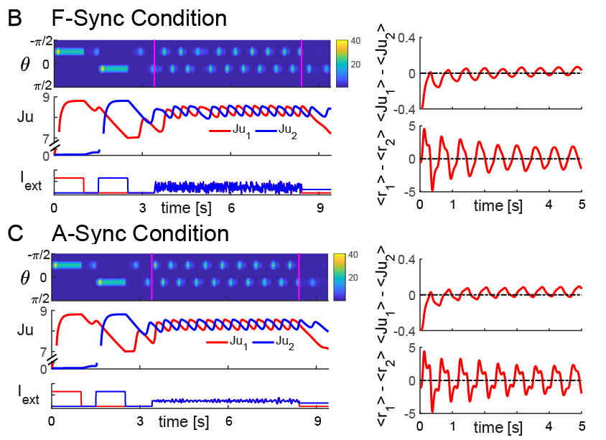
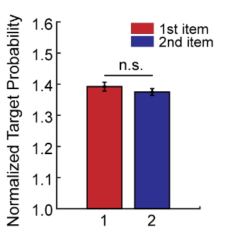
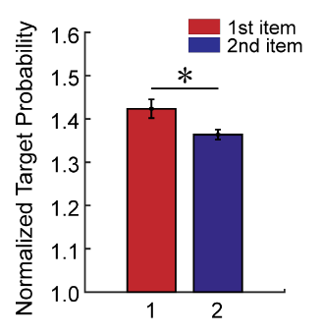
Synchronization Manipulation
Li, Huang et al., Progress in Neurobiology, in press

Slide 40
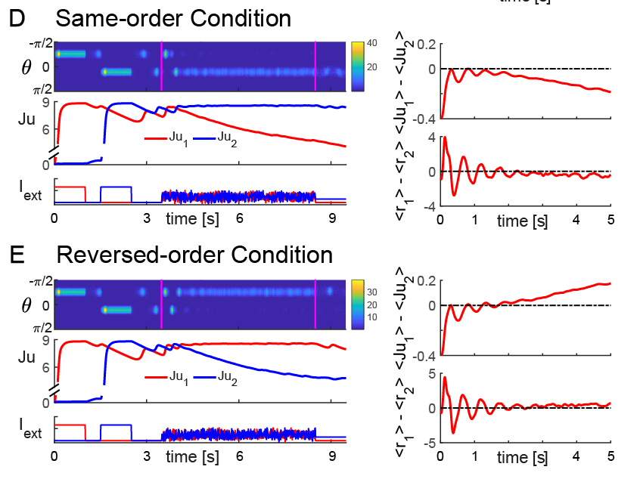
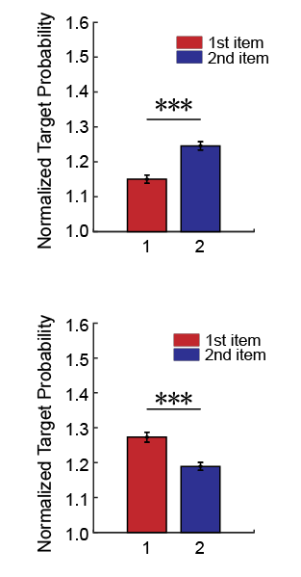
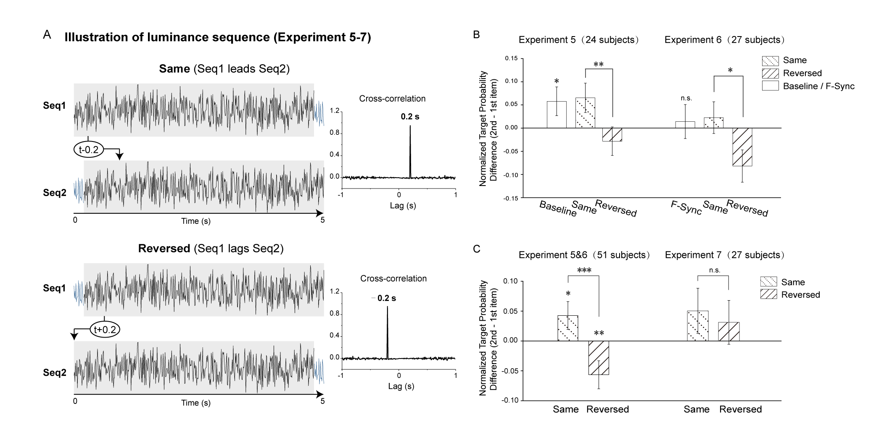
Order Reversal Manipulation
Recency reversal
Li, Huang et al., Progress in Neurobiology, in press

Slide 41
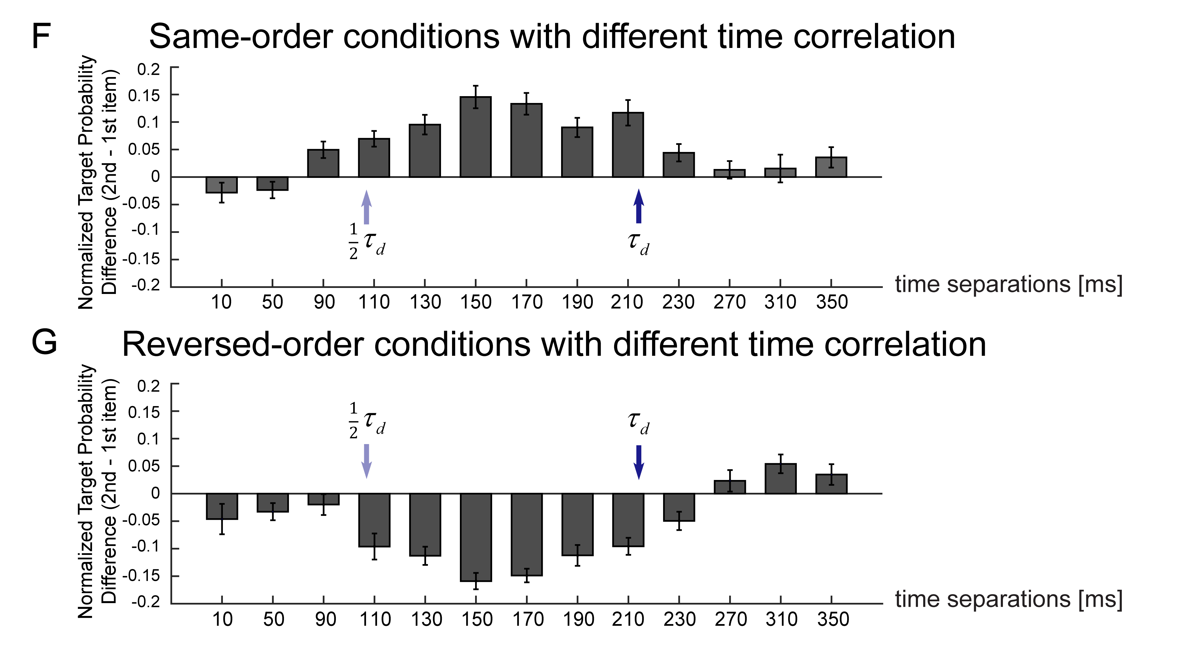
Model Predictions
Effective time range
Li, Huang et al., Progress in Neurobiology, in press

Slide 42
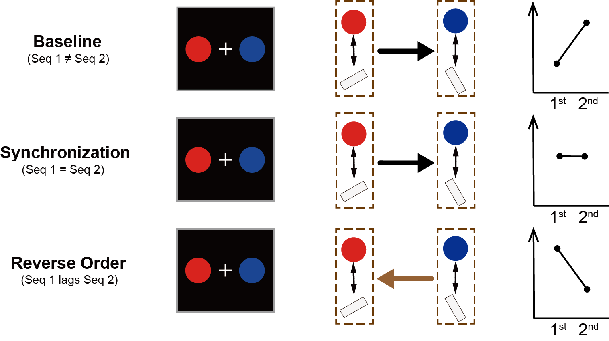
“Dynamic perturbation” summary
Recency effect

Slide 43
~ 150 subjects
Li, Huang et al., Progress in Neurobiology, in press

Slide 44
Summary III
We developed a “dynamic perturbation” approach to manipulate the relative memory strength of a list of WM items, by interfering with their neural dynamics in a temporally correlated or uncorrelated way.
A computational model incorporating CANN with STP principles reproduces the empirical findings and demonstrates that this “dynamic perturbation” induces changes in the relative synaptic efficacies of WM items and eventually causes the modulation of their relative memory strength.
Our results support the causal role of temporal dynamics of neural network during WM retention in mediating multi-item WM and offer a promising, non-invasive approach to manipulate WM.

Slide 45
Conclusion
Multiple items organized by sequence structure are stored in varied latent states of WM network, which could be assessed by transiently perturbing the retention stage and reading out their reactivations;
Using the PING approach, we demonstrate that content and structure of an auditory sequence are stored in a distinct manner, which would benefit memory generalization of stable structure to new inputs
Based on STP principles, we developed a novel ‘dynamic perturbation’ approach to modulate relative memory strength of items maintained in WM, by presenting temporally-related flickering probes.
Computational modelling (CANN+STP) fully reproduces our results and supports that the manipulation operates through STP-based neural dynamics.

Slide 46
Spatiotemporal reorganization of information in the brain
External world
Internal world
Information reorganization in time and space
…
…
Temporal dynamics of external world does not necessarily correspond to that of the internal world (brain)
In order to manipulate information processing in the brain, we should take the perspective of the brain
Notes:
所以，简单来说，外部世界所包含的存在着相互关系的多个物体是如何表征在复杂的大脑神经活动中的呢？这其中需要一种从外部到内部的信息时空重新组织的方式，而这也是我们研究的出发点和核心。所以，关键科学问题是研究xxxxx，此外，我们着重研究xxx,这完全不同于在人类受试上通常采用的xxx

Slide 47




Acknowledgements
黄巧莉
Collaborators
Fang Fang, Hang Zhang, Ming Meng, Nai Ding, Ke Zhou…
Huihui Zhang, postdoc
Ying Fan
Jiaqi Li
Minghao Luo

Slide 49
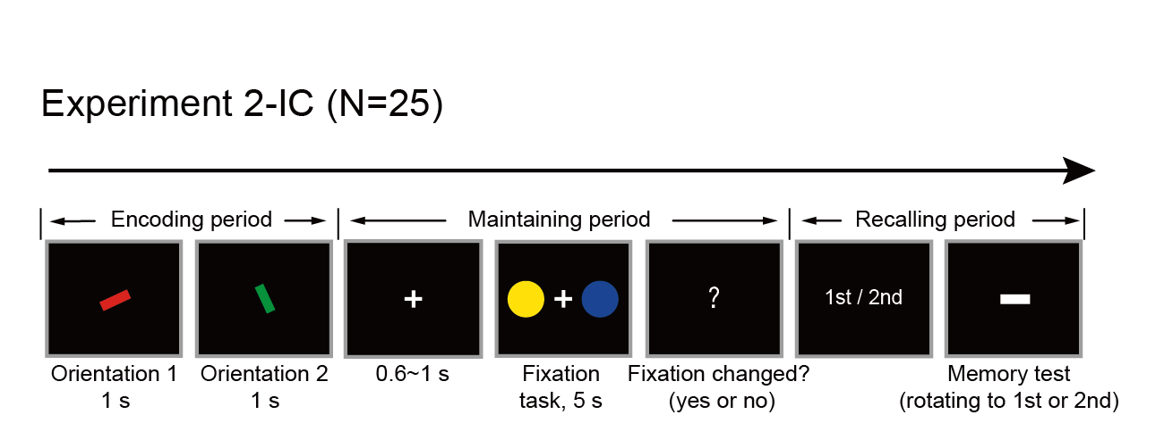

Memory-irrelevant color probes do not disrupt recency
Experiment 2-IC (N = 27)
Li, Huang et al., Progress in Neurobiology, in press

Slide 51
Experimental paradigm: no perturbation condition
Classical recency effect
(2nd > 1st)
Li, Huang, Han, Mi, Luo, Biorxiv
Notes:
First, we did a control study without any manipulation during retention and observed the recency effect.

Slide 53
Experimental paradigm (N = 30)
Unresolved issue:
Retrocue: an informative PING about structure
White noise: a neutral PING about content
Could we reactive structure information using a neutral PING?

Slide 54
Recalling ordinal position instead of frequency content (N = 31)
Indicating to-be-recalled content
A neutral PING:
hypothesized to reactive structure information
Recalling ordinal position
Could structure representation be reactivated by a neutral PING (as white noise for content reactivation) during retention ?
Fan et al., in prep.
Ying Fang

Slide 55
Neutral PING reactivates structure but not content & Behavioral correlates
Structure reactivation correlates with ordinal position memory performance
Structure reactivation after neutral impulse
No content reactivation after neutral impulse
Fan et al., in prep.

