Slide 1

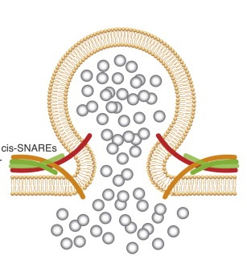
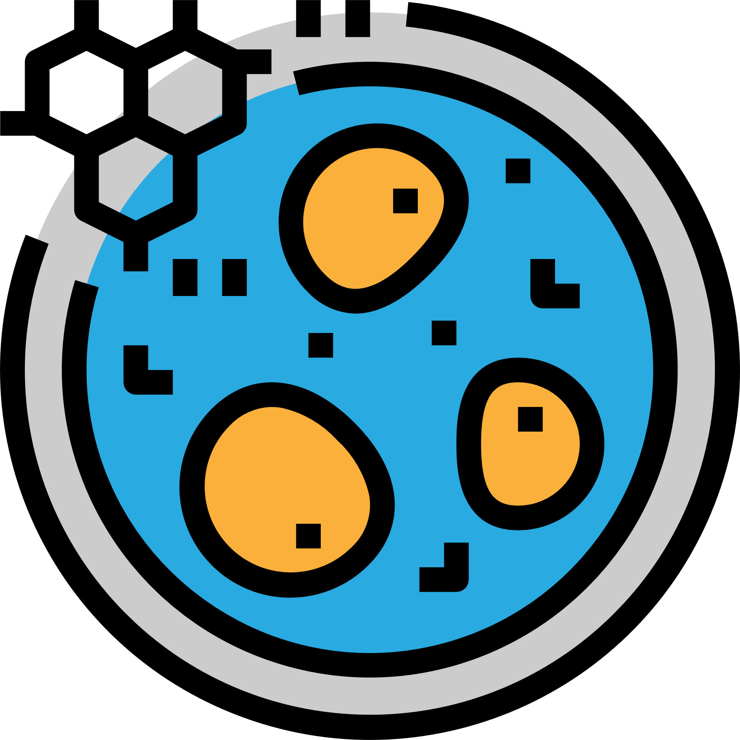

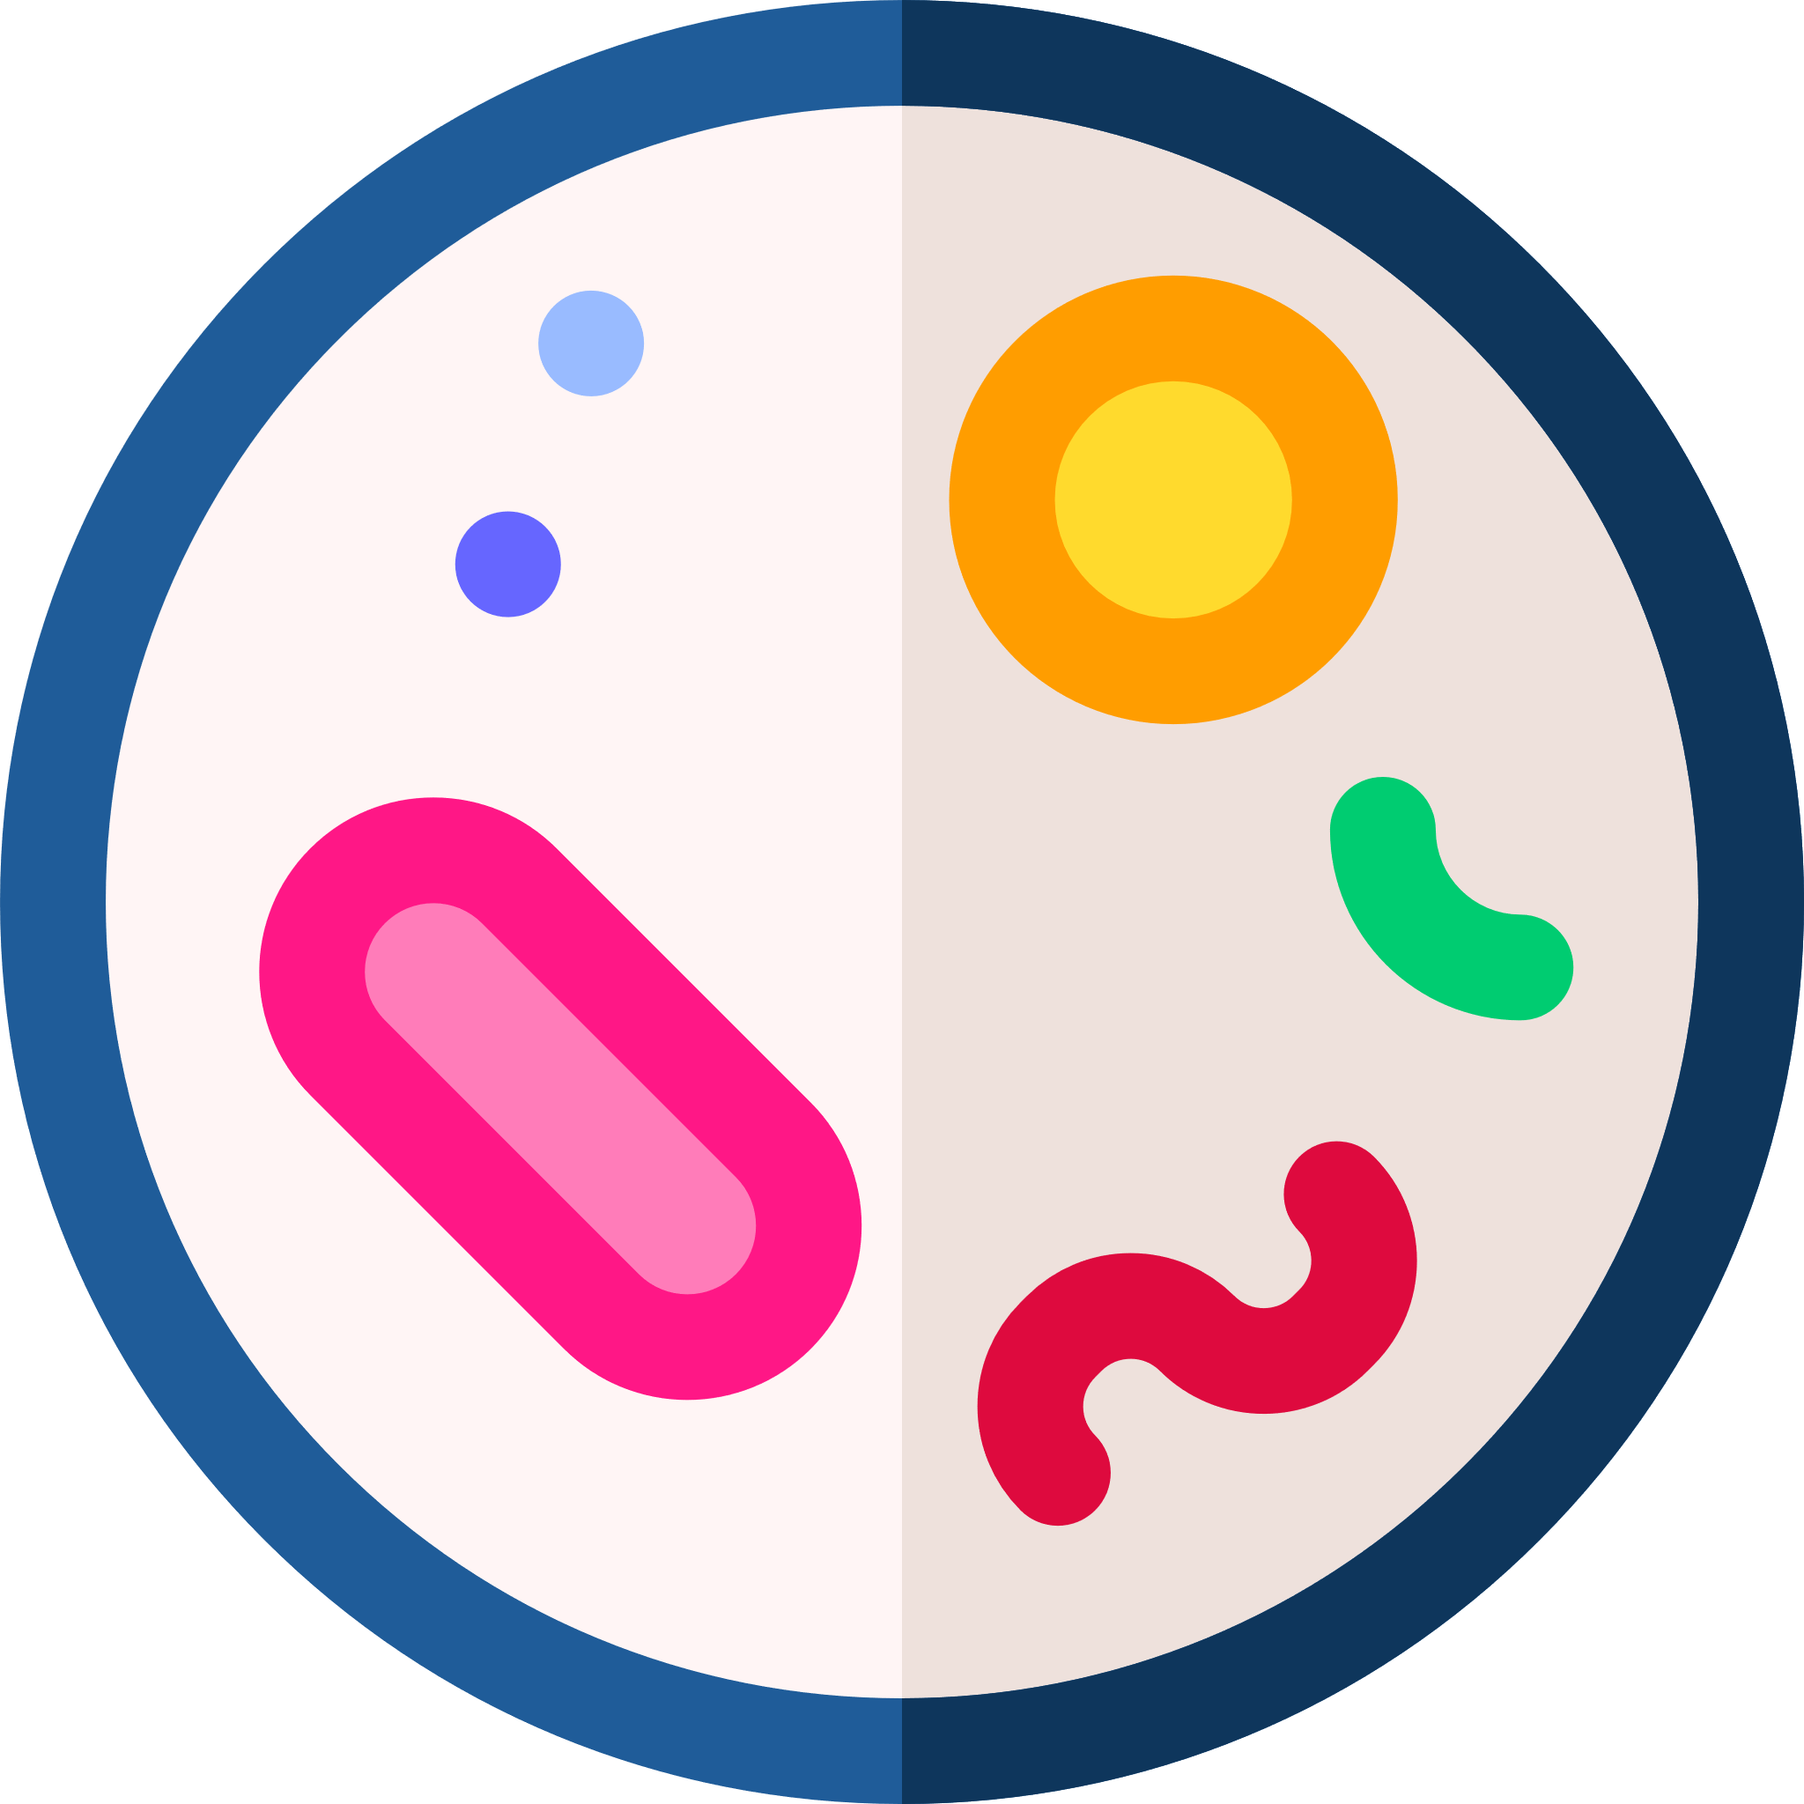
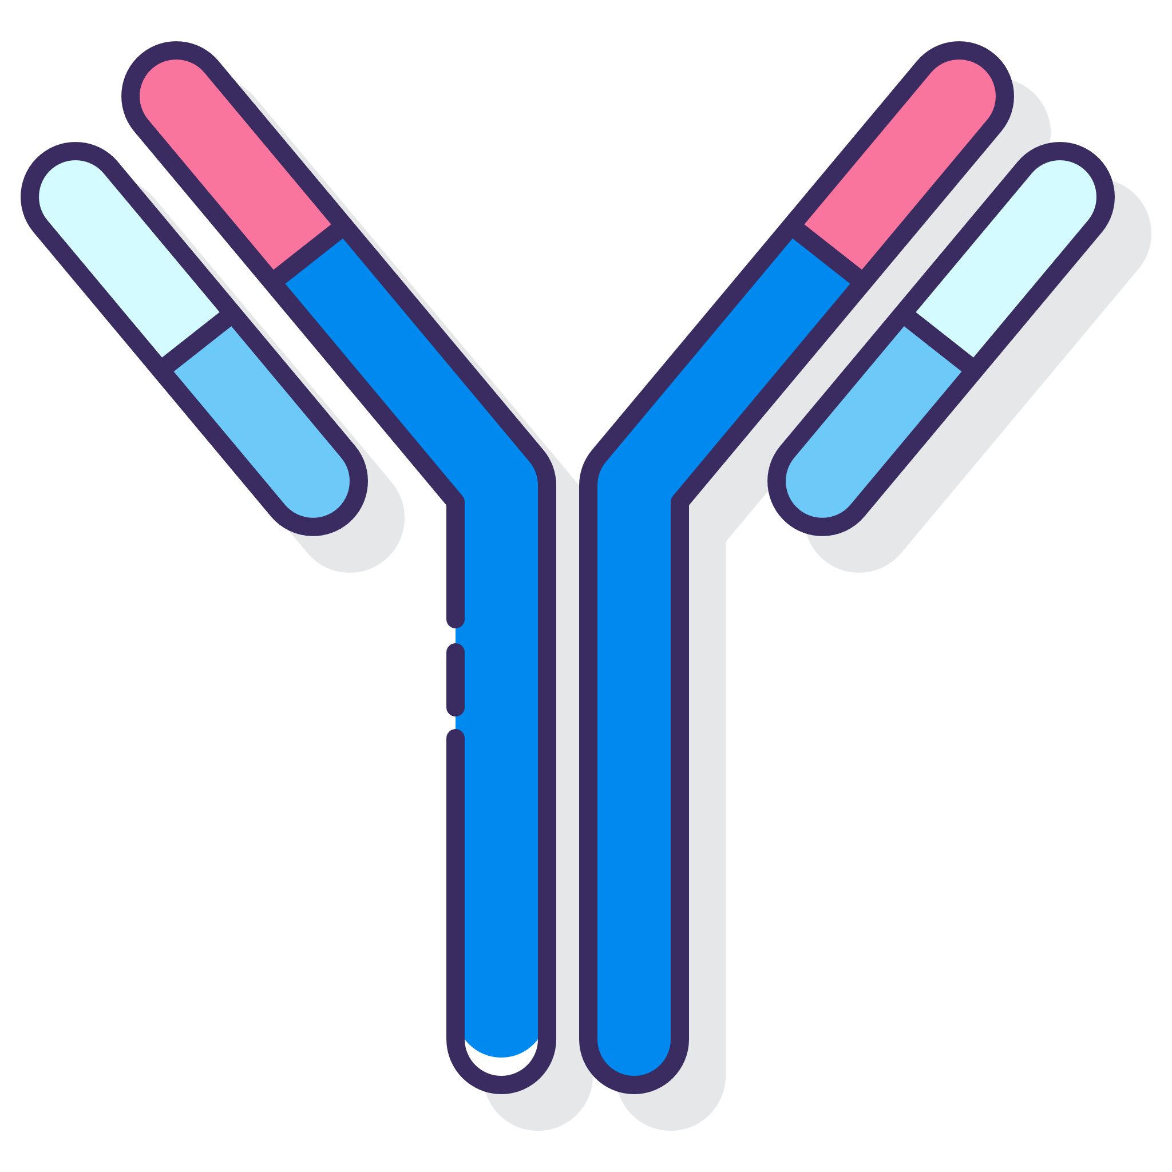
Deep Geometric Representations for Modeling the Effects of Mutations on Protein-Protein Binding Affinity
Xianggen Liu
Metabolism
Virus invasion
Immunoreaction
Neurotransmitter release
Notes:
Hello, everyone, my name is Xianggen Liu, I am very glad to share my recent study to you. It is about a deep learning algorithm for the prediction of protein-protein interaction. This is a very important research problem. Because the protein-protein interaction, # is a very important and fundamental activity in the living things, such as metabolism, virus invasion, immunoreaction, neurotransmitter release. Compared with the previous seminars, this work is related to a different field, that is, bioinformatics. I hope it can provide some interesting ideas for your research.

Slide 2
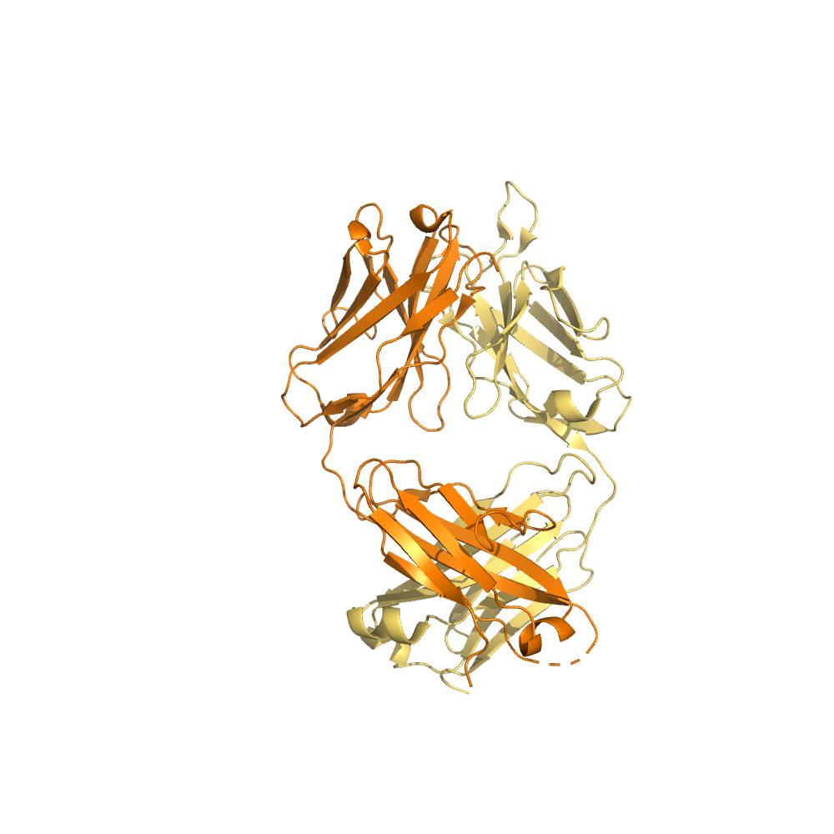
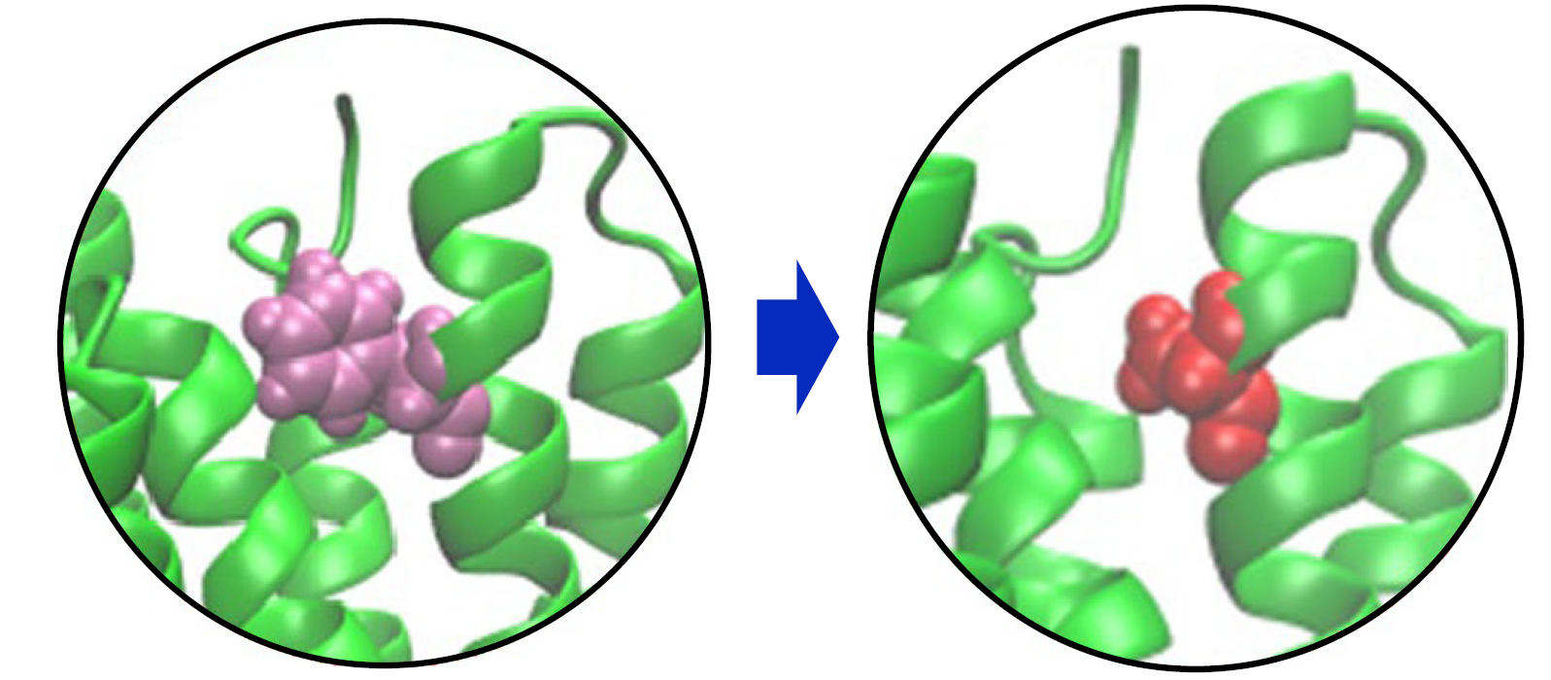
1.1 Prediction of the effects of mutation on PPI
Applications:
  Optimize the binding affinity of the given protein by iteratively performing mutations.
  Study mechanism underlying the protein-protein interactions
Notes:
In our work, we aim at predicting the effects of mutation on binding affinity as accurately as possible. This technique is very useful, # because it can be used to Optimize the binding affinity of the given protein by iteratively performing mutations. And we can also use it to Study the mechanism underlying the protein-protein interactions

Slide 3
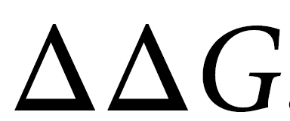
1.1 Prediction of the effects of mutation on PPI
Complex
3D structure
Mutant
3D structure
Prediction model
Binding affinity changes
Notes:
First of all, Here we define the input and output of the prediction model formally. The input of the model is two structures, including the three dimensional structures of the complex and the mutant. And the output of the model is the Binding affinity changes caused by the mutation, which is also called delta delta G.

Slide 4
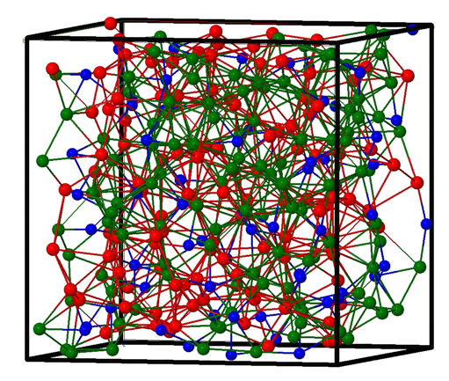
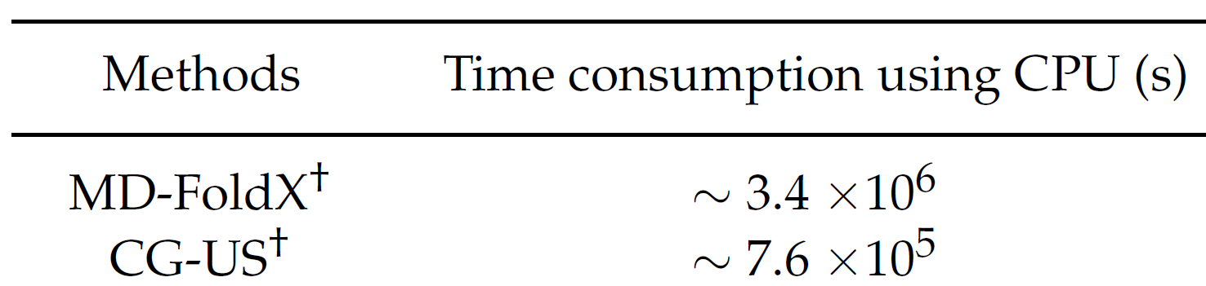
1.2 Related works
Computational time/structure
Molecular modeling approach
Notes:
Traditional methods for modeling the binding affinity changes upon mutations can be grouped into three categories: the first category is the molecular modeling approach, which simulates the difference of free energy between two states of a system based on continuum solvent models. One of the typical examples is CG-US, # the abbreviation of the coarse-grained molecular dynamics simulations. it usually provides reliable simulation results but require heavy computational resources, which limits its applications.

Slide 5
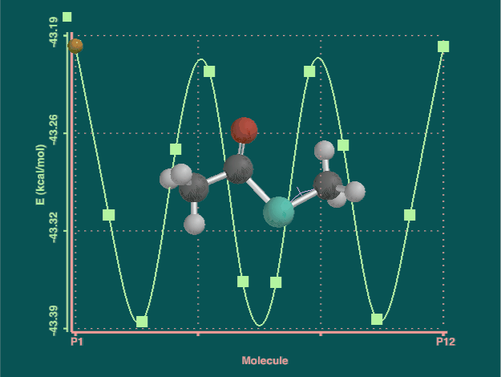
1.2 Related works
Empirical energy-based methods
Machine learning
STATIUM, FoldX and Discovery Studio
Notes:
The second category of the traditional methods is empirical energy-based methods. It leverages classical mechanics or statistical potentials to calculate the free-energy changes. The empirical energy-based methods, such as STATIUM, FoldX and Discovery Studio, have accelerated the prediction but suffered from insufficient conformational sampling, especially for mutations in flexible regions. # The third category is machine learning. it fits the experimental data using engineered features of the changes in structures.

Slide 6
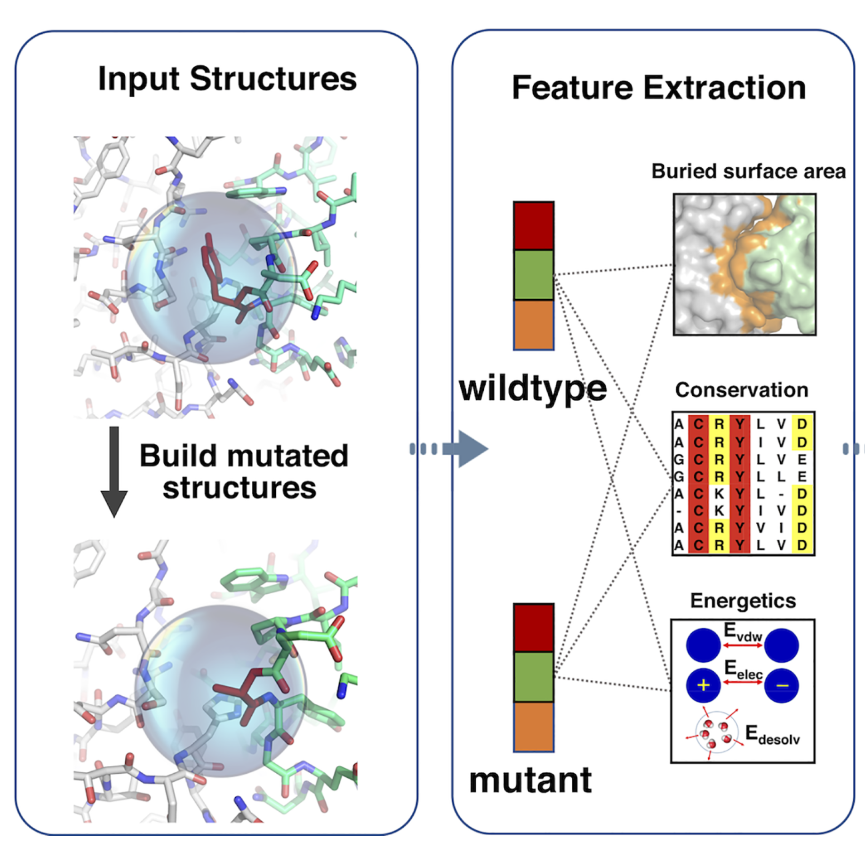
1.2 Related works
BeAtMuSic
(Dehouck, et al., 2013)
MutaBind (Li et al., 2016)
iSEE (Geng et al., 2018)
mCSMPPI
(Rodrigues et al., 2019)
MutaBind2
(Zhang et al., 2020)
Notes:
Recently, The accumulating of experimental data has provided an opportunity for machine learning methods to directly model the intrinsic relationship between a mutation and the resulting change on the binding affinity. The conventional machine learning methods address this problem by manually constructing features. In particular, Geng et al. used a limited number of predictive features derived from interface structure, evolution and approximated energy, as the input of a random forest model to predict the affinity changes upon mutations. However, Most of these existing machine-learning methods # use physical quantities as input features, which require considerable computational time to solve and these features are not generalizable enough. Therefore, we try to seek for a new way to predict the mutation impacts.

Slide 7
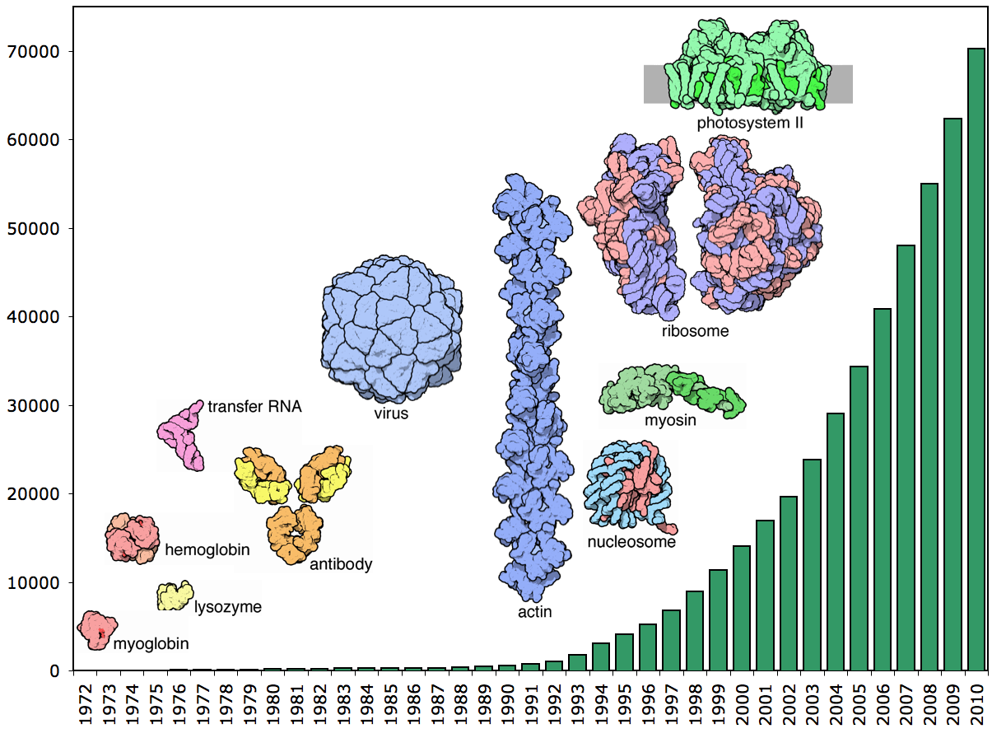
2 Self-supervised representation learning
Protein-protein interaction (PPI) dataset
Dataset | # Complex | # Variants
S645 | 24 | 645
S1101 | 32 | 1101
S1131 | 45 | 1131
S4169 | 120 | 4169
VS.
source：RCSB Protein Data Bank.
Notes:
We first introduce the commonly used PPI data sets, which mainly include the following four, S645, S1101, and so on. It can be seen that these data sets contain very few types of proteins, ranging from dozens to one hundred. Neural networks trained on these data tends to be overfitted. #On the other hand, the number of the known protein structures has grown very rapidly. By 2010, there were more than seventy thousand complexes on the PDB website, and few people can use them effectively at present, which is a pity.

Slide 8
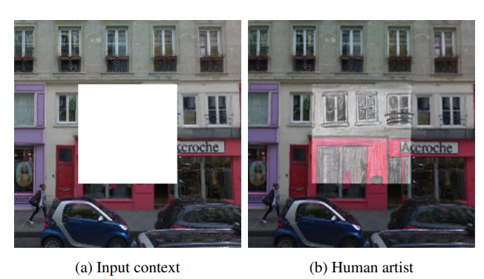
2 Self-supervised representation learning
Self-supervised representation learning for protein structures
GeoPPI
Prediction based on the learned the geometric representations
Self-supervised representation learning for computer vision
Notes:
At the same time, In computer vision, a similar situation also exists. Researchers have proposed a self-supervised method to learn image representation. For example, we can remove a certain part of the picture and then use neural network to reconstruct it. In this way, The neural network can learn the texture of the image. #Inspired by this, we divide the prediction of PPI affinity into two steps. The first step is to use self-supervised training to learn protein structural representation. The second step is to complete the above-mentioned affinity prediction task based on the learned geometric representations of these proteins. Therefore, we called the proposed method as GeoPPI.

Slide 9
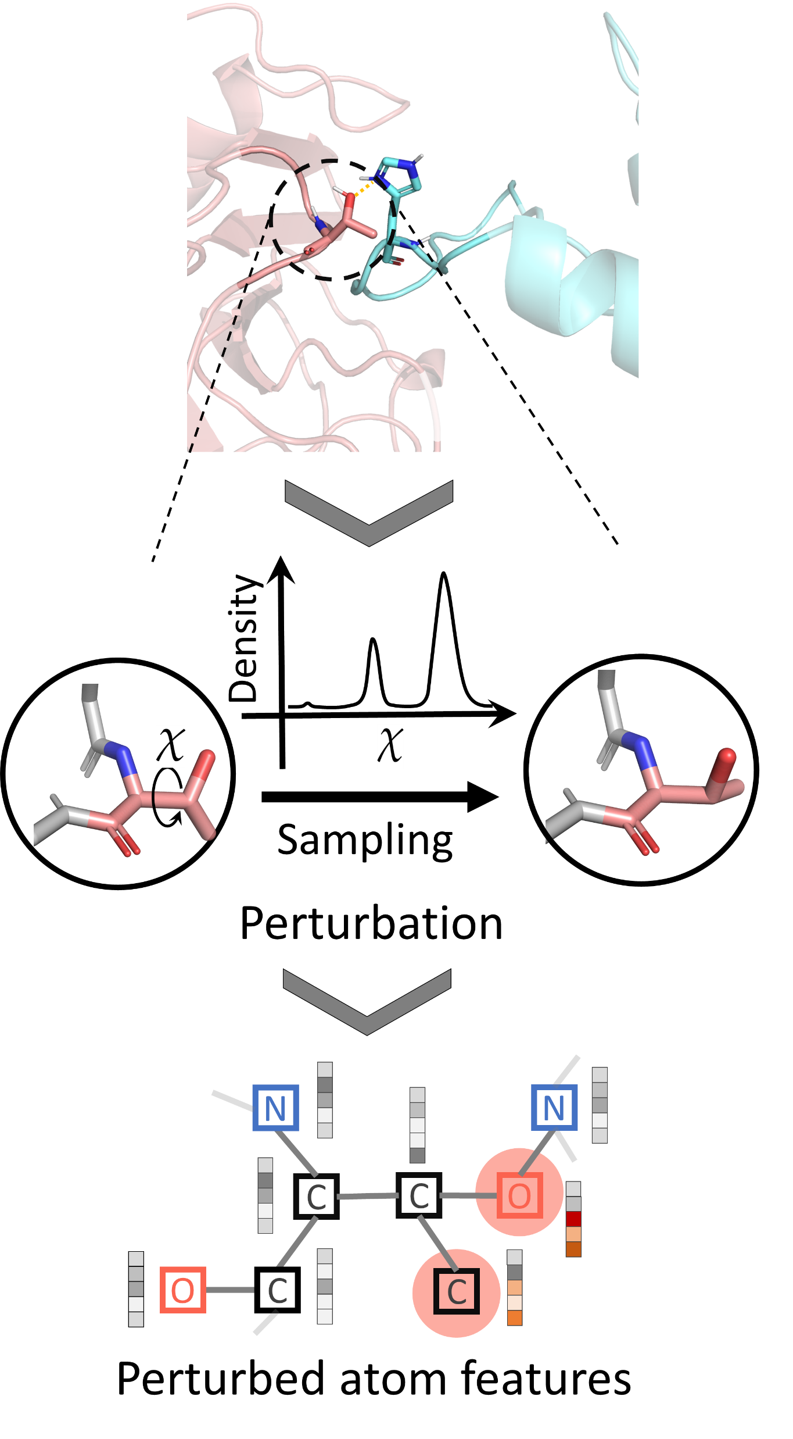
2.1 Self-supervised learning
Step 1: perturbation
Notes:
Specifically, our GeoPPI first conducts a self-supervised training process. We first select an amino acid side chain from the protein complex to perturb. that is to say, we randomly choose a side chain angle according to the angle distribution, # then we convert the perturbed protein structure into a topological structure for the ease of process for neural networks.

Slide 10
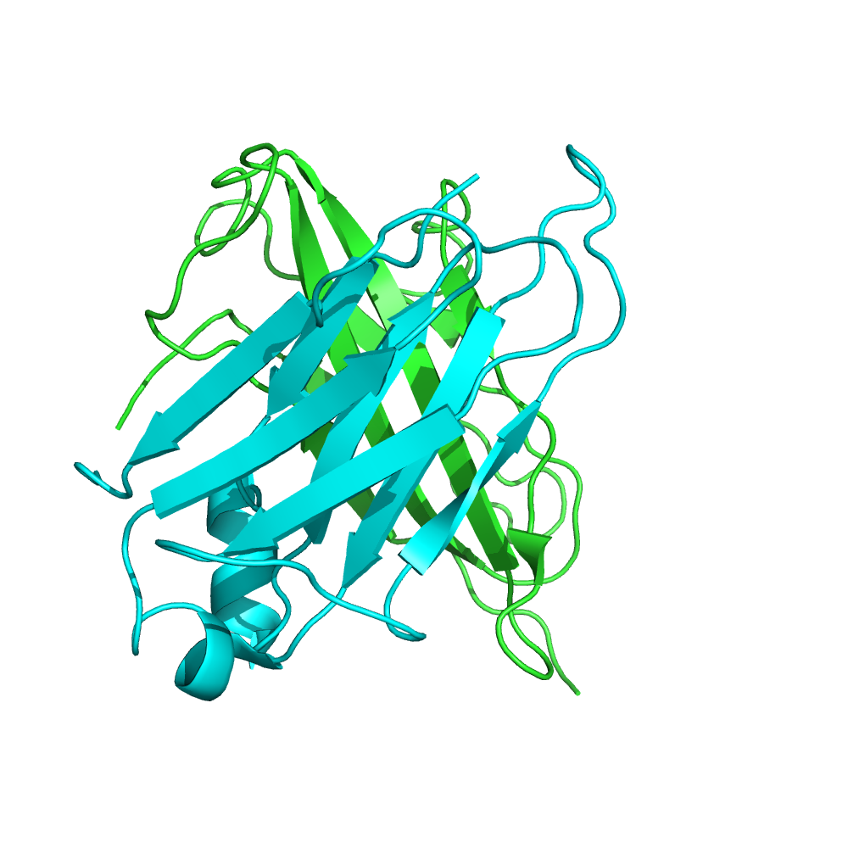
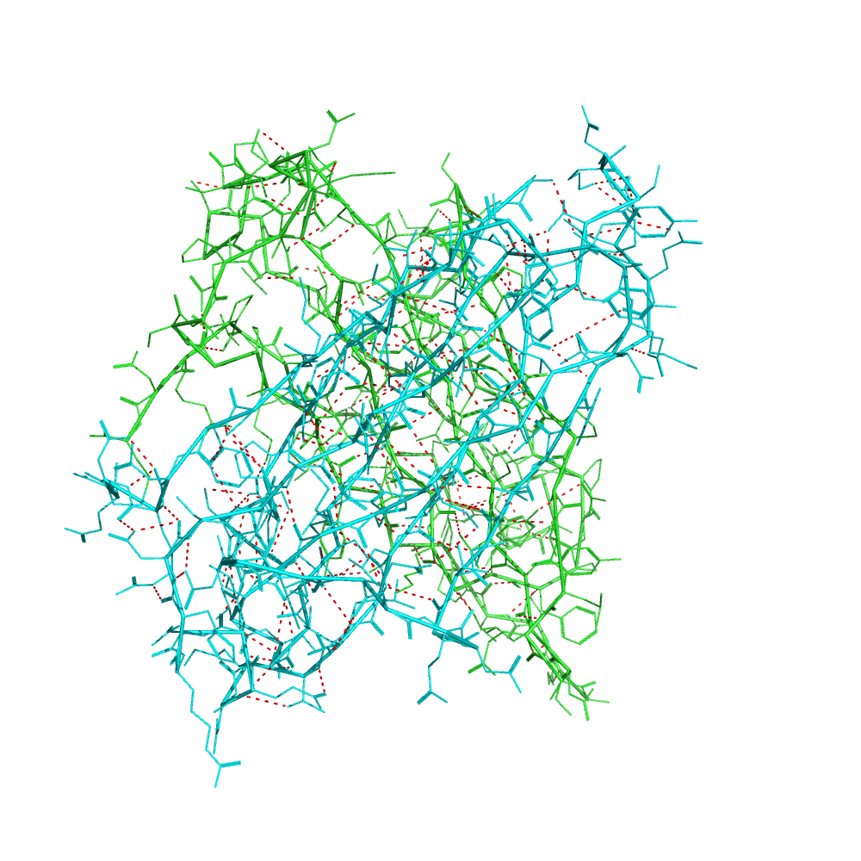
2.1 Representation learning
How to describe the inter-quantum forces in the protein structures?
Notes:
However, a key question is how to extract the useful structural features. different from the images and languages, the structure of protein is three-dimensional. Specifically, there are very complex quantum interactions in molecules, such as scattered mutual attraction, static electricity, as well as the interactions with water. These forces constitute a very complex interaction network! This makes it difficult for us to model and analyze molecules. So, there is a fundamental question, How to describe the inter-quantum forces in the protein structures? In our work, we adopt graph neural networks. Of course, hyperbolic representation is also a way.

Slide 11
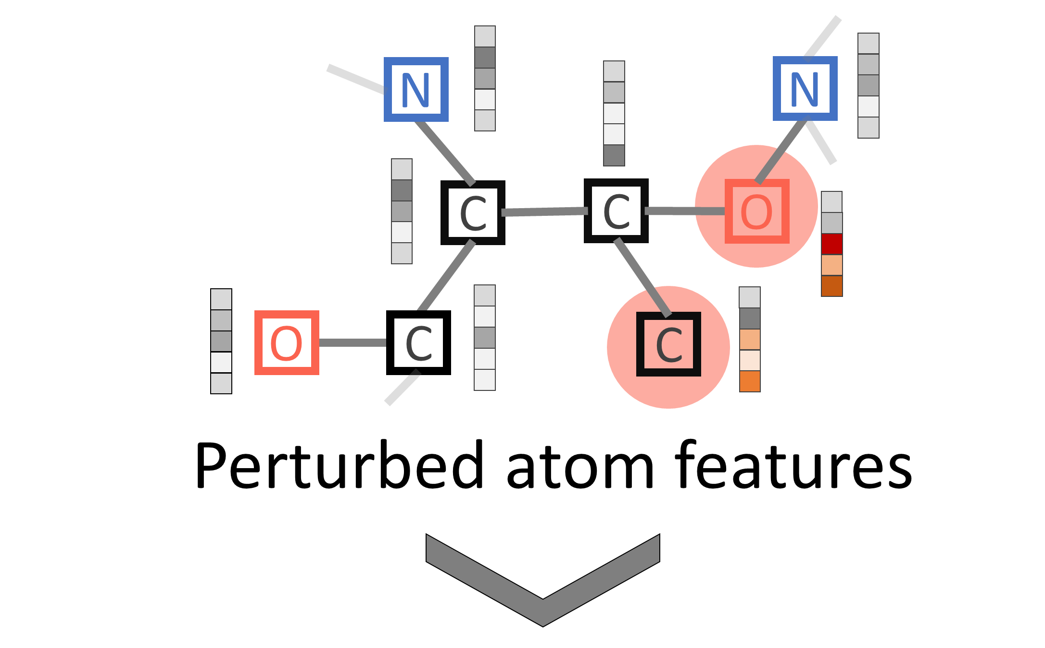
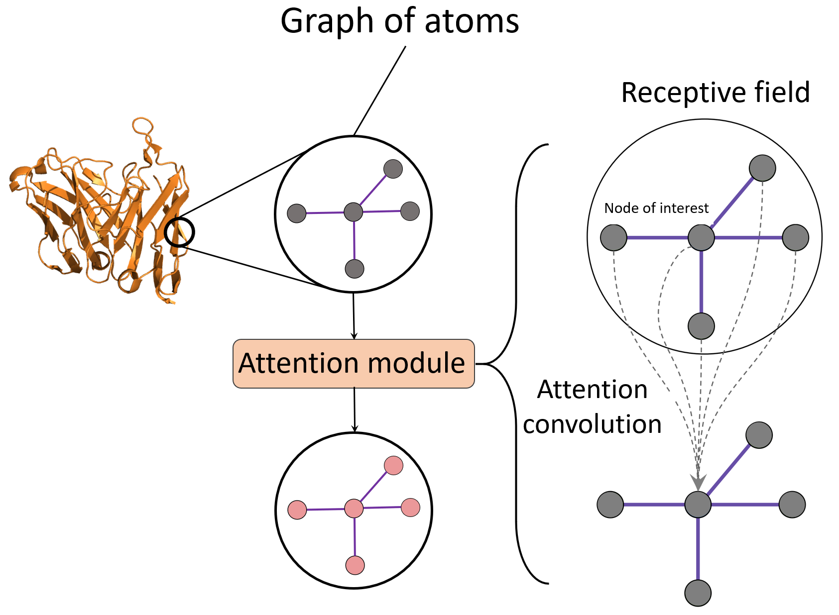
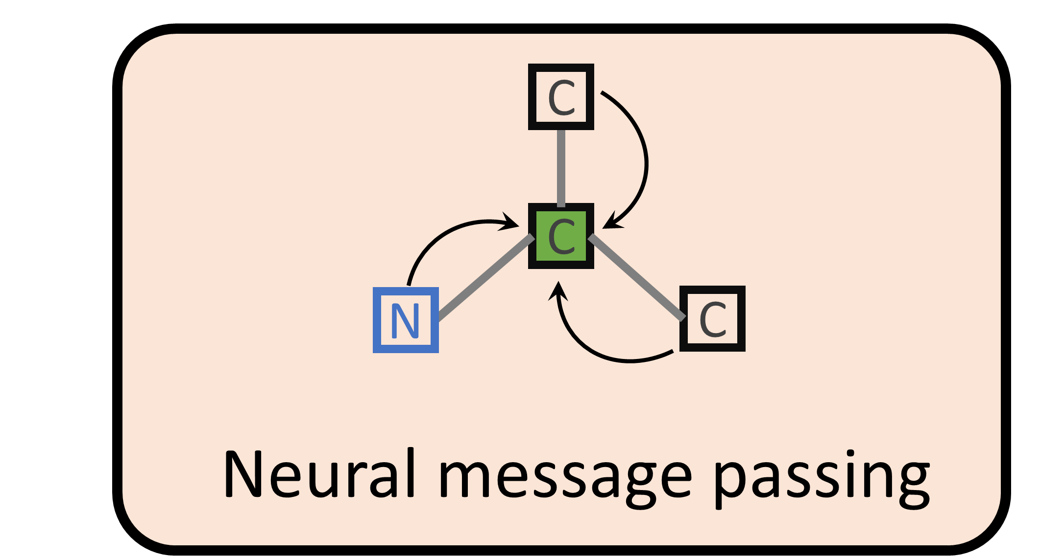
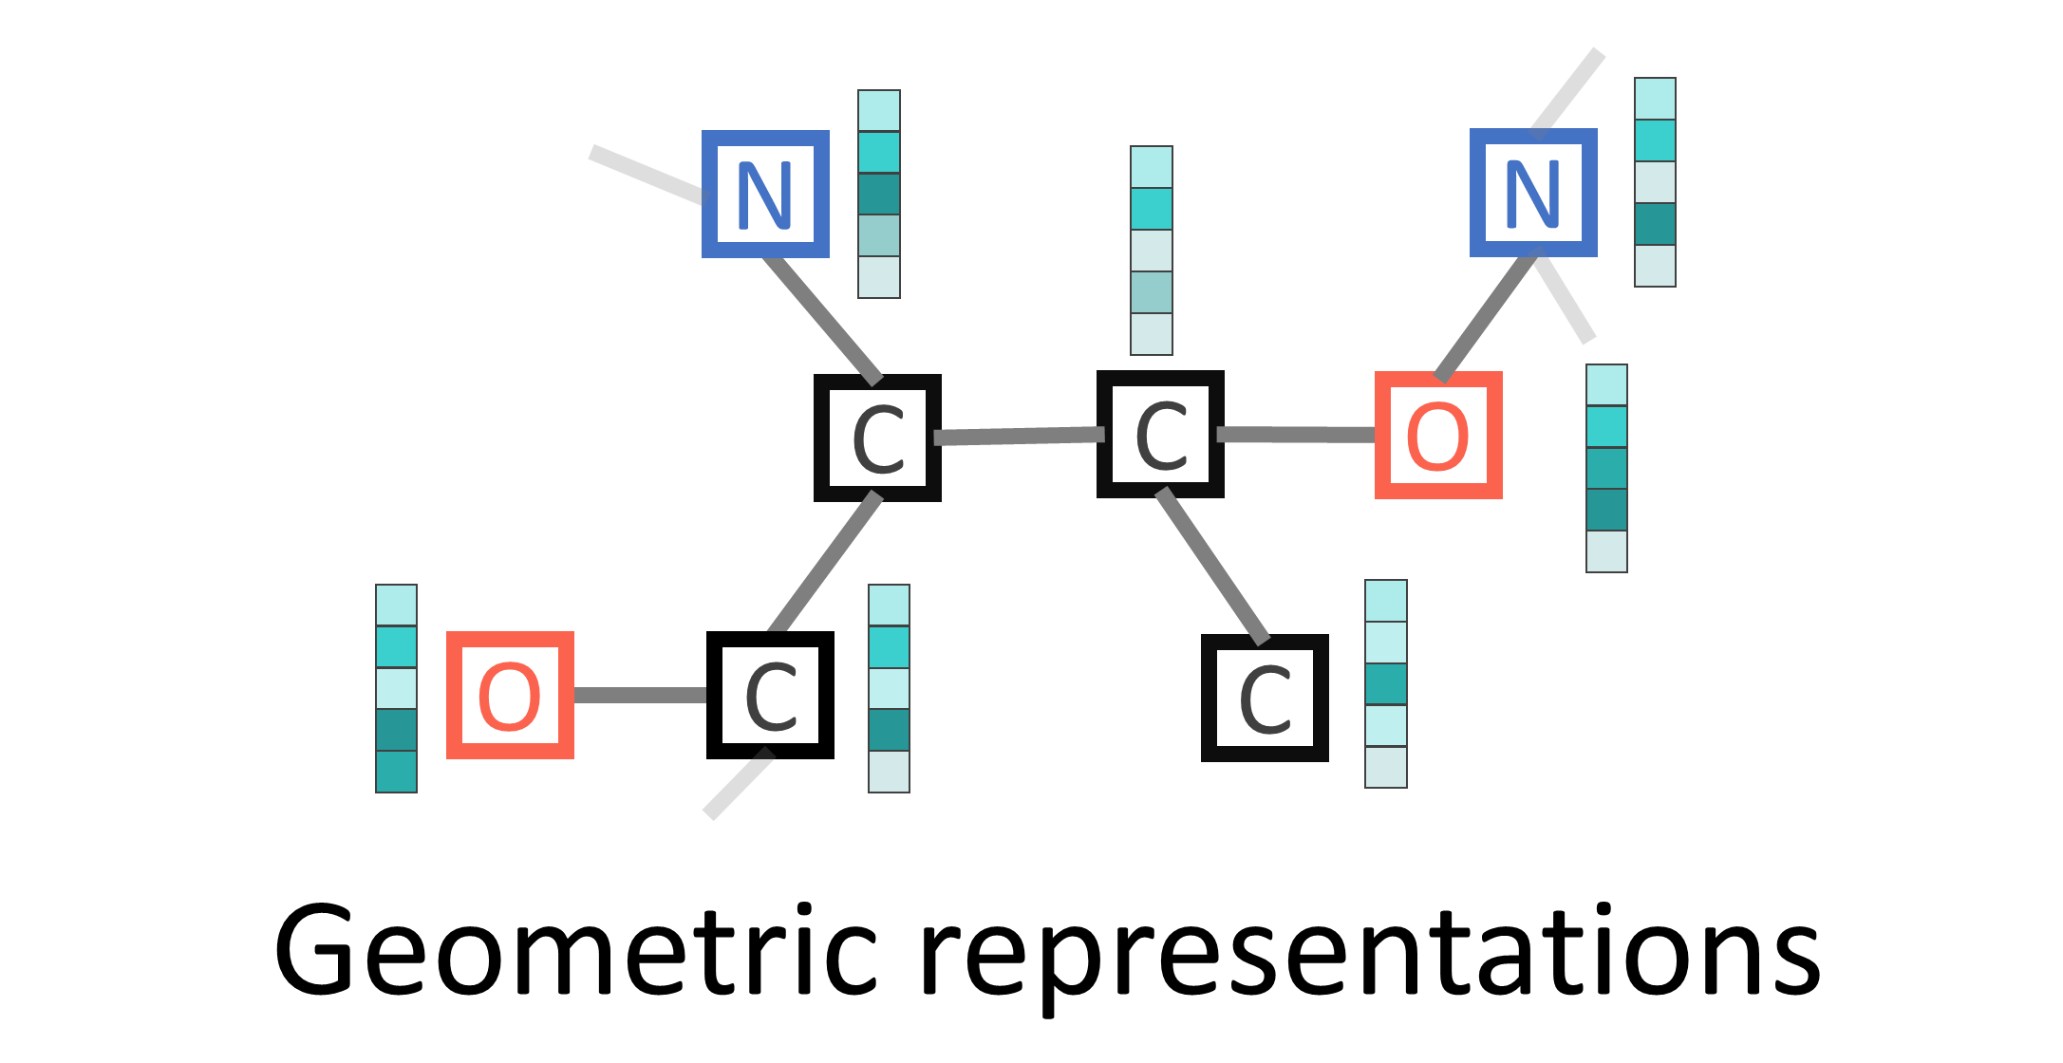
2.1 Self-supervised learning
Geometric encoder
Graph neural network
Notes:
we first represent the protein structure as a geometric topology, where each node stands for a atom and the edge stands for the chemical bonds between them. And then, we introduce a graph neural network to handle this geometric topology by performing neural message passing. # The graph neural network learns the representation of nodes based on the topological graph structure. The graph neural network follows the neighborhood aggregation strategy. In this strategy, we iteratively update the representation of the node by aggregating the features of the neighboring nodes. After multiple iterations, the representations of the node will capture the structural information in its neighborhood

Slide 12
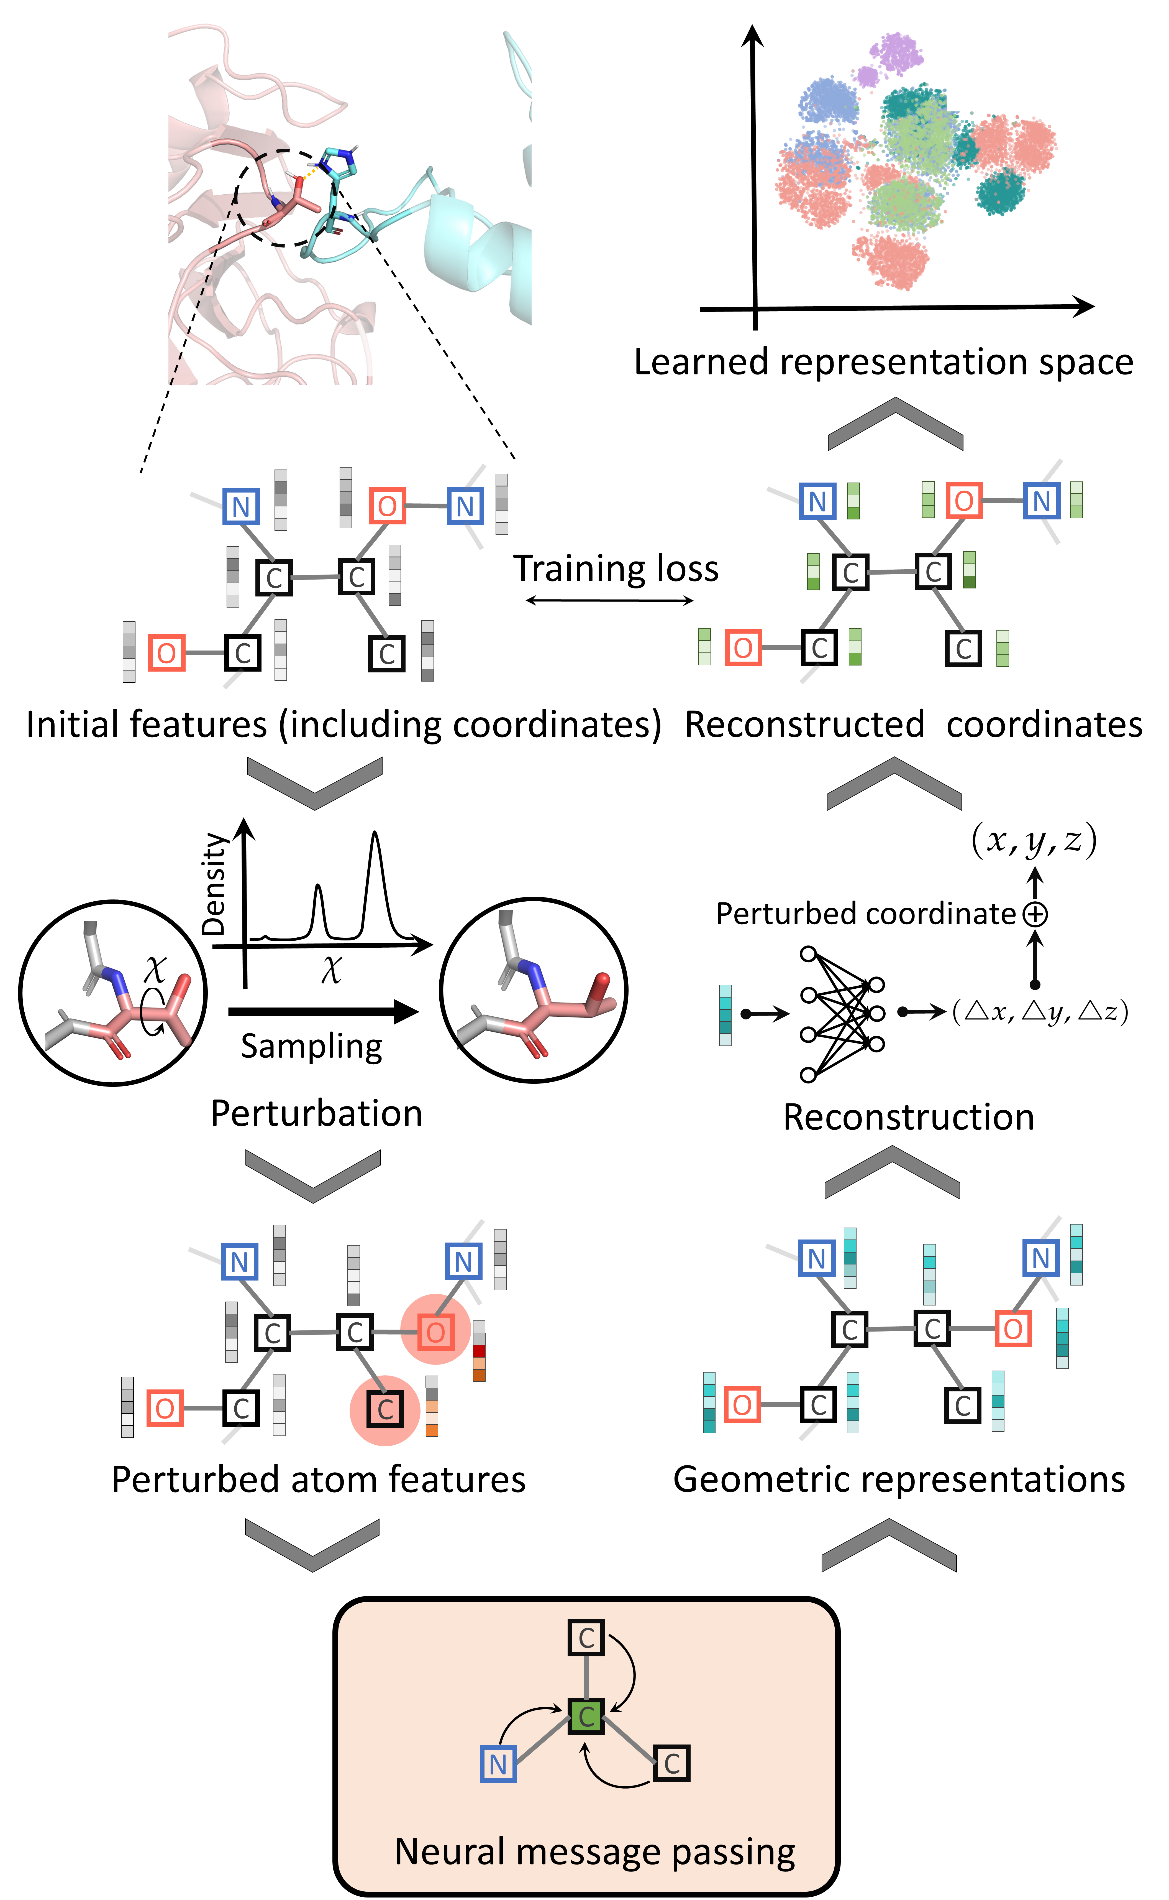
2.1 Self-supervised learning
Step 2: reconstruction
Meaningful representations
18744 complexes
1000 times of perturbation
Totally 18744000 training samples
perturbation
Reconstruction
Graph neural network
Notes:
The second step of our self-supervised learning process is reconstruction. As said before, The graph neural network performs information transmission and feature extraction of adjacent nodes, and obtains the structural representation of the protein. Then, We use a fully connected network to reconstruct the coordinates of the perturbed atoms based on these structural representations. Next, #We train the graph neural network by comparing the reconstructed coordinates with the original coordinates. For the training data, #We first collected more than eighteen thousand complexes, we then randomly perform 1000 times of perturbations on each complex. finally we obtained more than eighteen million training samples. Through this self-supervised learning method, #we hope to learn some meaningful representations from a large amount of protein structure data, so as to help the downstream affinity prediction tasks.

Slide 13
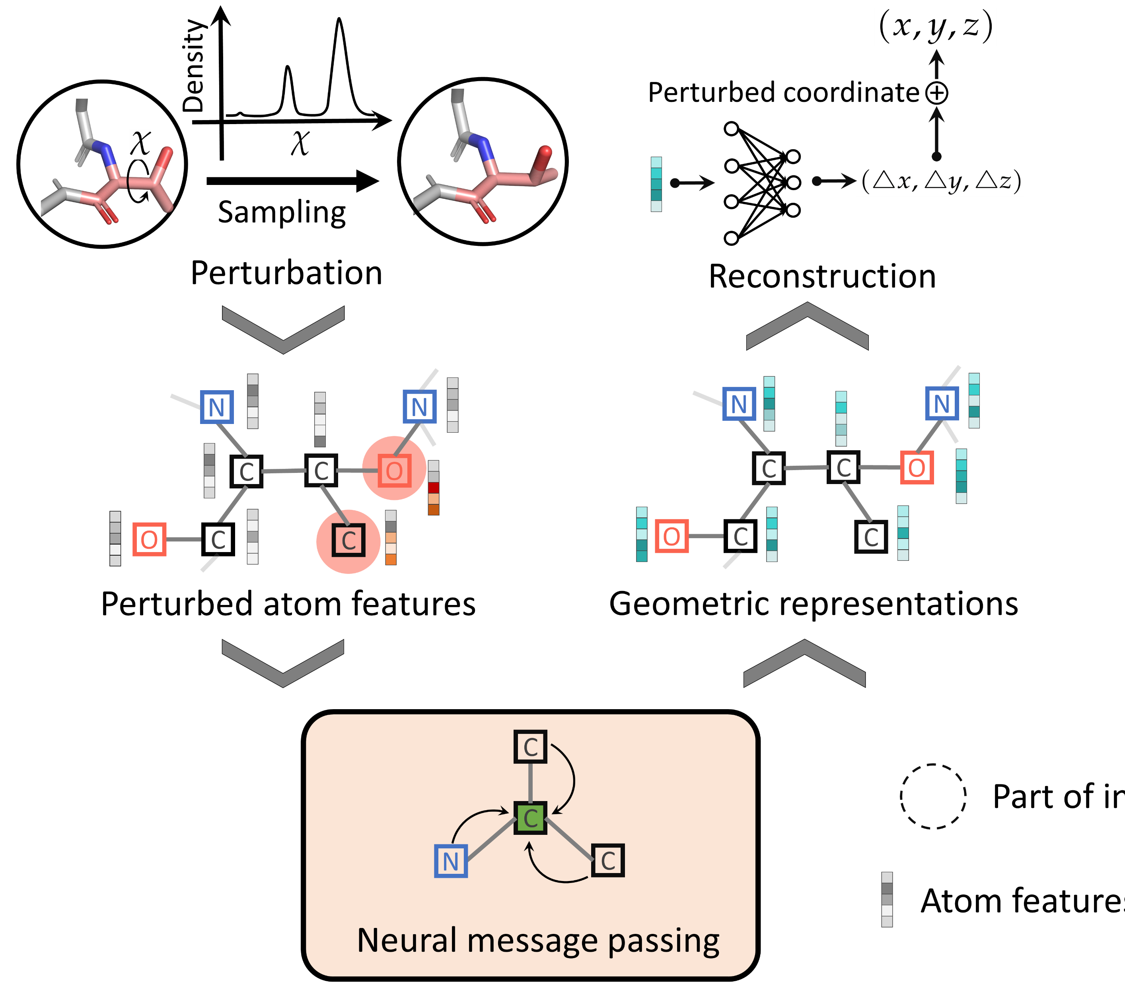

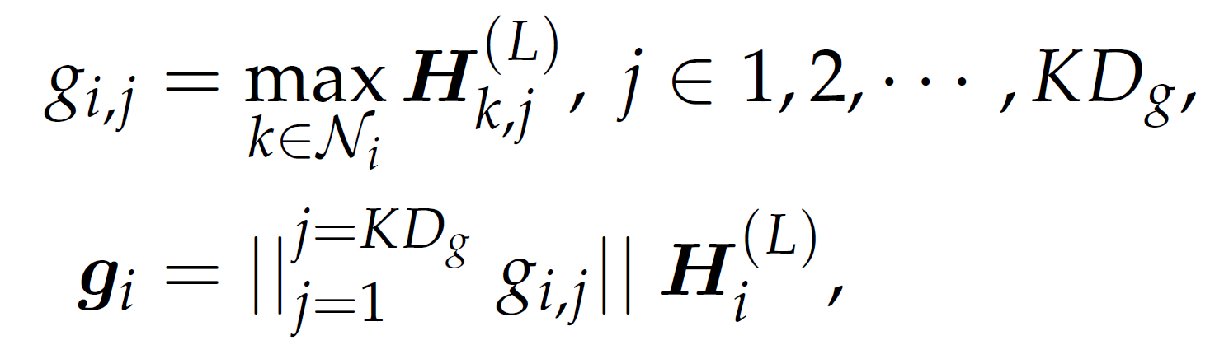

2.1 Self-supervised learning
Question: The geometric features of original structure are zeros?
Max-pooling to encourage large features
Notes:
In this way, we hope our neural networks can capture the difference between the natural structure and the mutated structure. You may also ask, if the input is the original structure, are the features outputted by graph neural networks are zeros? The answer is no. we expect the features outputted by graph neural networks are large values, which contain the information of difference between the natural and mutated structure. To achieve it, # we use max pooling operation to aggregate the neighboring atoms, therefore, features with large values will be selected to characterize the structures of proteins.

Slide 14
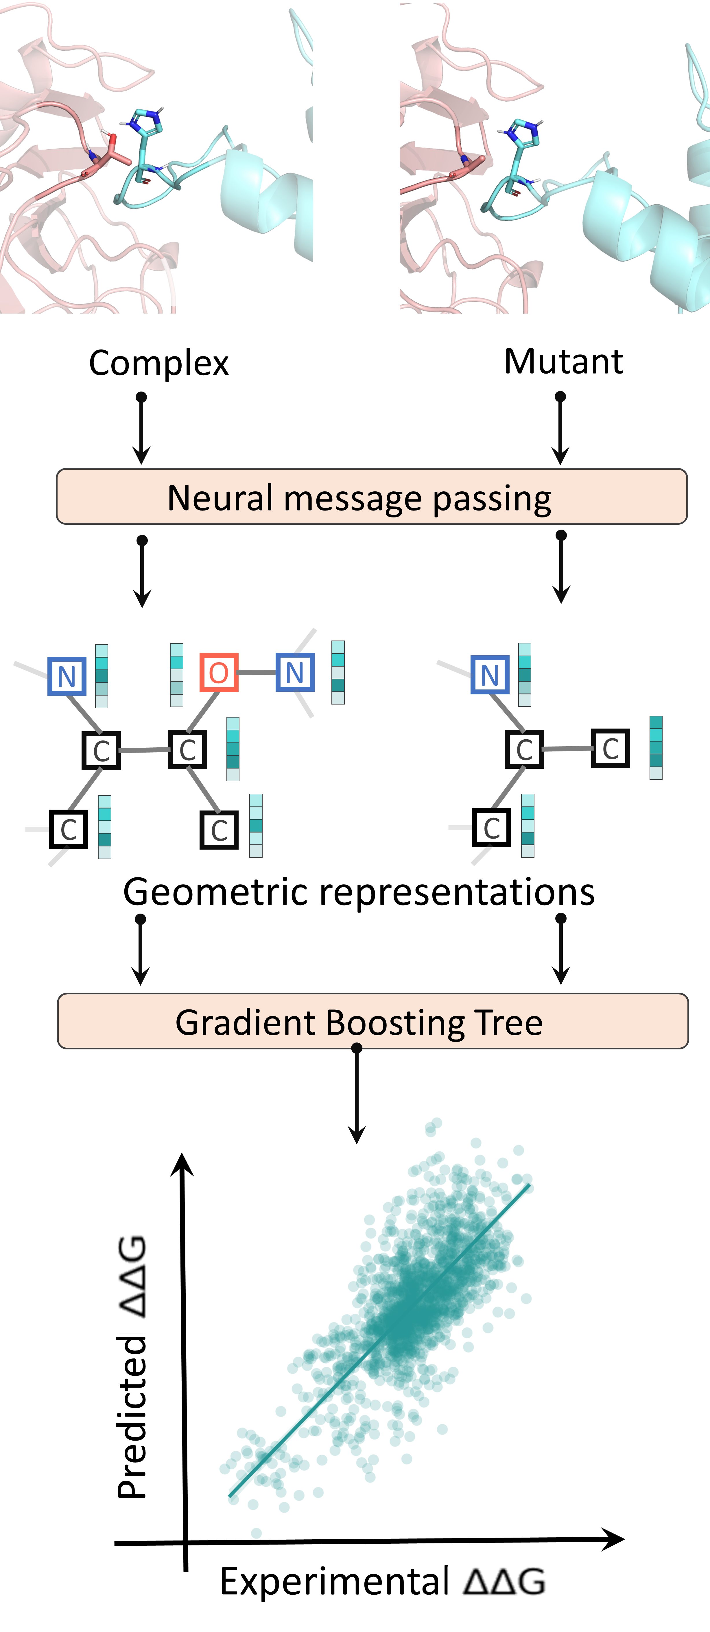
2.2 GeoPPI: prediction process
PPI prediction:
Graph neural network
梯度提升树预测器
Notes:
Besides the self-supervised learning process. Below, we introduce the second step of our framework. That is, we predict the PPI affinity based on the geometric representations produced by the trained graph neural network. Our prediction task is supervised learning. The main process is to extract the features of the protein complexes as well as those of the mutant by the graph neural network, # and then, we feed them into the gradient boosting tree to predict the change of the binding affinity.

Slide 15
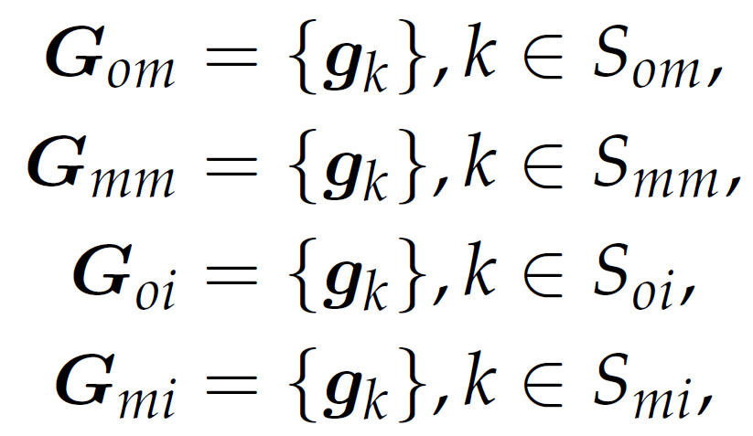
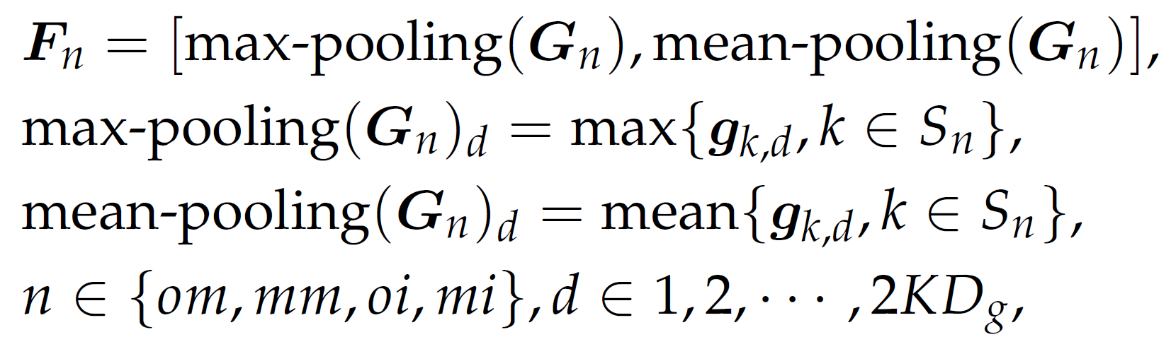
2.2 GeoPPI: prediction process
Feature extraction:
Features of mutations
Features of the interface
Dimension reduction：
Output:
Notes:
To be more specific, the prediction process can be divided into three steps, that is, feature extraction, dimension reduction, and output of the results. # Gk stands for the learned geometric representations for atom K. in feature extraction, we collect the representations of the atoms in mutated residues, and the representations of the atoms in the interface. Then, # we use max-pooling operation and mean pooling operation to construct features of mutation. Finally, # we take these constructed features as the input of gradient boosting tree, to predict the mutation impacts, which is also called delta delta G.

Slide 16
Notes:
Here, we provide an overview of the GeoPPI pipeline. GeoPPI consists of two parts, including the self-supervised learning scheme and the prediction process. during the self-supervised learning scheme, # a geometric encoder learns to reconstruct the original structure of a complex given the perturbed one. The geometric encoder is a neural network that performs the neural message passing operation on graph structures. The prediction process of GeoPPI, # use the trained geometric encoder to produce geometric representations for a given wild-type complex and a mutant, respectively. Finally, a gradient boosting tree takes these representations as the input to predict the corresponding affinity change.

Slide 17
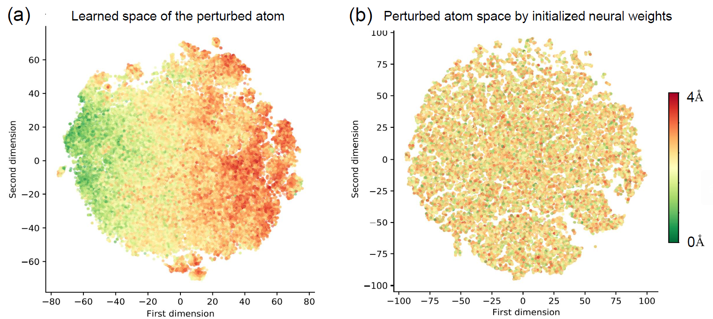
3.1 Experiment: representation space
Notes:
In the experiment, we attempt to explore whether the geometric representation learned by the self-supervised strategy is meaningful or not. Therefore, first of all, we tried to test whether the trained geometric encoder in GeoPPI is sensitive to abnormal interactions between atoms. To this end, # we randomly selected an atom in a complex and perturbed its coordinates. # Then we fed the perturbed structure of the complex into the geometric encoder and # obtained the geometric representations of the corresponding perturbed atom. # As shown in the figure, we employed the t-SNE technique to perform dimension reduction and visualize them , where the color indicates the perturbed distance. We noticed that, if the geometric encoder is not trained, all the perturbed atoms are scattered uniformly in the atom space, showing that the geometric encoder initially fails to recognize the abnormal interactions in proteins. After the self-supervised learning scheme, the geometric representations of the perturbed atoms are arranged orderly in terms of the first dimension. This comparison demonstrates that the trained geometric encoder can detect the abnormal binding interactions between atoms in a complex.

Slide 18
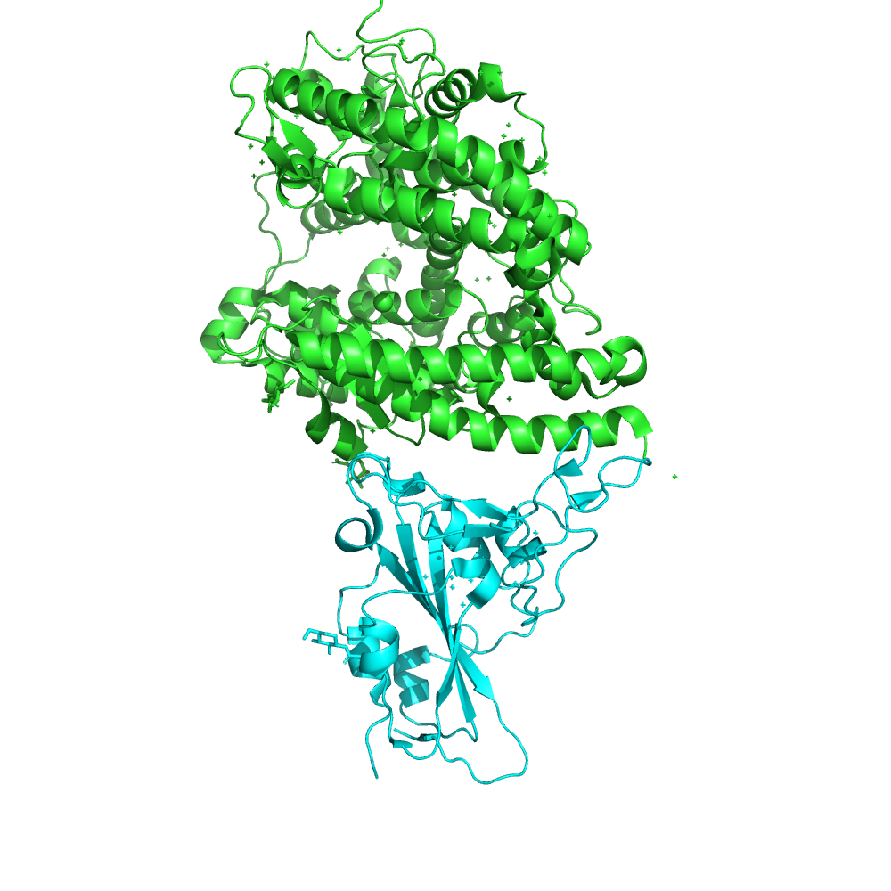
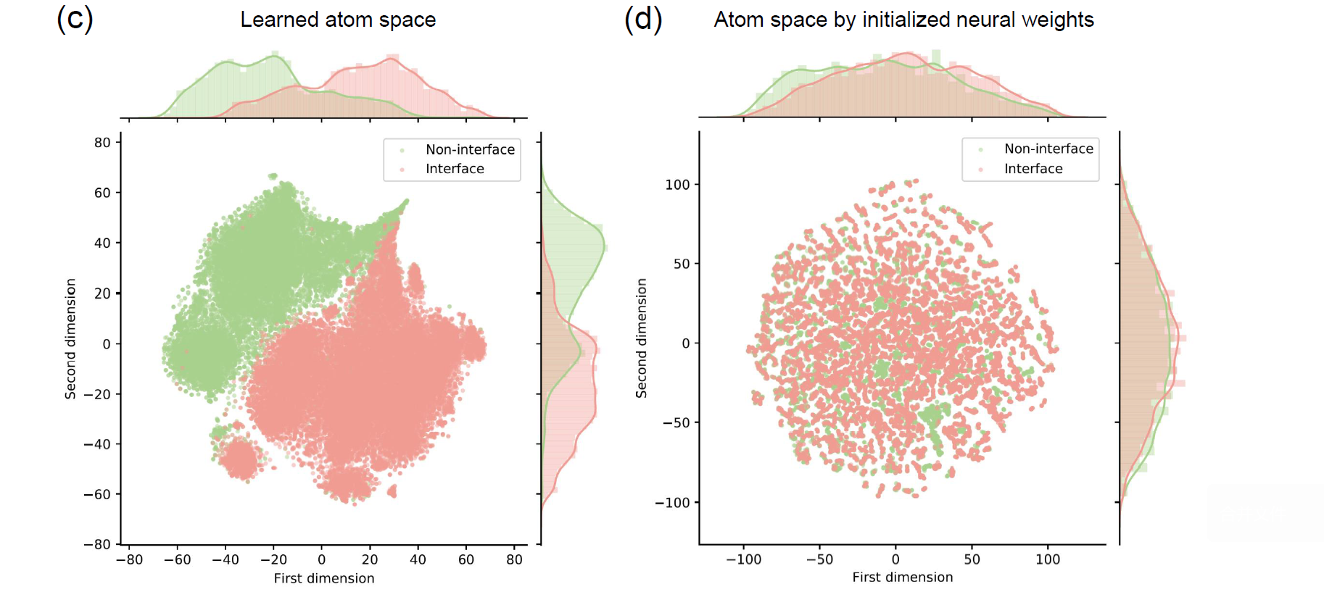
3.1 Experiment: representation space
Notes:
Next, we tried to investigate whether the trained geometric encoder can identify the interface region of the complexes. As expected, # with the self-supervised learning scheme, the two distributions of the residues on and not on the interface become dramatically different in the two dimensional space reduced by t-SNE.

Slide 19
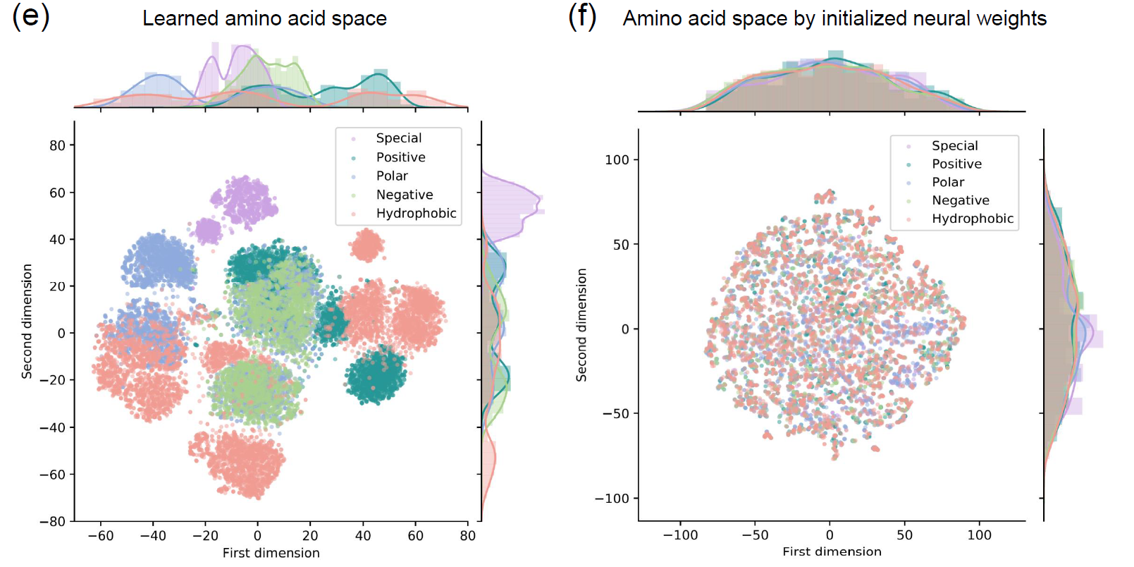
3.1 Experiment: representation space
The first study that uses self-supervised learning strategies to learn protein representations
Notes:
Finally, we try to test whether the trained geometric encoder can capture the fundamental characteristics of individual residues, such as hydropathy and charge. Interestingly, although we did not input the biochemical properties of amino acids, the representation of amino acids obtained by our graph neural network can be automatically clustered according to their biochemical properties, such as positive, negative, polar, hydrophobic and special-case. #And if there is no self-supervised learning, the representation of the neural network output is messy. It shows that self-supervised learning enables the graph neural network to learn meaningful rules in protein structure. #This is also the first study using self-supervised learning strategies to characterize the geometric topology of proteins.

Slide 20
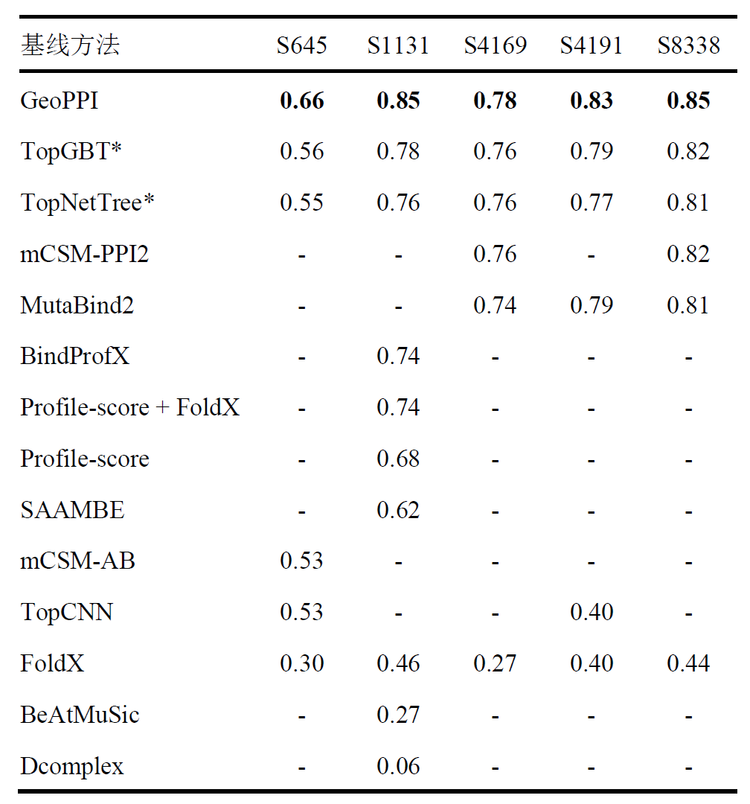
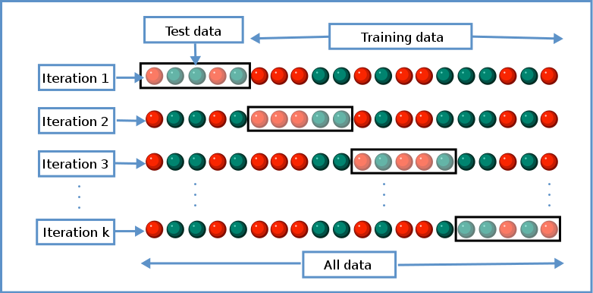
3.2 Experiment: cross-validation
PPI dataset
Pearson correlation
dataset | # complex | # Variants
S645 | 24 | 645
S1101 | 32 | 1101
S1131 | 45 | 1131
S4169 | 120 | 4169
Cross-validation test
Gufosowa
Notes:
Below, we use the protein mutation data set to measure the predictive performance of our GeoPPI. Specifically, we use a 10-fold cross-validation experiment to test our model. #10-fold cross-validation experiment is to divide the data into 10 parts, one tenth of which is used as the test data, and the remaining part is used to train the model. We Repeat this 10 times, and then report the overall predictive performance. # We found that the affinity prediction performance of our model GEOPPI significantly surpasses the best existing models, and the improvement in prediction correlation is up to 10 percent.

Slide 21
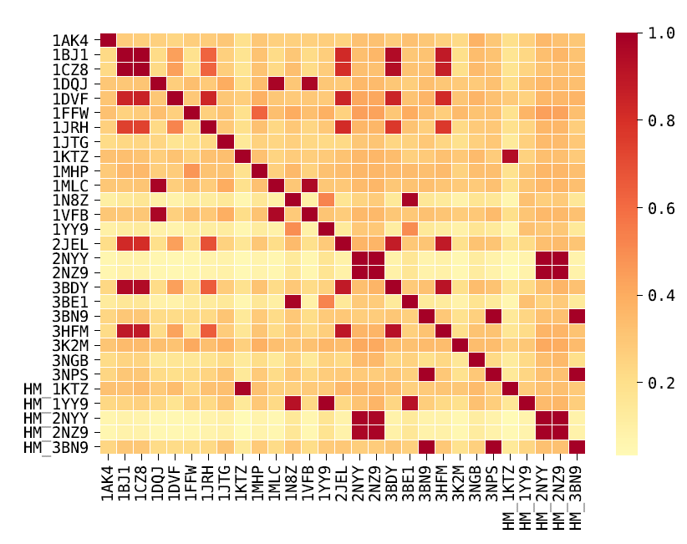
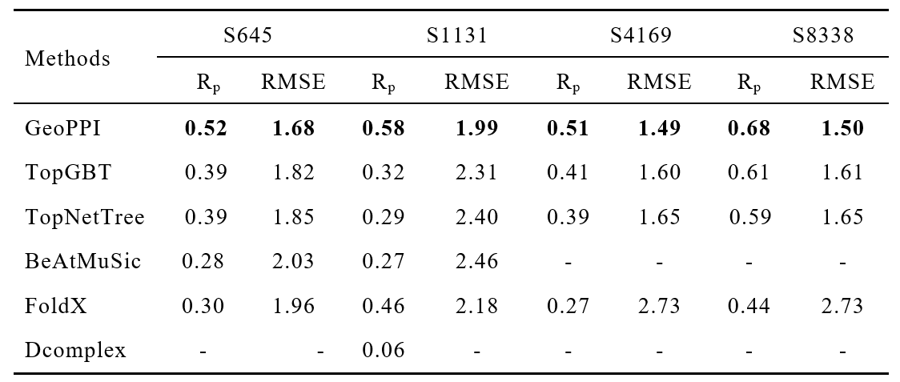
3.2 Experiment: cross-validation
PPI dataset
dataset | # complex | # Variants
S645 | 24 | 645
S1101 | 32 | 1101
S1131 | 45 | 1131
S4169 | 120 | 4169
Similarity
Split-by-structure cross-validation
The first to adopt such a strict evaluation criteria
Notes:
At the same time, we found that there is a strong similarity between the structures of different complexes in the data set, and the current mainstream methods have not considered this. This will cause the over-fitting problem of the machine learning model, because the model may only remember Training samples without generalization. #In order to better measure the generalization of the model, when we are doing cross-validation experiments, we use different structures as the training set and test set, respectively. For the first time, we adopted this more rigorous testing criteria and discovered the problem of the overestimation of the previous existing models. At the same time, we observed that our model is significantly better than other prediction models on the four data sets, which proves the accuracy and generalization of GeoPPI.

Slide 22
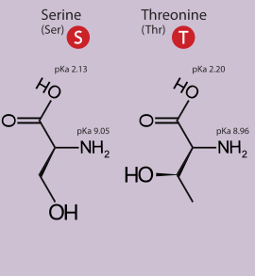
3.3 Experiment: conservative mutations
Two amino acids with similar biochemical properties.
Notes:
To further understand why GeoPPI can achieve better prediction performance, we analyzed its behavior on the most difficult mutation cases, that is, the most conservative mutations. Here, we defined the most conservative mutation as the substitution that happens between two amino acids that share similar biochemical properties and have only a single atom difference. As shown in subfigure (a), # In spite of the minimum structural changes in these mutations, the binding affinity may also be substantially influenced. # We collected the predictions of GeoPPI and TopGBT on the most conservative data points from the S645 dataset. We found that GeoPPI obtains a correlation of seventy percents while TopGBT only yields a correlation of twenty one percents. GeoPPI has been shown before to be sensitive on the atom level, which is one of the reasons why it performs much better than TopGBT in this setting. In addition, # we also notice that our model can significantly accelerate the prediction speed of the existing methods.

Slide 23
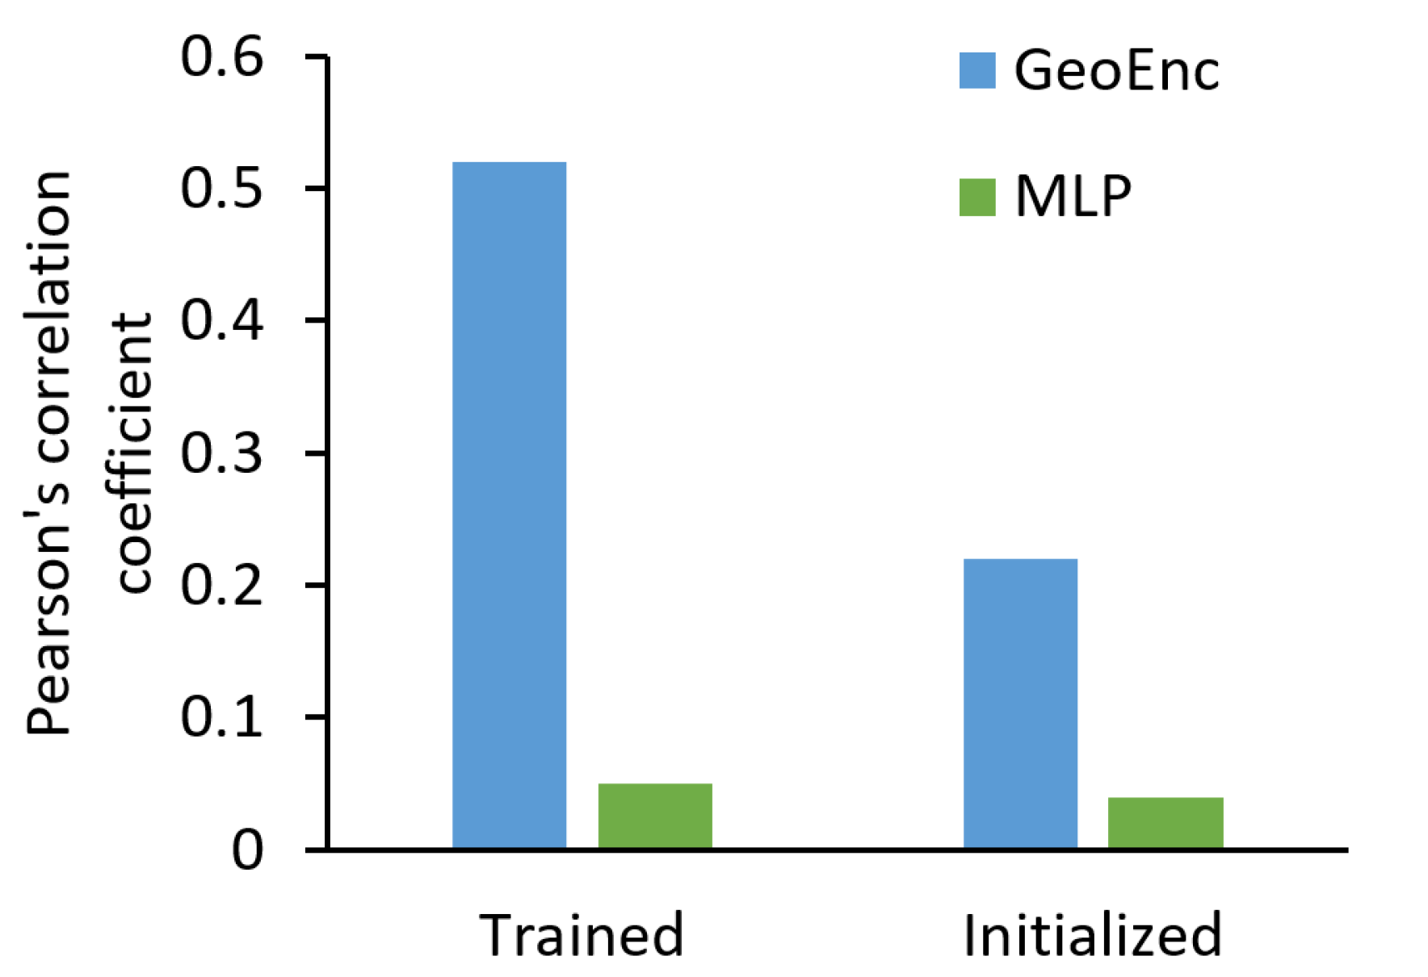
3.4 Experiment: ablation study
Notes:
We also conducted a series of ablation studies to investigate the influences of different design choices of GeoPPI on the prediction performance. We first compared the difference in the performance of GeoPPI with and without the self-supervised learning. As shown in the picture, without a self-supervised learning scheme, GeoPPI shows a significant decrease in prediction performance. This result shows that the well-designed self-supervised learning scheme greatly improves the predictive power of GeoPPI. Next, the ablation study on a key component in GeoPPI, # i.e., the geometric encoder, further confirms that it plays a critical role in representing the complex structures. And It is superior to other neural networks, such as the multiple layer perceptron.

Slide 24
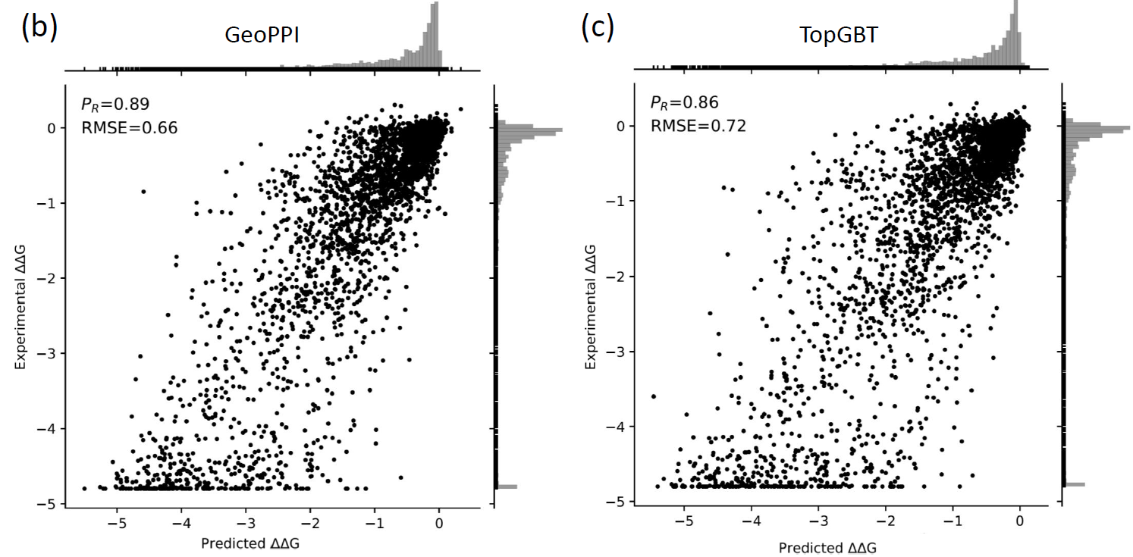
3.5 Experiment: SARS-CoV-2 & human
Prediction performance on the complexes of SARS-CoV-2 bound with human host cell ACE2
Host cell ACE2
SARS-CoV-2
Notes:
Next, we took covid-19 as an example to test the realistic utility of our framework. We collected a dataset that contains more than three thousand mutations of SARS-CoV-2 and the corresponding affinity changes when it is bound to the human host cell ACE2. # Considering that GeoPPI obtains a correlation of eightt nigh percent, our test results demonstrated that GeoPPI is able to accurately capture the effects of mutations on SARS-CoV-2.

Slide 25
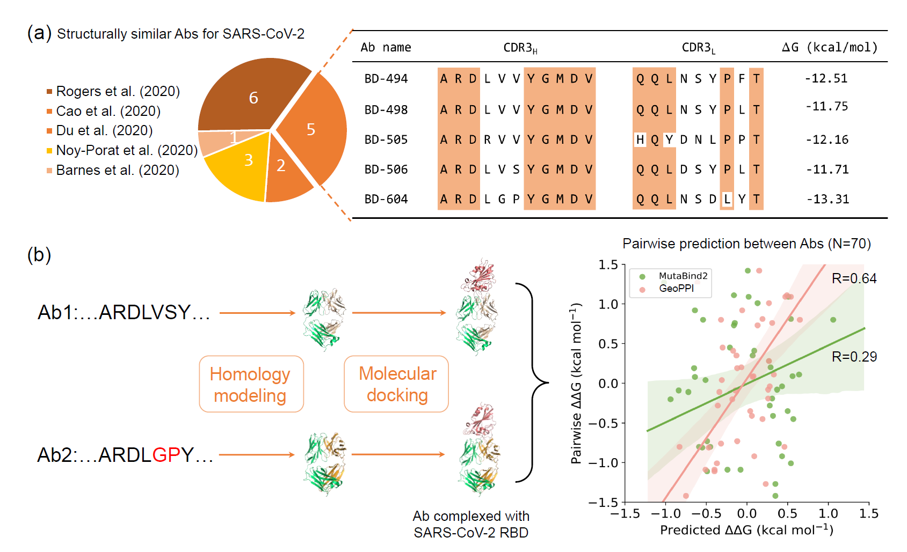
3.6 Experiment: SARS-CoV-2 & antibody
利用同源建模方法估计抗体的三维结构
Notes:
In view of the above prediction performance, we further investigated the application potential of the GeoPPI model in reality. We collected 17 sars-cov-2 antibodies with similar structures and the corresponding binding affinity. These sars-cov-2 antibodies can be transformed into each other through multiple mutations. We use GeoPPI to predict the affinity gap between them. However, since we only know the sequence structures of these antibodies, it is very difficult to predict the affinity based on the sequence information alone. # Therefore, we first tried rossetta homology modeling and docking to obtain the three-dimensional structure of the complexes, where these antibodies bind to the sars-cov-2. Then we use GeoPPI to predict the difference in binding affinity between the two antibodies. We found that the correlation between the predicted value and the measured value is sixty percent, while the best existing prediction tool has a correlation of only thirty percent. It further illustrates the superior predictive performance of our model.

Slide 26
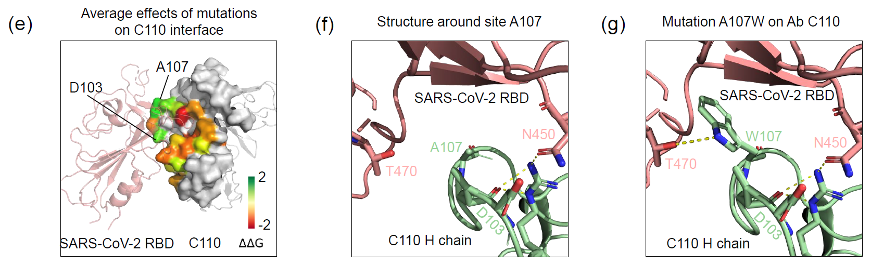
3.6 Experiment: antibody optimization
Antibody optimization towards higher binding affinity
The proposals generated by GeoPPI are reasonable.
26
Notes:
Based on this performance, we try to optimize the neutralizing antibody to make it with higher binding affinity with sars-cov-2. We chose antibody C110. We searched for single-point mutants from all amino acids on the contact surface of C110, and we selected the mutation with the highest value predicted by GeoPPI. We found the site A107 is predicted to have the most positive impact. We further explored why this mutation can enhance affinity. #The last two pictures show the structures of C110 before and after the mutation of A107W, respectively. We found that after A107 is mutated to tryptophan, it will have one more hydrogen bond with sars-cov-2 RBD protein, thus increasing the strength of the interaction between the two proteins. #Therefore, it shows that the optimization suggestions provided by the GeoPPI are reasonable.

Slide 27
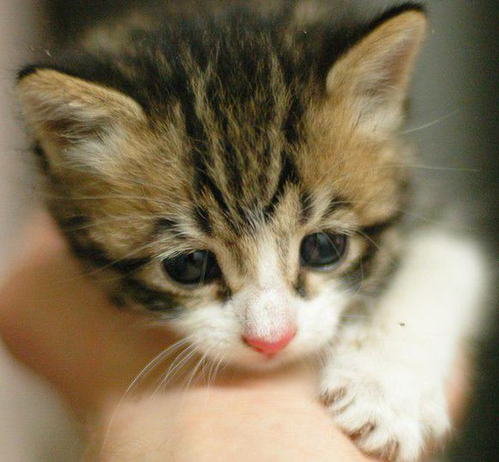

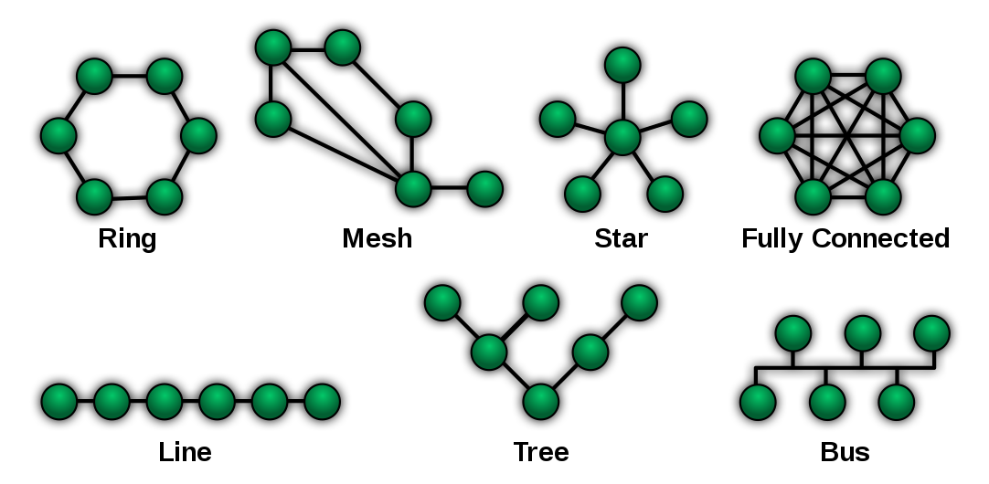
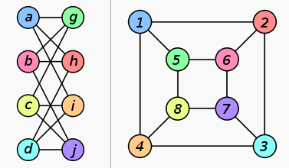
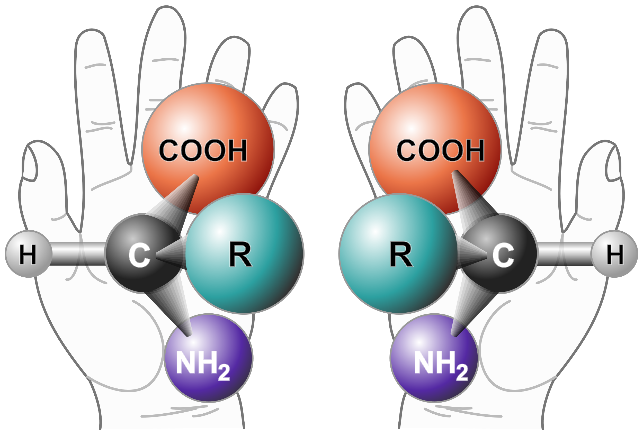
4. Future work
2012 CNN
2013 CNN/LSTM
2016 Graph neural Network
?
Isomorphism
Chirality
Notes:
As we all know, the deep learning technology has achieve great success in processing the real-world data and shows promising results in various applications. the main breakthrough happened in 2012, where the convolutional neural network is proposed to handle image data. Afterward, # CNN and LSTM are the two popular tools for the natural language processing. As for the graph data, # graph neural networks are proposed in 2016. life seems perfect, right? However, we still can not address the isomorphism problem, which is the distinguish whether the given two graph is the same structure. Further, the current graph neural network can not address the chirality problem, either. In the view of graph neural network, these two atom graphs are the same. So, we are seeking for a more powerful computational technique to address these problems. And the protein structure is a suitable form for us to use and analyze. In the future, we are going to develop more structure learning algorithm to represent the graph data.

Slide 28
Acknowledge
Thank You!
Q&A
Notes:
Finally, thanks for your attention. If you have any questions, I am very glad to discuss with you. Thank again!

