Slide 1
From AlphaGo to MuZero
A brief analysis of the evolution of artificial intelligence algorithms
Longfei Zhang
PhD student, a visiting scholar of Tsinghua University

Slide 2
Outline
1. Prerequisites
2. AlphaGo’s algorithm
3. The specific of AlphaGo Zero/AlphaZero
4. brief introduction about Muzero
5. Latest research and Research institutions

Slide 3
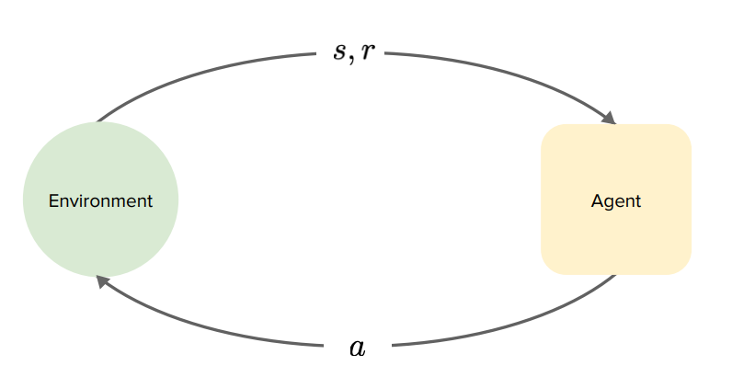
Sequential decision making
Prerequisites

Slide 4
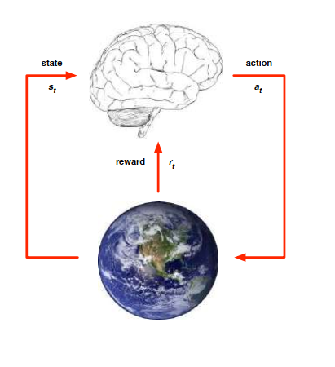
Prerequisites
At each step $t$ the agent:
Receive state $s_{t}$
Receive scalar reward $r_{t}$
Executes action $a_{t}$
The environment:
Receive action $a_{t}$
Emits state $s_{t}$
Emits scalar reward $r_{t}$

Slide 5
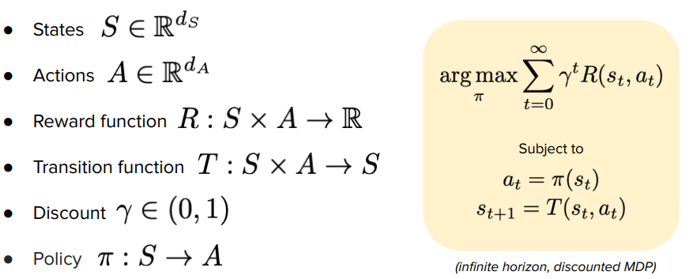
Prerequisites

Slide 6
Reinforcement Learning
RL is a general-purpose framework for decision-making
RL is for an agent with the capacity to act
Each action influences the agent’s future state
Success is measured by a scalar reward signal
Goal: select actions to maximize future reward

Slide 7
Deep Learning
DL is a general-purpose framework for representation learning
Given an objective
Learn representation that is required to achieve objective
Directly from raw inputs
Using minimal domain knowledge

Slide 8
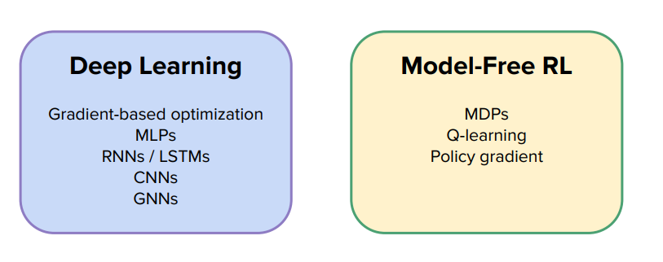
Deep Learning and Reinforcement Learning

Slide 9
Deep Reinforcement Learning: AI = RL + DL
We seek a single agent which can solve any human-level task
RL defines the objective
DL gives the mechanism
RL + DL = general intelligence

Slide 10
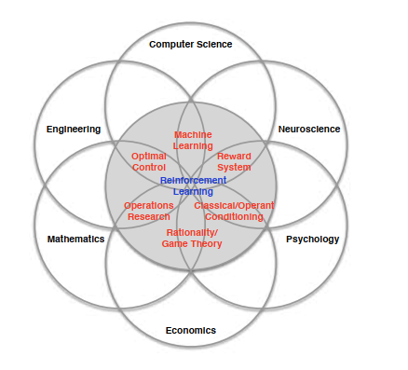
Many faces of Reinforcement Learning

Slide 11
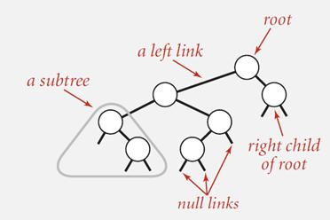
Tree Search

Slide 12
Go in numbers

Slide 13
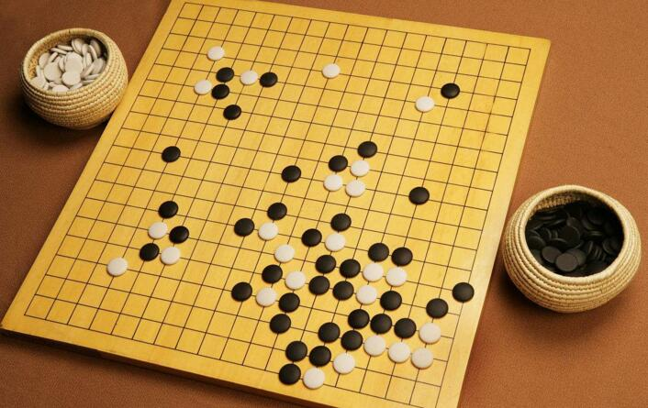
Why is Go hard for computers to play?
Brute force search intractable:
1. Search space is huge
2.“Impossible” for computers
to evaluate who is winning
Game Tree complexity = $b^{d}$
For chess$b≈35, d≈38$
For Go$b≈350, d≈150$

Slide 14
How to solve this problem?
Reduce the search space:
1. The depth of the search may be reduced by position evaluation: truncating the search tree at state s and replacing the subtree below s by an approximate value function v(s)≈v*(s) that predicts the outcome from state s.
2. The breadth of the search may be reduced by sampling actions from a policy p(a|s) that is a probability distribution over possible moves a in position s.

Slide 15
How has AlphaGo solved this problem?
Before AlphaGo
The strongest Go programs are based on MCTS, enhanced by policies that are trained to predict human expert moves(Supervised Learning : SL, not RL). These policies are used to narrow the search to a beam of high-probability actions, and to sample actions during rollouts. This approach has achieved strong amateur (not professional)play.
However, prior work has been limited to shallow policies or value functions based on a linear combination(Not Deep Neural Network)of input features

Slide 16
How has AlphaGo solved this problem?
AlphaGo : MCTS + SL + DL + RL
They pass in the board position as a 19×19 image(input) and use convolutional layers (DL)to construct a representation of the position. They use these neural networks to reduce the effective depth and breadth of the search tree: evaluating positions using a value network and sampling actions using a policy network.

Slide 17
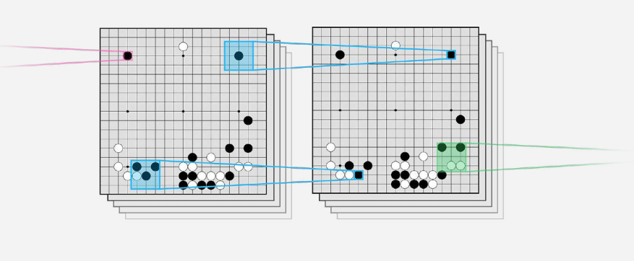
AlphaGo: Convolutional Neural Network

Slide 18
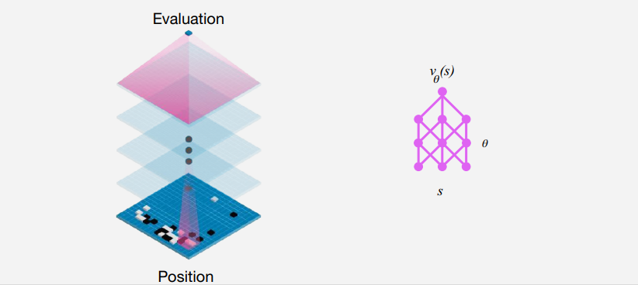
AlphaGo: Value Network

Slide 19
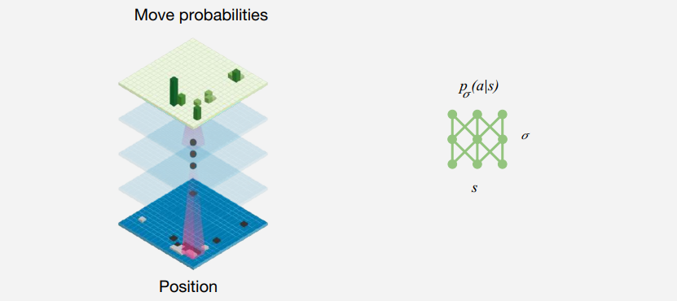
AlphaGo: Policy Network

Slide 20
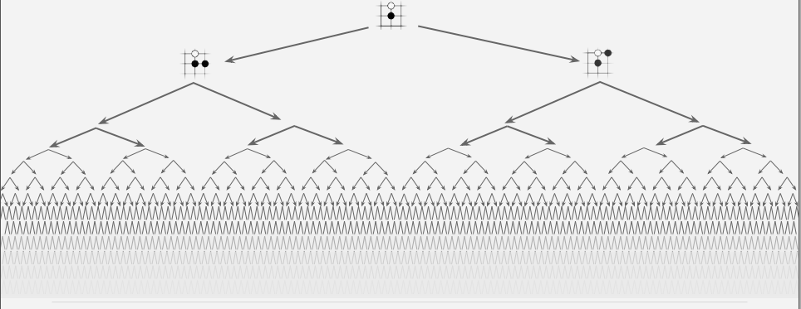
AlphaGo: Exhaustive Search

Slide 21
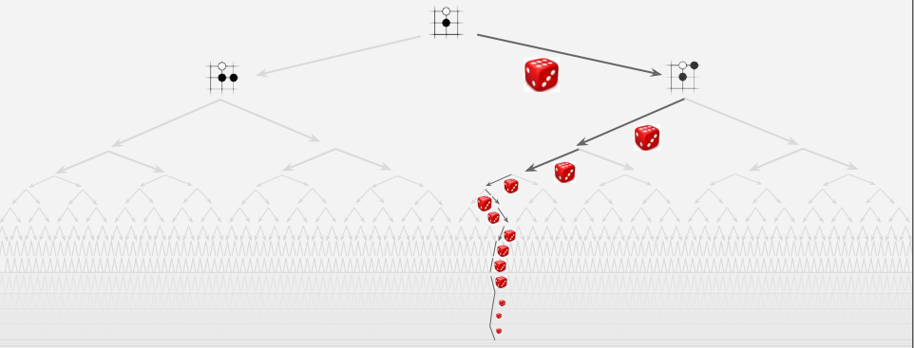
AlphaGo: MCTS

Slide 22
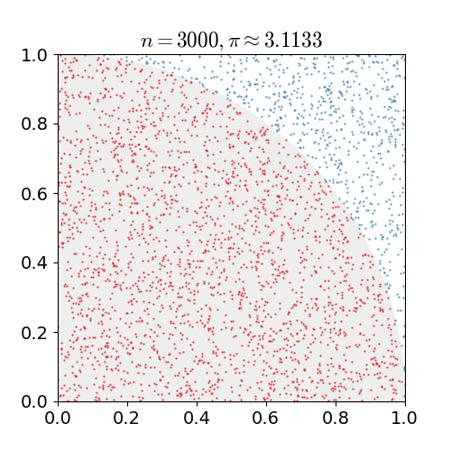
AlphaGo: MC

Slide 23
MCTS(Monte Carlo Tree Search )
MCTS uses Monte Carlo rollouts to estimate the value of each state in a search tree. As more simulations are executed, the search tree grows larger and the relevant values become more accurate. The policy used to select actions during search is also improved over time, by selecting children with higher values. Asymptotically, this policy converges to optimal play, and the evaluations converge to the optimal value function.

Slide 24
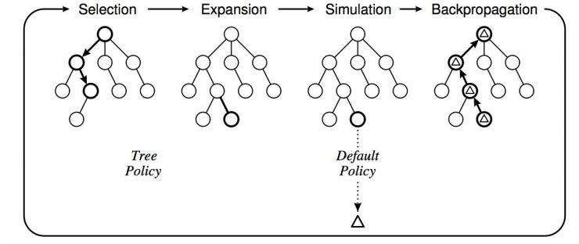
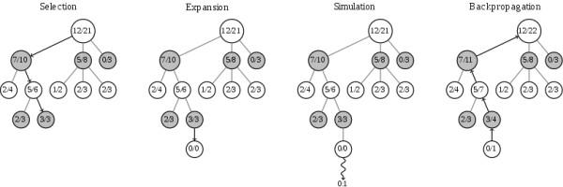
MCTS(Monte Carlo Tree Search )

Slide 25
MCTS(Monte Carlo Tree Search ) in AlphaGo

Slide 26
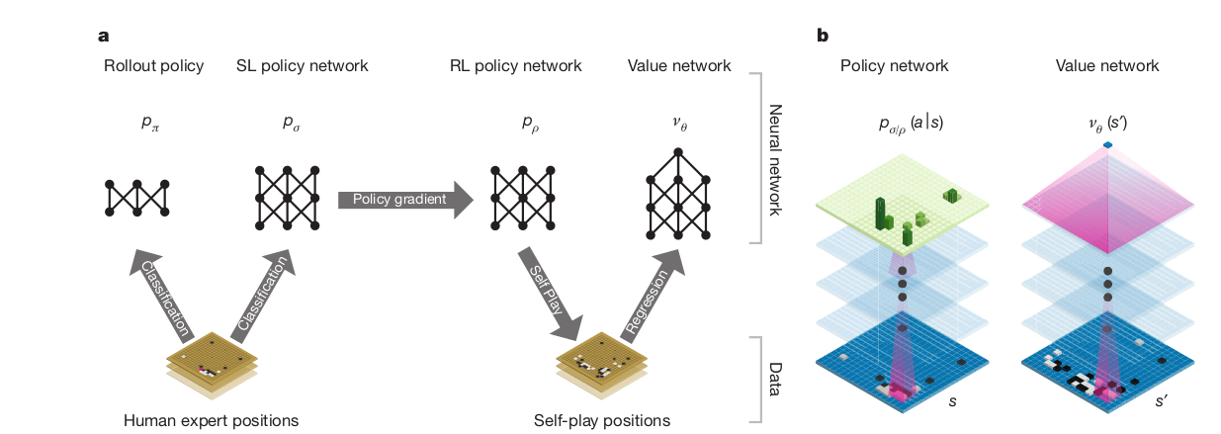
AlphaGo

Slide 27
Deep Reinforcement Learning in AlphaGo

Slide 28
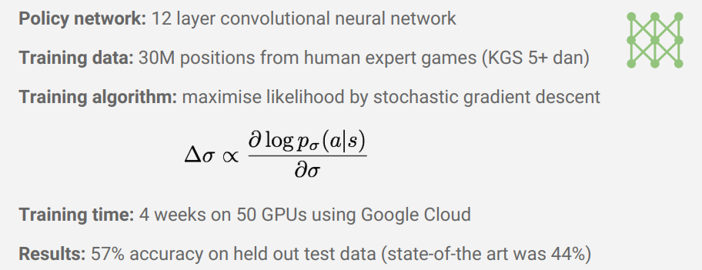
Supervised learning of policy networks

Slide 29
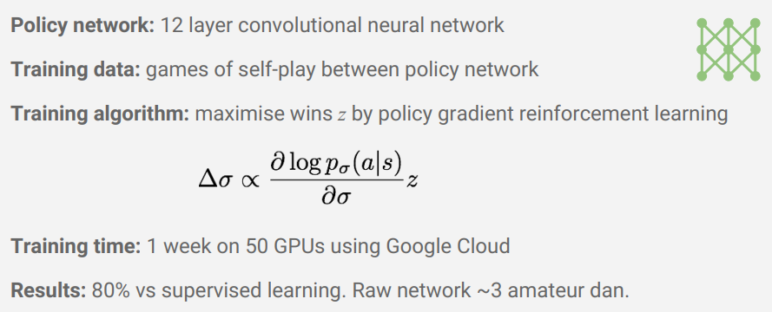
Reinforcement learning of policy networks

Slide 30
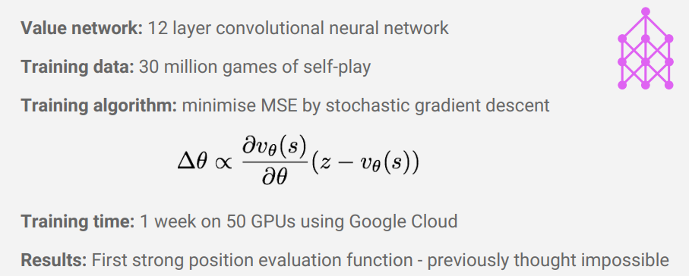
Reinforcement learning of value network

Slide 31
Deep blue vs AlphaGo

Slide 32
AlphaGo Zero
Differs from AlphaGo in 4 aspects:
1.It is trained solely by self­-play reinforcement learning, starting from random play, without any supervision or use of human data.
2.It uses only the black and white stones from the board as input features.
3.It uses a single neural network, rather than separate policy and value networks.
4.It uses a simpler tree search that relies upon this single neural network to evaluate positions and sample moves, without performing any Monte Carlo rollouts(Still use MCTS).

Slide 33
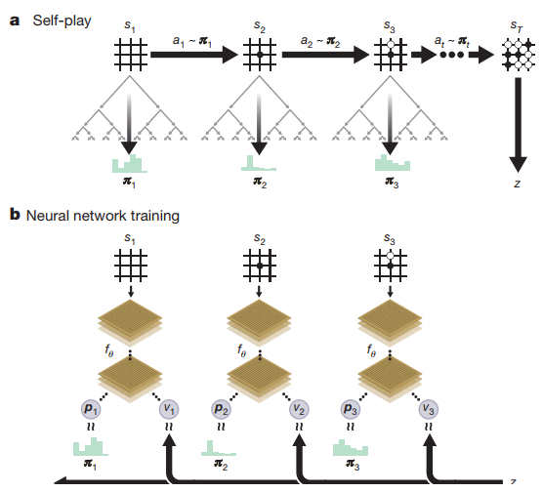
Self-play reinforcement learning in AlphaGo Zero
Notes:
a, The program plays a game s1, ..., sT against itself. In each position st, an MCTS αθ is executed (see Fig. 2) using the latest neural network fθ. Moves are selected according to the search probabilities computed by the MCTS, at∼πt. The terminal position sT is scored according to the rules of the game to compute the game winner z.
b, Neural network training in AlphaGo Zero. The neural network takes the raw board position st as its input, passes it through many convolutional layers with parameters θ, and outputs both a vector pt, representing a probability distribution over moves, and a scalar value vt, representing the probability of the current player winning in position st. The neural network parameters θ are updated to maximize the similarity of the policy vector pt to the search probabilities πt, and to minimize the error between the predicted winner vt and the game winner z (see equation (1)). The new parameters are used in the next iteration of self­play as in a.

Slide 34
Reinforcement learning in AlphaGo Zero
The neural network $\left(p,v\right)=f_{θ_{i}}(s)$ is adjusted to minimize the error between the predicted value v and the self-­play winner z, and to maximize the similarity of the neural network move probabilities p to the search probabilities π. Specifically, the parameters θ are adjusted by gradient descent on a loss function that sums over the mean­squared error and cross­entropy losses, respectively:

Slide 35
Alpha Zero
Differs from AlphaGo Zero:
generalize this approach into a single AlphaZero algorithm that can achieve superhuman performance in many challenging games. Starting from random play and given
no domain knowledge except the game rules, AlphaZero convincingly defeated a world champion program in the games of chess and shogi (Japanese chess), as well as Go.

Slide 36
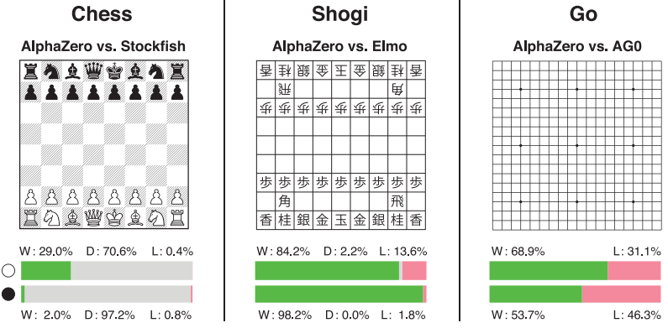
Alpha Zero

Slide 37
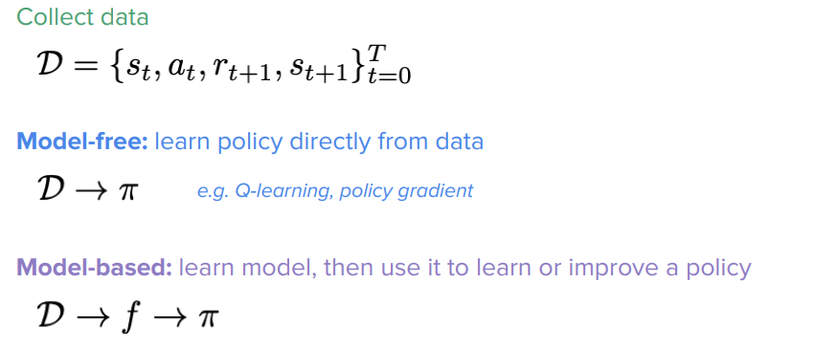
Before MuZero
Model-free vs. model-based reinforcement learning

Slide 38
What is a Model?

Slide 39
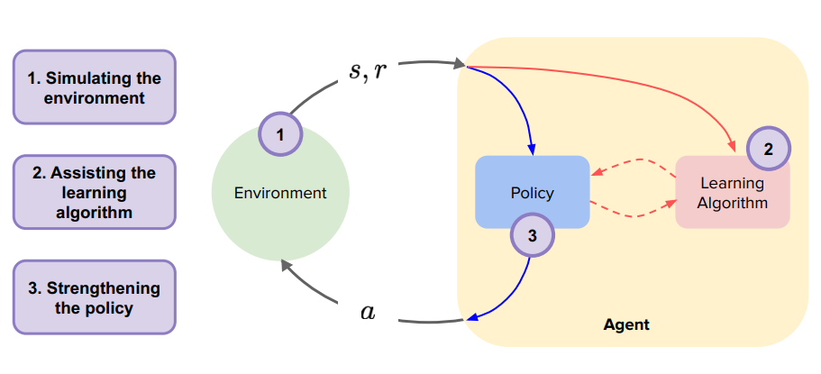
What can we do with this model?

Slide 40
Why MuZero need to learn a model?
Tree-based planning methods have enjoyed huge success in challenging domains, such as chess and Go, where a perfect simulator is available.
However, in real-world problems the dynamics governing the environment are often complex and unknown.

Slide 41
MuZero
MuZero combines a tree-based search with a learned model,
achieves superhuman performance in a range of challenging and visually complex domains(includes Go,Chess,Shogi,and Atari games), without any knowledge of their underlying dynamics(even the rule of games).
MuZero learns a model that, when applied iteratively, predicts the quantities most directly relevant to planning: the reward, the action-selection policy, and the value function.

Slide 42
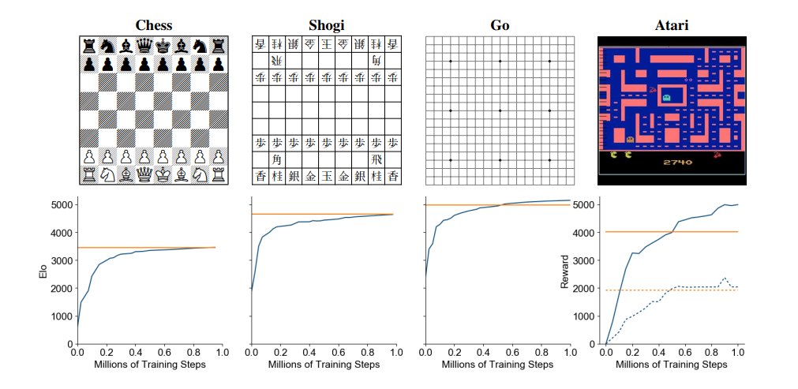
Games in MuZero
Evaluation of MuZero throughout training in chess, shogi, Go and Atari

Slide 43
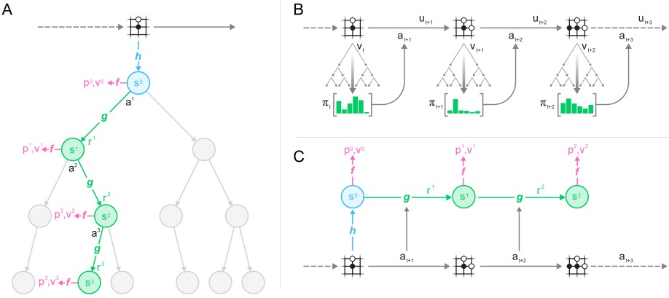
MuZero
planning,acting,and trainng with a learned model
Notes:
How MuZero uses its model to plan.The model consists of three connected components for representation, dynamics and prediction. Given a previous hidden state sk-1 and a candidate action ak, the dynamics function g produces an immediate reward rk and a new hidden state sk. The policy pk and value function vk are computed from the hidden state sk by a prediction function f. The initial hidden state s0 is obtained by passing the past observations (e.g. the Go board or Atari screen) into a representation function h.
How MuZero acts in the environment. A Monte-Carlo Tree Search is performed at each timestep t, as described in A. An action at+1 is sampled from the search policy πt, which is proportional to the visit count for each action from the root node. The environment receives the action and generates a new observation ot+1 and reward ut+1. At the end of the episode the trajectory data is stored into a replay buffer.
How MuZero trains its model. A trajectory is sampled from the replay buffer. For the initial step, the representation function h receives as input the past observations o1; :::; ot from the selected trajectory. The model is subsequently unrolled recurrently for K steps. At each step k, the dynamics function g receives as input the hidden state sk-1 from the previous step and the real action at+k. The parameters of the representation, dynamics and prediction functions are jointly trained, end-to-end by backpropagation-through-time, to predict three quantities: the policy pk ≈ πt+k, value function vk ≈ zt+k, and reward rt+k ≈ ut+k, where zt+k is a sample return: either the final reward (board games) or n-step return (Atari)

Slide 44
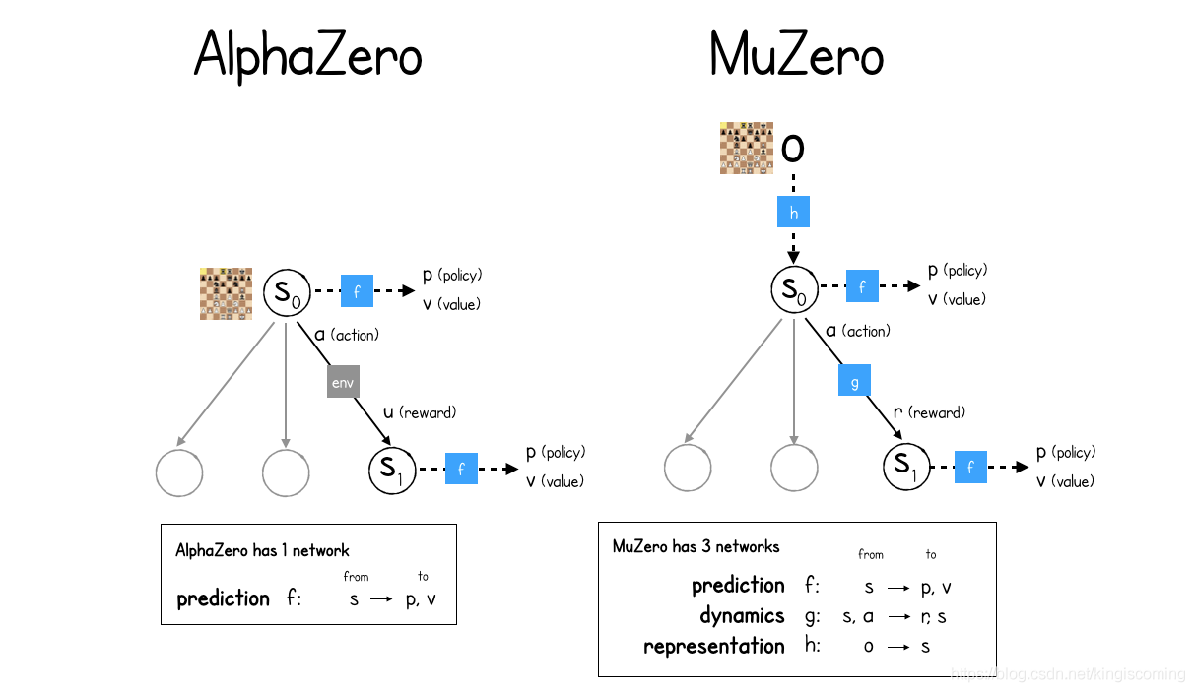
MuZero VS AlphaZero

Slide 45
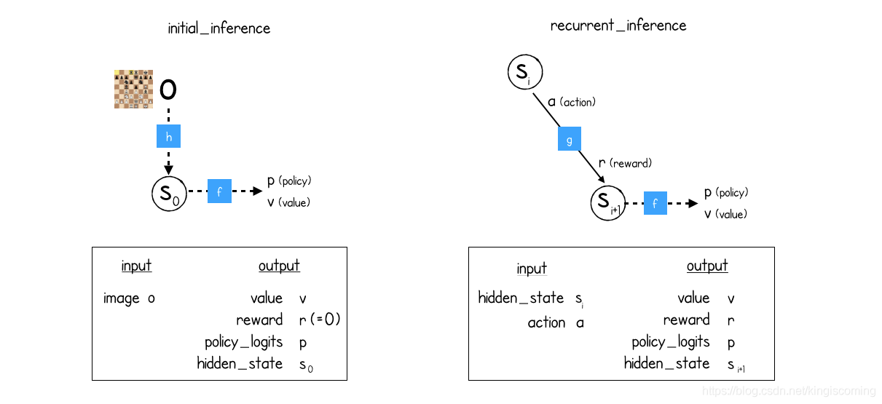
Two reasoning ability of MuZero

Slide 46
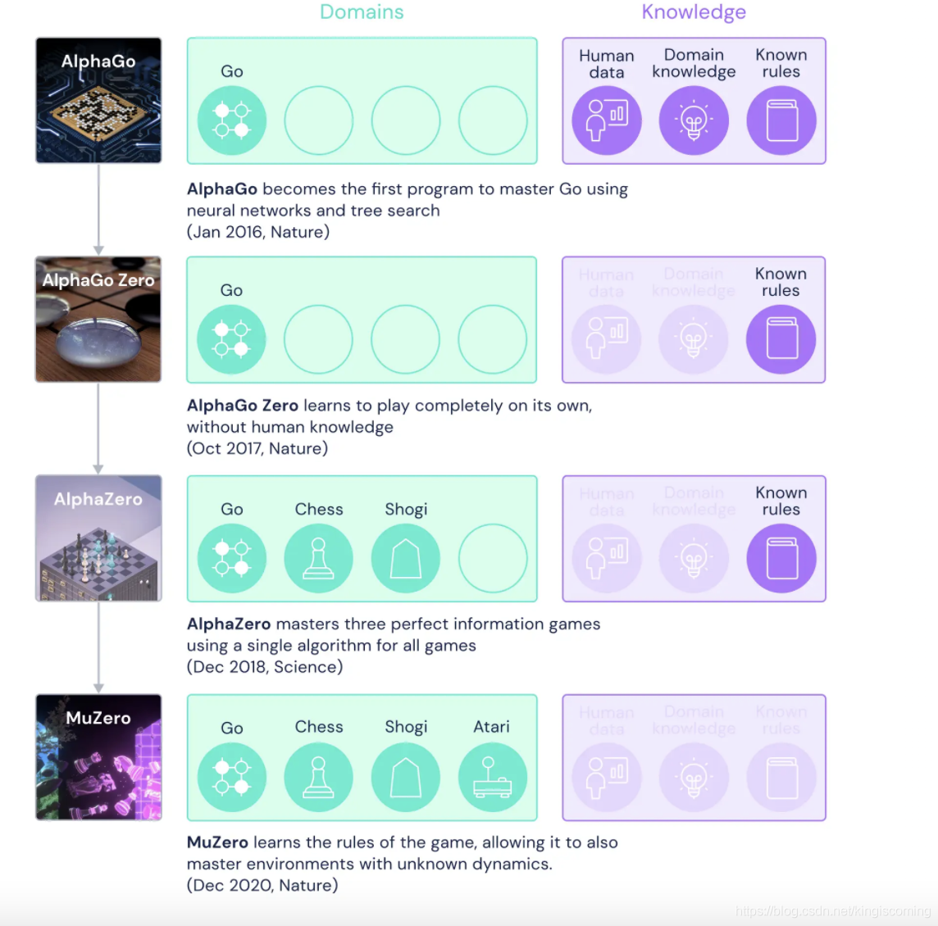
Comparison and Conclusion

Slide 47
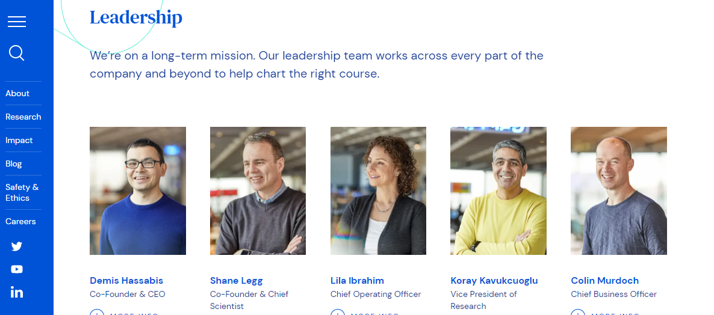
Developer of the series AI programs

Slide 48
Multi-Agent AI --AlphaStar

Slide 49
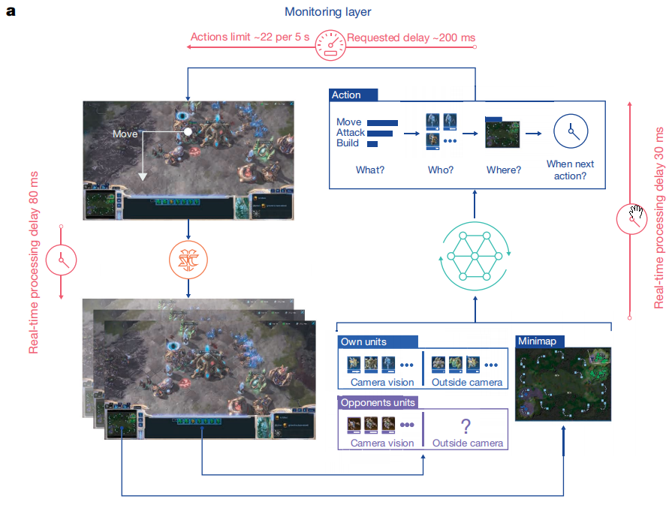
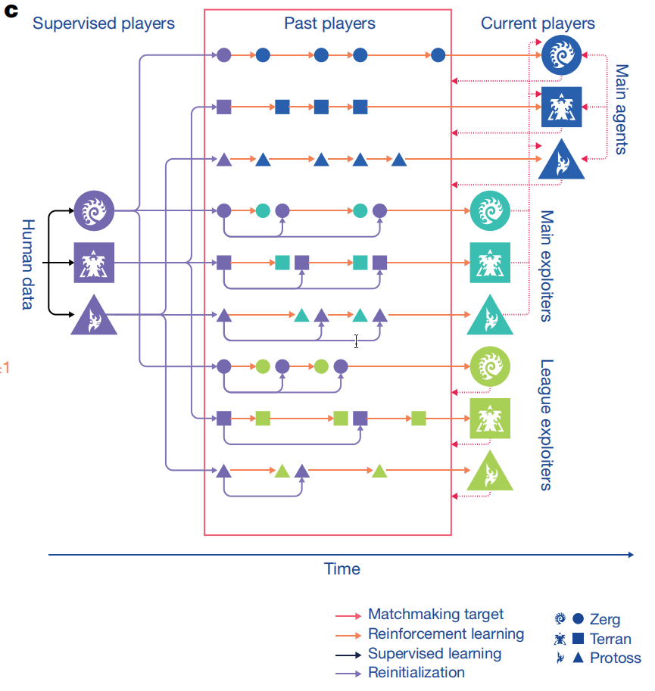
Framework of AlphaStar
Notes:
AlphaStar achieves grandmaster level in the game of StarCraft II. Matches were played using a pro approved interface, on the full game without any restrictions

Slide 50
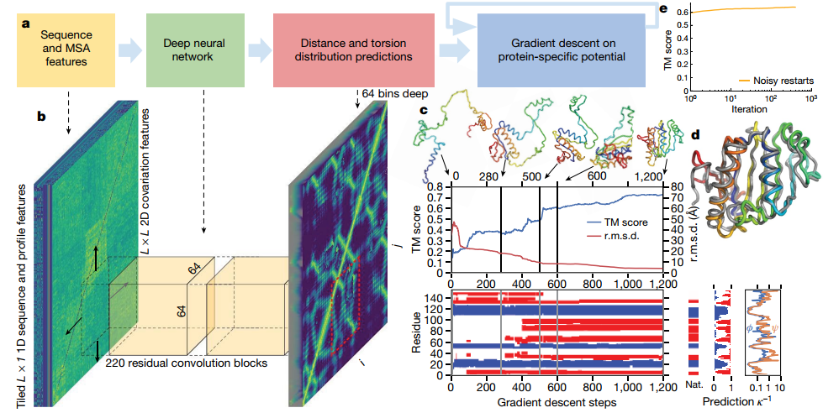
Framework of AlphaFold
Notes:
DeepMind’s AlphaFold solves the protein folding problem.

Slide 51
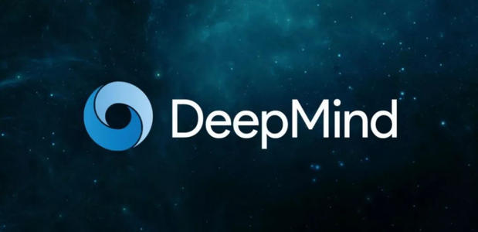
Research institutions

Slide 52
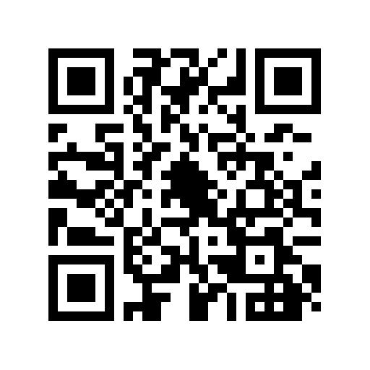
Thanks for your participation in THBI-SS, we are doing a statistic survey in order to make it better, we could appreciate if you could finish it.
https://www.wjx.top/vj/ON6yroS.aspx

